Slide 1
http://www.slideshare.net/jeanvdd/a-review-of-animation-techniques-for-user-interface-design
Keynote address for
Congreso Internacional de Ingeniería del Software Armenia'2012 (Quindio, October 10th, 2012)
A review of Animation Techniques for User Interface Design
Jean Vanderdonckt, Vivian Genaro Motti
Université catholique de Louvain (UCL)

Slide 2
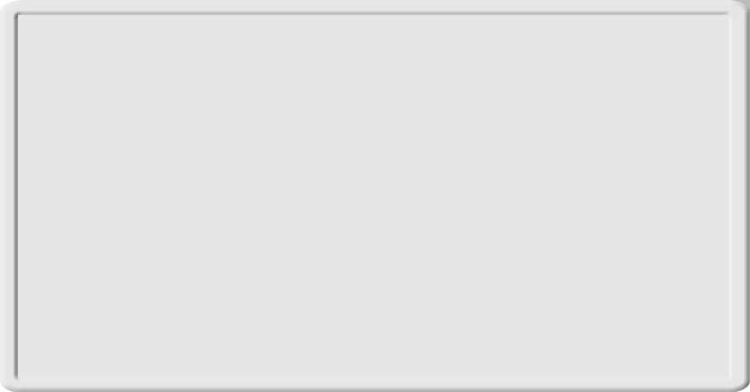
Content
Motivations
Why and what of animated transitions
Basic concepts
First example: web adaptation
Second example: transition between UI views
Conclusion and Future work

Slide 3
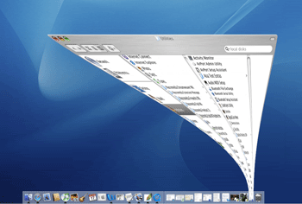
Motivations
Animation in general
  Does not necessarily improve user interface
  Should be relevant
Animated transition in particular

Slide 4
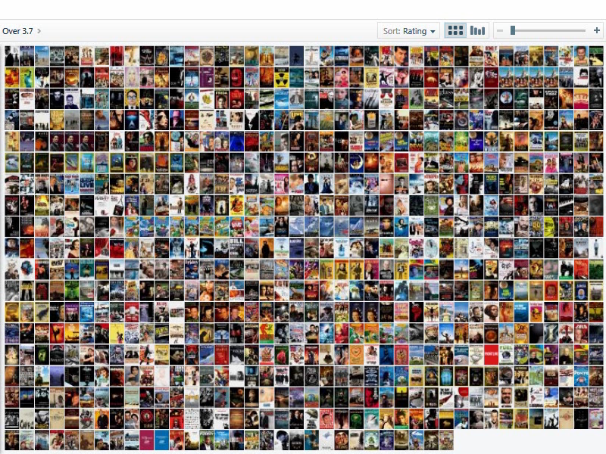
Related Work
PivotViewer
[www.silverlight.net/learn/pivotviewer/]

Slide 5
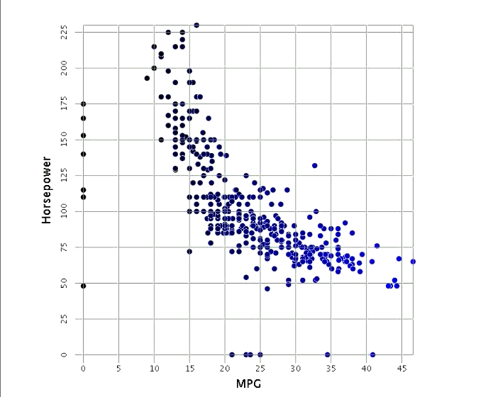
Related Work
InfoVis
[Elmqvist et al., 2008]

Slide 6
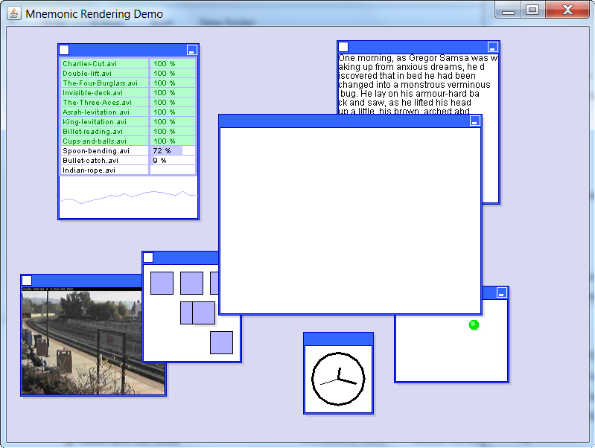
Related Work
Mnemonic rendering
[Bezerianos, Dragicevic, Balakrishnan, 2008]

Slide 7
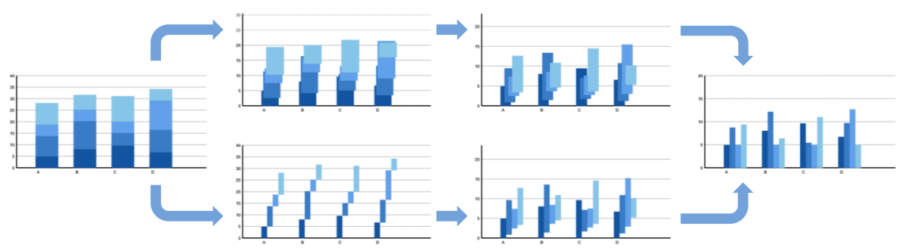
Related Work
Spatial aspects
Initial Image
Final Image
?
?
[Heer, Robertson, 2007]

Slide 8

Related Work
Animation
in statistics
[Heer, Robertson, 2007]

Slide 9
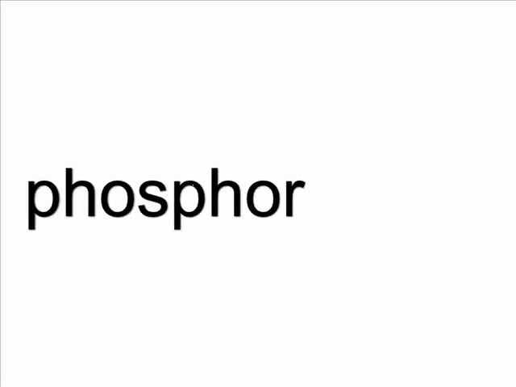
Related Work
Phosphor
Widgets
[Baudisch, P., Tan, D., Collomb, M., Robbins, D., Hinckley, K., Agrawala, M., Zhao, S., and Ramos, G, UIST'2007]

Slide 10
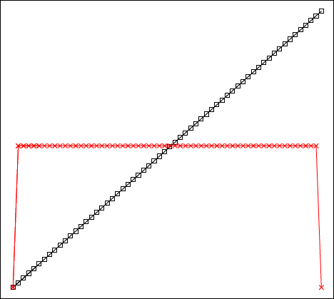
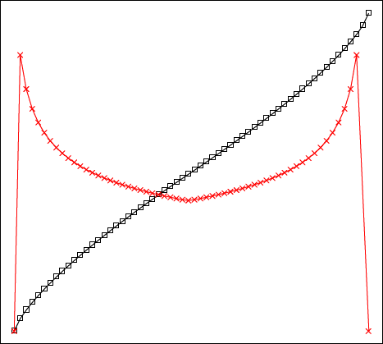
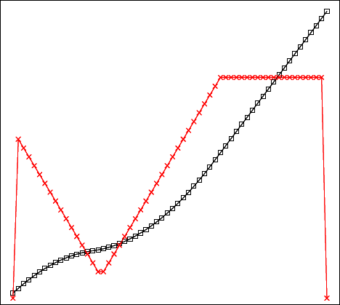
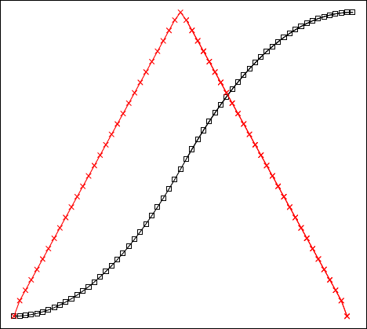
Temporal Aspects
  Slow In/Slow Out is better in all regards
  Adaptive speed performs best when complexity found at endpoints
Slow In
Slow Out
Fast In
Fast Out
Constant
Adaptive
Fast
Fast
Slow
t
Slow
→
Speed
[Dragicevic, Bezerianos, Javed, Elmqvist, Fekete, 2011]
time →

Slide 11
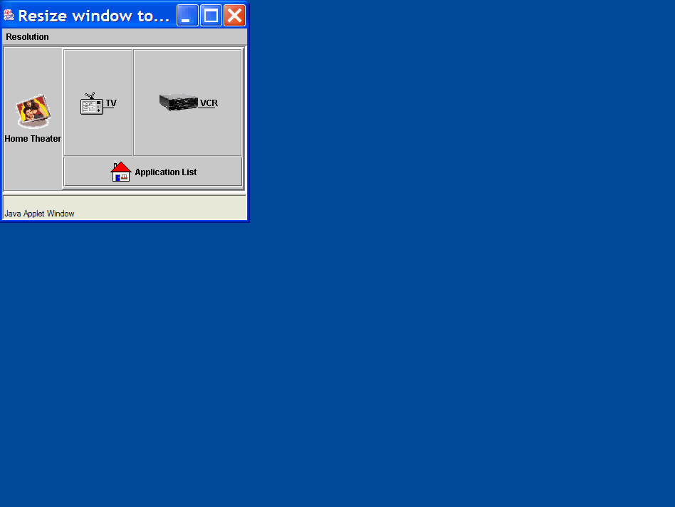
Related Work
Adaptive
Layout
[Plomp & Keranen, NordiCHI'2002]

Slide 12
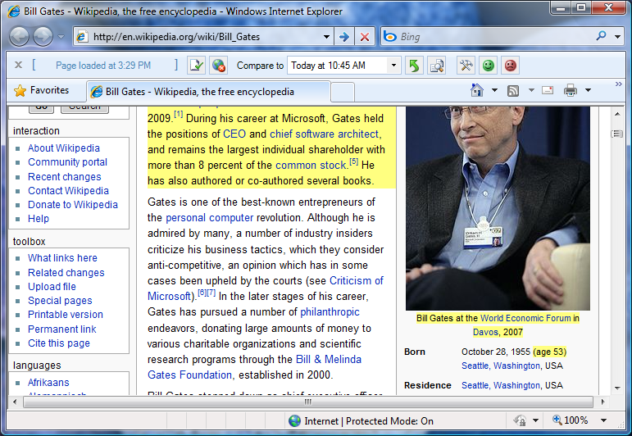
Related Work
Diffie
New to you
Always on
Non-intrusive
Changes to page since your last visit
In-situ
[Teevan, Dumais, Liebling, Hughes,2010]

Slide 13
When to use animated transition

Slide 14
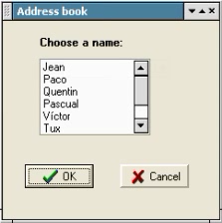
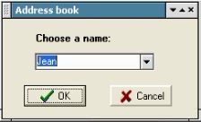
Examples of animated transition
First example: user interface adaptation
  What happens when a GUI is adapted?
Nothing between
End user disruption
Cognitive perturbation

Slide 15
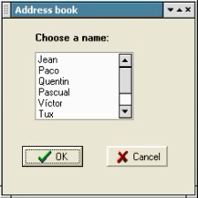
Examples of animated transition
Potential solution: use animated transition

Slide 16
Examples of animated transition
Use animated transition to ensure a smooth transition between the initial UI and the final (adapted) UI

Slide 17
Examples of animated transition
When to use
  to draw the audience's attention to a single element out of several, or to alert people to updated information
  to indicate the function of a hot spot (for example, a moving hiker could indicate the current location of Mungo Park adventurers)
  to draw attention to changes from one state to another (for example, animated map area changes could indicate deforestation over time).
  to demonstrate navigation in a particular direction (for example, a simple page-flip animation could easily distinguish forward from backward movement
  to create icons for actions that can't be adequately expressed with a flat, static picture

Slide 18
Examples of animated transition
How to do
  An animation sequence should be short
  The direction of movement influence the meaning of the information conveyed
  Animation should be supported by sound
  Animation techniques for global changes to the entire screen are cut, fade in and fade out, dissolve, wipe, overlap, and multiple exposure
  Animation techniques for local changes within a region of the screen are pop on and pop off, pull down and pull up, flip, and spin

Slide 19
Framework for animated transition

Slide 20
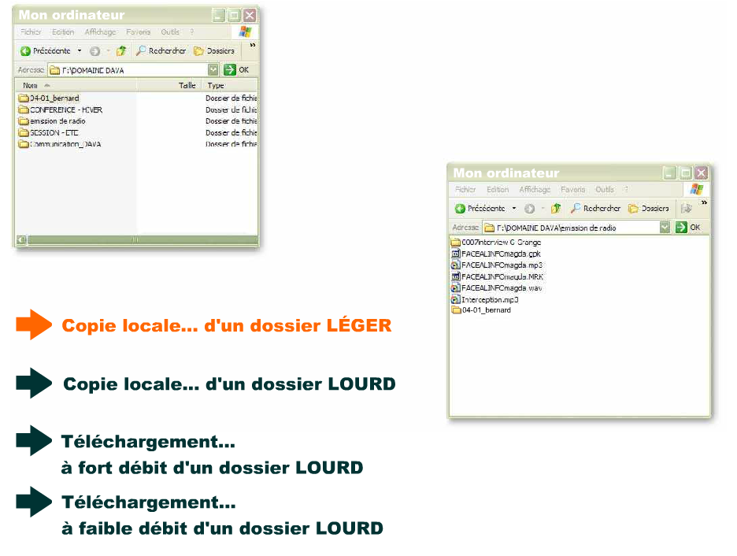
Example of instantiation: visual transitions
[Schlienger, Chatty, IHM 2006]

Slide 21
First instantiation for user interface adaptation

Slide 22
Software architecture

Slide 23
Adaptation operations
Resizing operations: are aimed at changing a widget size in order to optimize screen real estate, aesthetics, and visual design
  For instance, an edit field could be enlarged/shortened in height and/or length to take less space and to be subject to various alignments.
Relocating operations: are aimed at changing a widget location in order to reduce the screen space consumption
  For instance, “Ok”, “Cancel”, and “Help” push buttons could be relocated to the bottom of a dialog box.
Widget transformations: are aimed at replacing one or a group of widgets by another widget or another group of widgets ensuring the same task, perhaps with some degradation
  For instance, an accumulator that consists of list boxes with possible values and chosen values could be replaced by a multi-selection list, which could be in turn replaced by a multi-selection drop-down list.
Image transformations: are aimed at changing the size, surface, and quality of an image in order to accommodate the constraints imposed by the new context of use, namely the display/platforms constraints.
Splitting rules: are aimed at dividing one or a group of widgets into one or several other groups of widgets that will be displayed separately. For instance, a dialog box is split into two tabs in a tabbed dialog box

Slide 24
Associate an animated transition
Adaptation operation | Animation family, animated transition with justification
SET that modifies the length of a UI element into a larger value (absolute or relative) | Horizontal scroll/wipe from left (F1): this operation minimizes the visual change since only the right part resulting from the enlarging is changing. For edit fields, for instance, this is particularly appropriate because it gives the feeling that the field is really expanding
SET that modifies the height of a UI element into a larger value (absolute or relative) | Vertical scroll/wipe from bottom (F1): this operation minimizes the visual change since only the right part resulting from the enlarging is changing
DISPLAY that displays a new UI element at a certain position | Uncover (F3), Box out (F4), or Iris open (F4): these operations all induce a progressive display of a new UI element at once, thus creating the illusion that it is coming from the empty.
UNDISPLAY that undisplays a new UI element at a certain position | Cover (F3), Box in (F4), or Iris close (F4): these operations all induce a progressive disappearing of a existing UI element at once, thus creating the illusion that it is shrunk to an empty/white region.
REPLACE that substitutes a UI element by another one | Barn door open (F2): this operation affects the entire visual aspect of the previous one and the new one.
DISTRIBUTE that computes a distribution of a series of UI Elements into a series of UI Containers | Bam door open (F2) or Iris open (F4): these operations enable the visualization of an entire group at once, instead of showing every little display change individually
MOVE that moves a UI element to a new location indicated by its coordinates x and y, possibly in a fixed amount of steps | Ideally, the UI movement could be represented by an animation depicting the movement itself. But practically, this would induce a very long animation, thus increasing again the lag. Therefore, we preferred to adopt a disappearing of the UI element from its original location and an appearing to its target location. Depending on these locations, vertical, horizontal or diagonal replacements (F1) are selected.

Slide 25
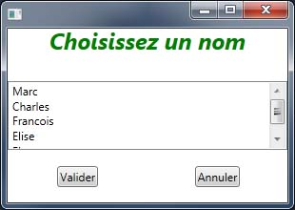
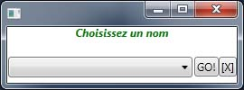
Sample #1

Slide 26
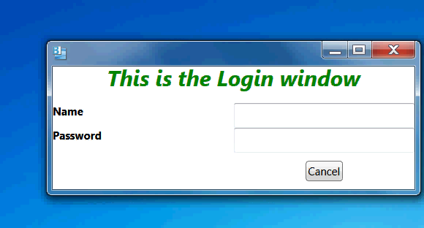
Sample #2

Slide 27
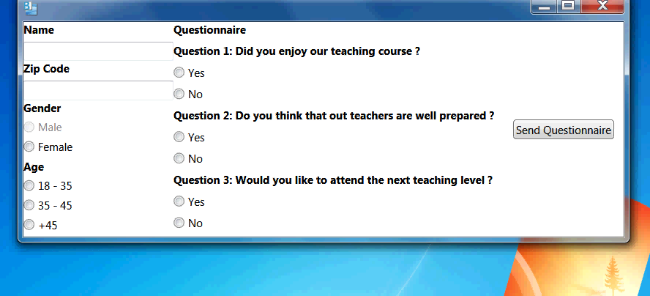
Sample #3

Slide 28
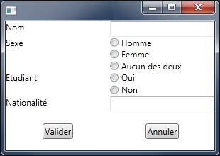
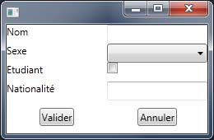
Sample #4

Slide 29
Examples of application
A simple login page: http://www.youtube.com/watch?v=2mvvTL1yYBA
A polling system: http://www.youtube.com/watch?v=2ZViwktUbhU
An address book: http://www.youtube.com/watch?v=8MxokT-GCMY

Slide 30
User study
12. I would recommend using the animation
11. The animation is fast
10. The animation represents the adaptation
9. The animation is easy to revert (backward animation)
8. The animation is easy to progress (forward animation)
7. The animation is easy to follow
6. The animation is easy to understand
5. The animation is easy to control
4. The animation is easy to use
3. I preferred the animation over no animation at all
2. I liked the animation interface
1. I liked the animation process

Slide 31
Second instantiation: transitions between UI views

Slide 32
Motivations
Transition between steps, levels is hard to grasp (imagine, understand, maintain, evolve)
  Models found at each level are different: concepts, relationships, and attributes are different
  Models may have different views depending on
    The stakeholder (designer, marketing, end user)
    The step (e.g., early design vs advanced design)
    The concepts (e.g., level of details)
  Transitions between models are complex
    E.g. mappings, transformation in MDE
Consequences
  Mode switching is frequent
  Cognitive load is high
  Learning curve is slow

Slide 33
Background
3 types of representation
  Internal: UI code (in programming of markup language)
  External: UI as experienced by the end user
  Conceptual: UI representation abstracted from the UI code
    Semantics
    Syntax
    Stylistics
Conceptual view
External view
Internal view

Slide 34
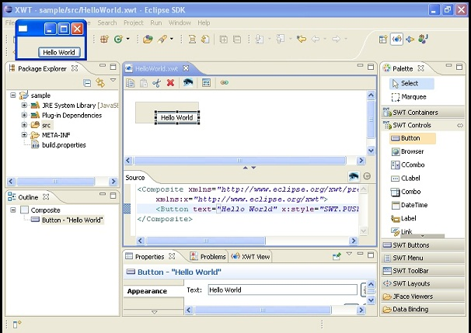
Background
Typical configuration in Integrated Development Environments
External view: final user interface
Conceptual view: hierarchical description
Internal view: user interface code and properties

Slide 35
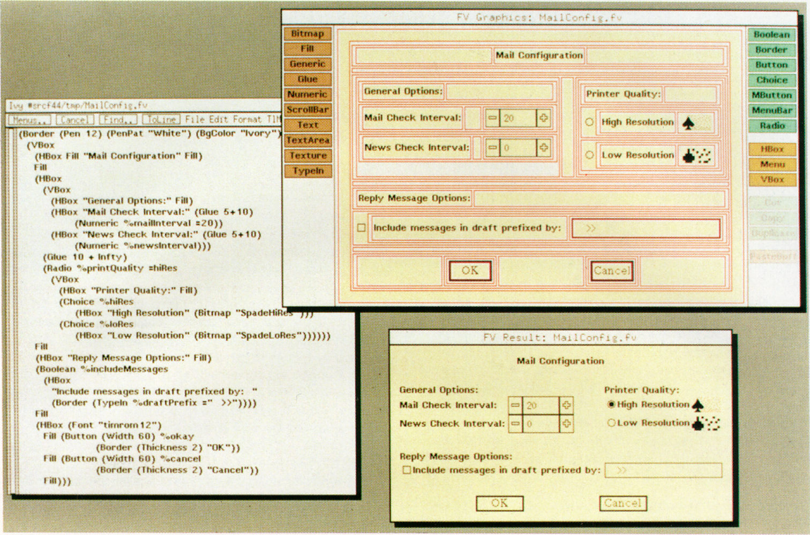
Background
FormsVBT [Avrahami89] synchronizes 2 UI views
Internal view: LaTex-like description
External view: final user interface
(with structure)
External view: final user interface
(without structure)

Slide 36
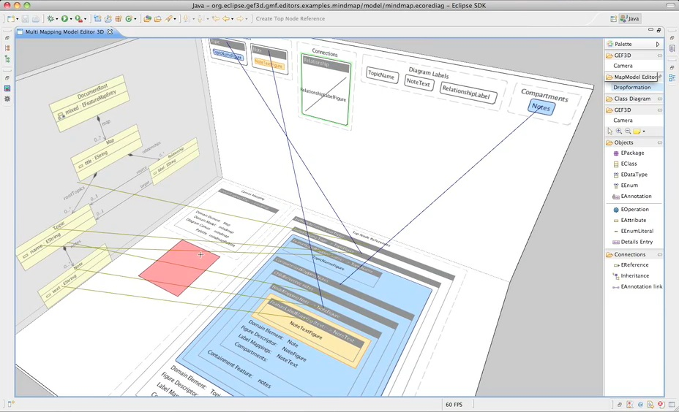
Background
GEF3D [von Pilgrim 08] synchronizes 3 views
Conceptual view: domain model (UML Class Diagram)
External view: final user interface
(without structure)
External view: final user interface
(with structure)

Slide 37
Methodology
1) Define the initial view
2) Define the final view
3) Define mappings between views
4) Derive the transition based on mappings previously defined
5) Identify animation technique to produce the transition
  Text-to-text
  Text-to-color
  Text-to-shape
  Disappearing elements
6) Execute the animated transition

Slide 38
Animated transitions
Transition type | Internal view | External view
Text-to-text | <label_short=”Birthdate”>
Text-to-position | <textfield … col=”4”…>
Test-to-length | <textfield … length=”20”.>
Text-to-color-saturation | <textfield. fgColor=”red”.>
Text-to-color-texture | <textfield … bgTexture=”checkerboard”…>
Text-to-shape | <textfield name=”Birthdate”>
Text-to-symbol | <textfield … required=”yes”… >

Slide 39
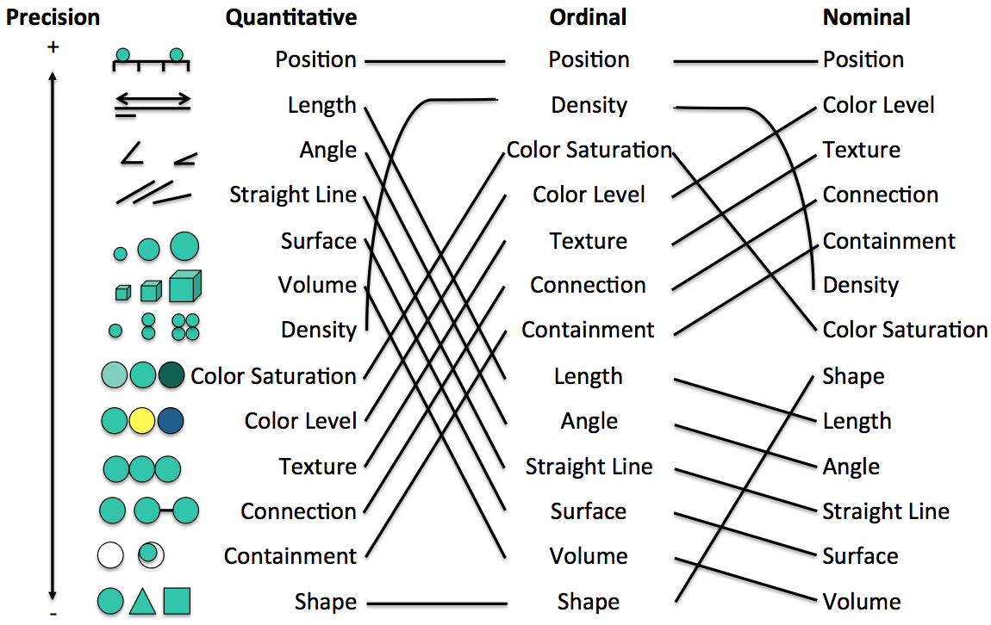
How to animate

Slide 40
UsiView: transitions between views

Slide 41
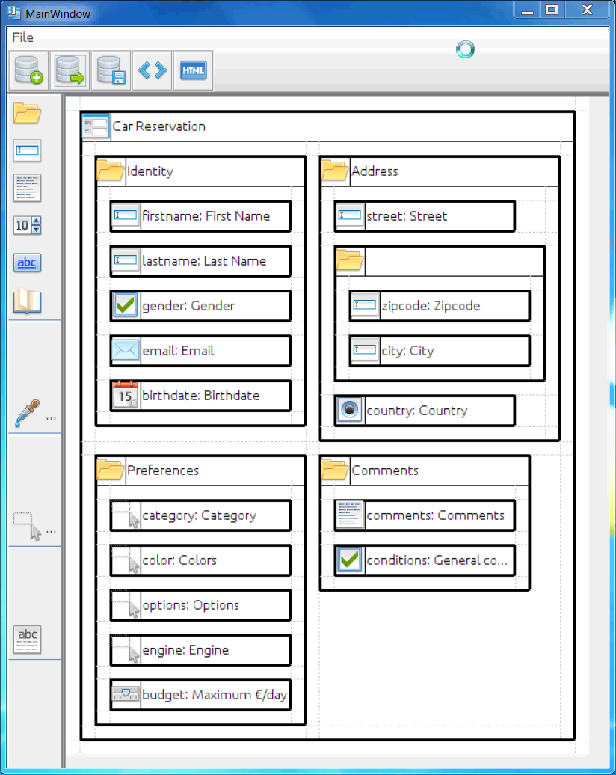
Animated Transition from CV to EV
Notes:
Mapping problem consist in the need to express link between different Uis views

Slide 42
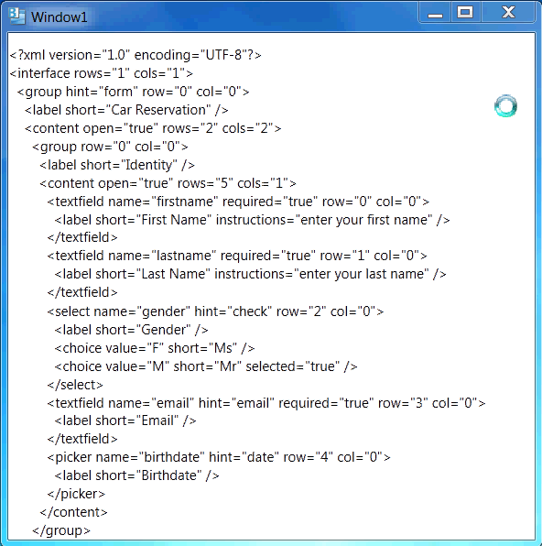
Animated Transition from IV to EV
Notes:
Mapping problem consist in the need to express link between different Uis views

Slide 43
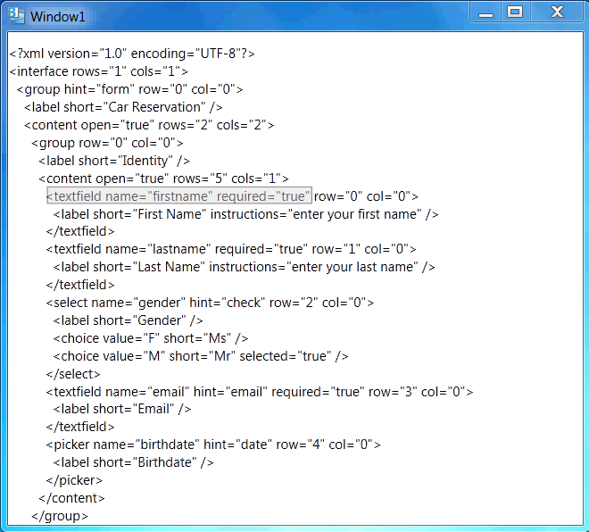
Anim. Trans. from IV to EV (identified)
Notes:
Mapping problem consist in the need to express link between different Uis views

Slide 44
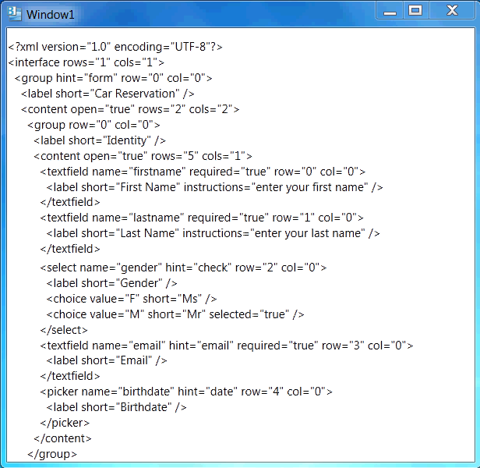
Anim. Trans. from IV to EV (Slow down)
Notes:
Mapping problem consist in the need to express link between different Uis views

Slide 45
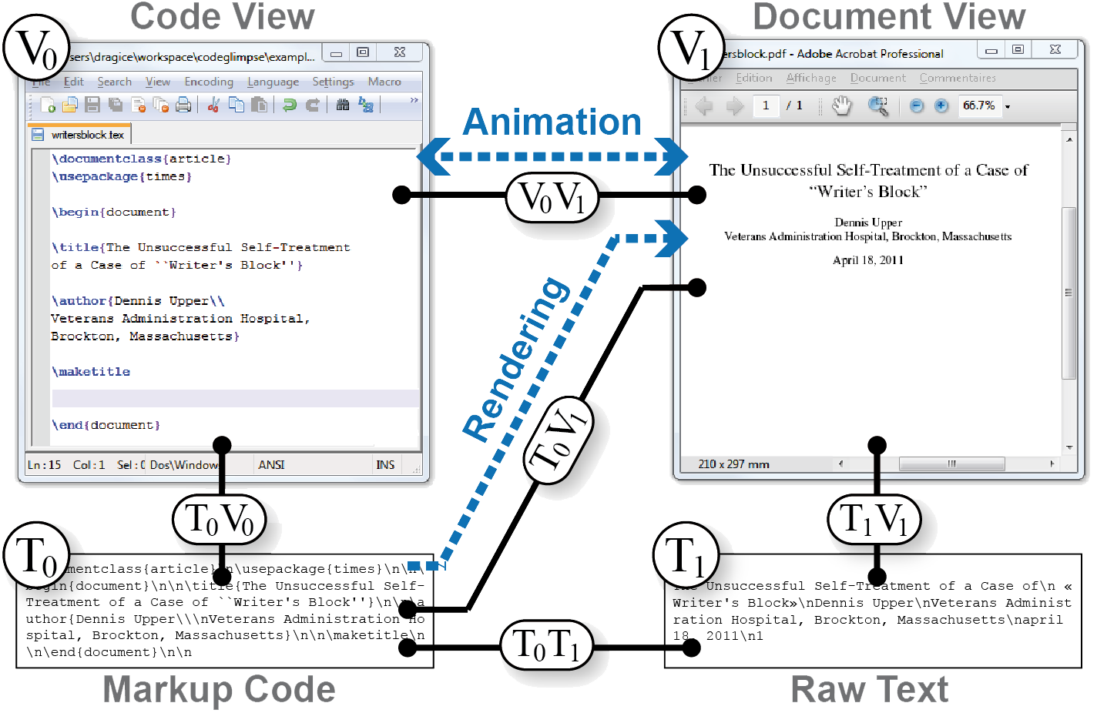
Related work: Gliimpse from P. Dragicevic
found at
[Dragicevic, Huot, Chevalier, UIST'2011]
Notes:
Mapping problem consist in the need to express link between different Uis views

Slide 46
Conclusion
Animated transitions are a viable approach for depicting the behaviour of some phenomenon
  For a change of context
  Between an initial and a final state
Provided that
  Temporal aspects are well designed
  Spatial aspects are adequately programmed
  Effects are derived from the model views, not randomly
Notes:
Mapping problem consist in the need to express link between different Uis views

Slide 47



Thank you very much for your attention!
This work is supported by
FP7 Serenoa European Project (www.serenoa-fp7.eu)

