Slide 1





Extending UsiXML to support User-aware Interfaces
Ricardo Tesoriero¹²
ricardo.tesoriero@uclm.es
Jean Vanderdonckt¹
jean.vanderdonckt@uclouvain.be
¹ Université catholique de Louvain
² University of Castilla-La Mancha

Slide 2
Agenda
Introduction
Scope
The UsiXML framework
The UsiXML extensions
The Study Case: Healthy Menu
Conclusions & future work

Slide 3

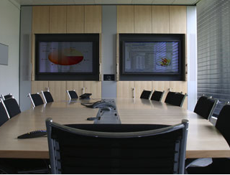

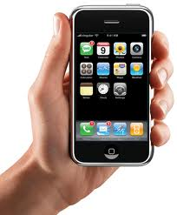
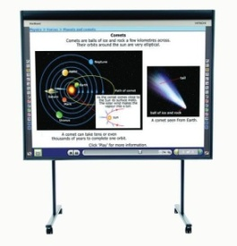
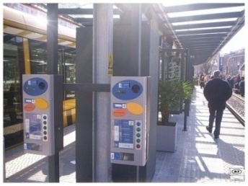
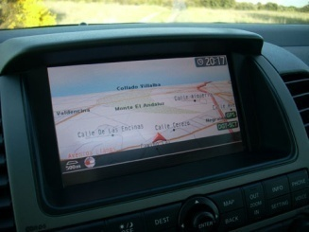

Introduction
Ubiquitous computing is everywhere…
Many computers are shared by each of us
  Information overload
    Calm Technology [1]
    Context-aware UIs
  Multi-modal UIs
At home
At work
Public spaces
Personal devices
Digital blackboards
Ticket machines
Navigators
[1] M. Weiser and J. S. Brown. The coming age of calm technology. The next fifty years of computing, pp. 75-85. Copernicus. 1997.
Notes:
We can find ubiquitous computing is everywhere, at home, at work, in public spaces and so on.
In ubiquitous computing many, computers are shared by each of us.
So, users interact with many computers, and vice-versa.
When users interact with many computers the information overload tends to be problem.
The Calm Technology tends to reduce this overload. One way to achieve it is through the context-awareness.
Moving to another subject, these computers are embedded into the environment in different ways.
The way we interact with them is different according to the device.
Therefore, we have to deal with multi-modal user interfaces.

Slide 4
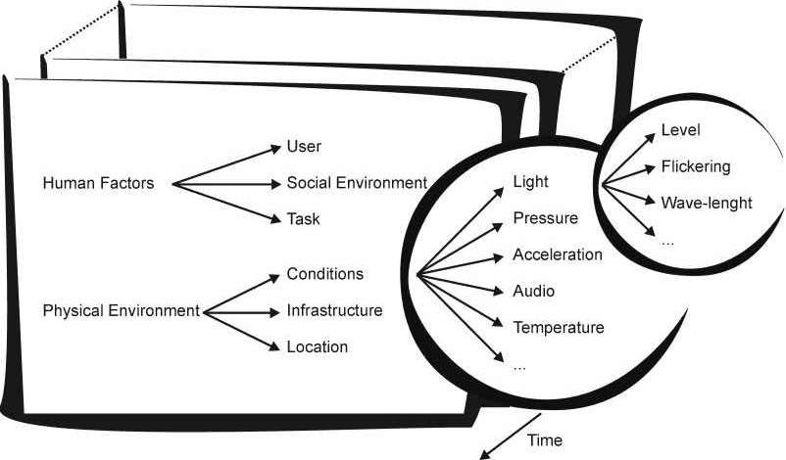
Scope: User-aware UIs
The context is any information that can be used to characterize the situation of an entity (person, place or object) that is considered relevant to the interaction between a user and an application [2].
Feature space for context [3]
Focus on
Partially boarded
From user perspective
[2] A. Dey. Understanding and using context. Personal and Ubiquitous computing, 5, pp. 4-7. 2001
[3] A. Schmidt, M. Beigl, H. W. Gellersen. There is more to context than location. Computer & Graphics, 23(6), pp. 893-901. 1999
Notes:
As the context is any information that can be used to characterize the situation of an entity, we have focused our effort on describing those characteristics that are focused on the user, particularly:
Information on the user (emotional state, bio-physiological conditions, skills, experience, etc.)
Users’ tasks (usually defined by the role played in the society)
The social environment is also partially boarded
From the physical environment, we also board the physical conditions and location, from the user perspective.

Slide 5
The UsiXML Framework
Defines a development process based on the Cameleon Reference Framework [4] to build multi-device interactive applications.
Context of Use
MDA to address the problem
from different perspectives.
Tasks & Concepts
CIM (TaskModel and DomainModel)
Abstract UI
TransformationModel
Mapping Model
PIM (AbstractUserInterfaceModel)
Concrete UI
PSM (ConcreteUserInterfaceModel)
ISM (Source Code)
Concretization
Final UI
Abstraction
[4] G. Calvary, J. Coutaz, D. Thevenin, Q. Limbourg, L. Bouillon, J. Vanderdonckt. A unifying reference framework for multi-target user interfaces. Interacting with Computers, 15(3), pp. 289-308. 2003

Slide 6
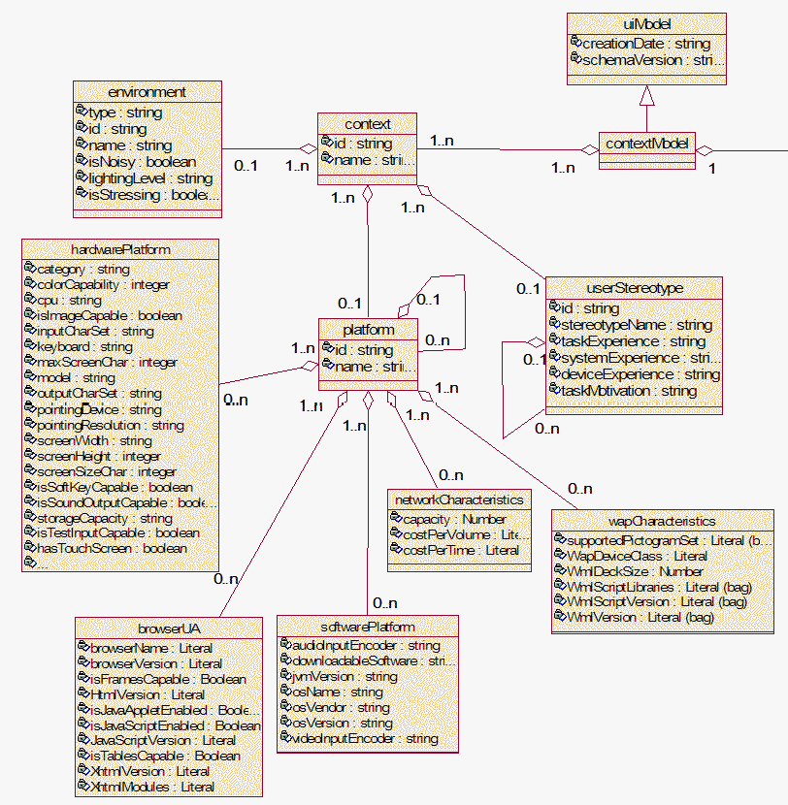
The ContextModel (context of use)
Fixed description of the User Characteristics / Capabilities
i.e.
  systemExperience
  deviceExperience
  browserCapablities
  hardwarePlatform
  softwarePlatform
  etc.

Slide 7
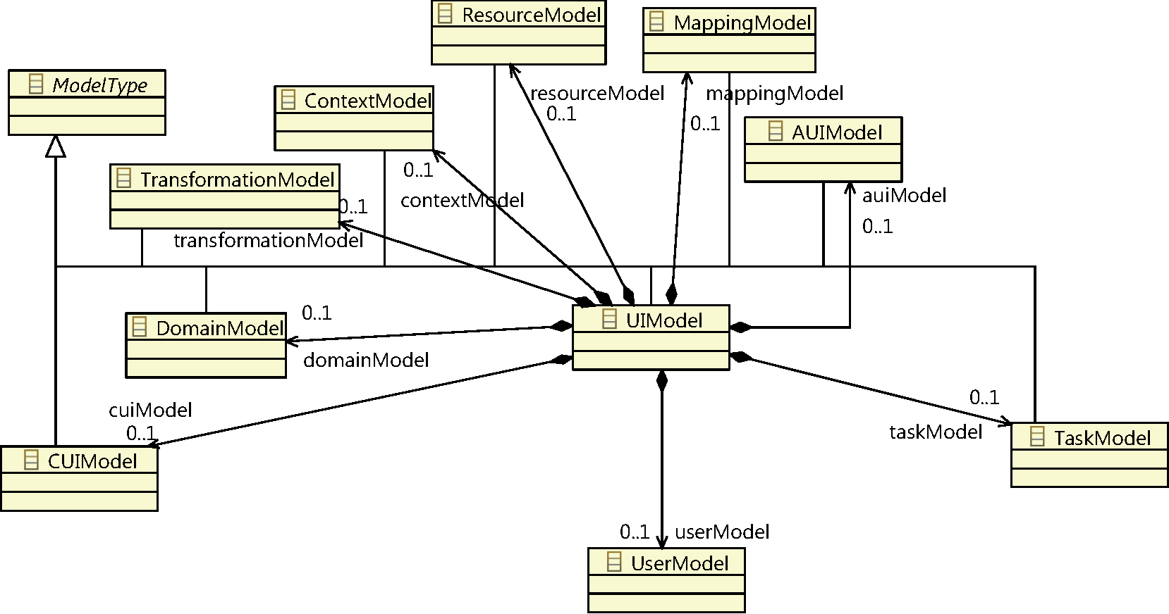
The UsiXML extension
Characterize user capabilities according to the application domain or capabilities
Express different user «situations» in terms of these characteristics
Extensions
Modifications
Notes:
For those that are not familiar with UsiXML, the framework is divided into four layers:
The Task & Concepts (T&C) layer describes users’ tasks to be carried out, and the domain-oriented concepts required to perform these tasks.
The Abstract User Interface (AUI) defines abstract containers and individual components, to specify the interface independently from the modality
The Concrete User Interface (CUI) concretizes an abstract UI for a given context of use into Concrete Interaction Objects (CIOs), the specification is independent of the computing platform.
Finally, the Final User Interface (FUI) is the operational UI running on a particular computing platform either by interpretation or execution.
The UIModel defines a completely new model, the UserModel.
Besides, introduces some extensions to the MappingModel (to relate the UserModel to all framework layers) and the CUIModel (to support new sensors and interpreters in order to capture information).

Slide 8



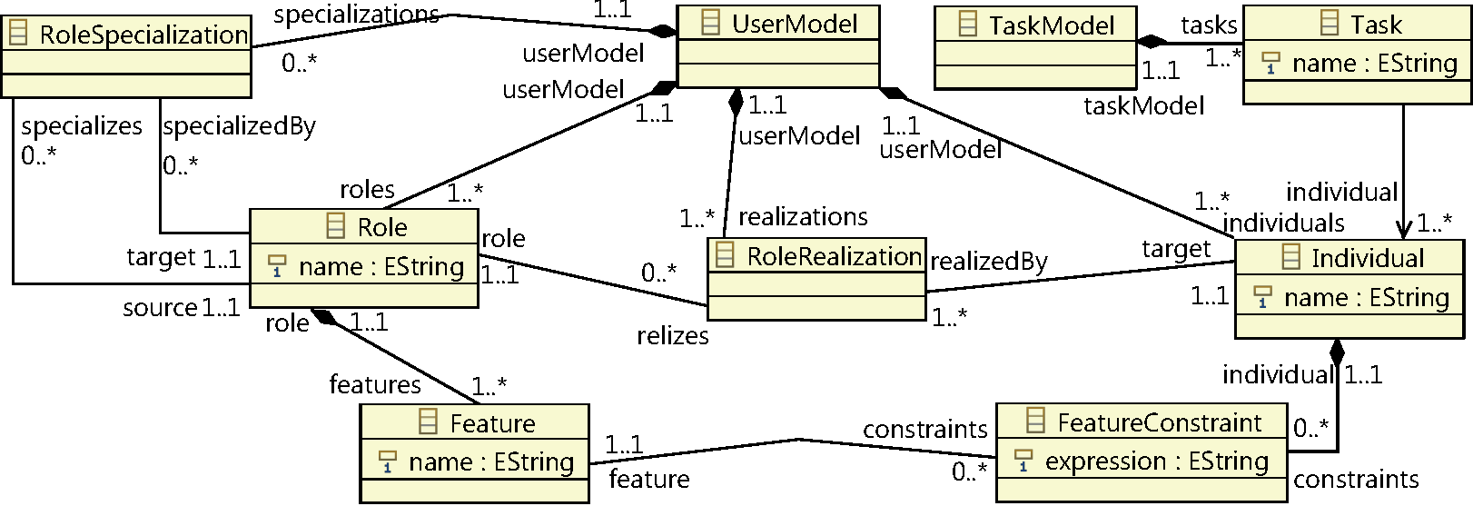
The Task & Concepts Layer
UserModel & TaskModel extensions
User Feature level: defines the features of the user that affect the UI in terms of Roles and Features (i.e. Patient[R].temperature[F])
  RoleSpecialization (common characteristics)
User Profile level: characterizes the features according to runtime situations in terms of Individuals and Feature Constraints (i.e. PatientWithFever[I].temperature[F] > 38.5[FCo])
  RoleCharacterization (i.e. Patient[R]<->PatientWithFever)
Note: R=Role, I=Individual, F=Feature
and Fco=Feature Constraint
Allowed
Not allowed
Task-Individual Relationship
TaskModel extension
Feature level
Profile level
Notes:
The goal of this model is the representation of the user features that affect the UI.
To carry out this task, the model represents this information in two levels of abstraction: the user feature level and the user profile level.
In the feature level, we have the Role entity representing a “type of” user.
Roles are describes in terms of Features that represents the characteristics (or qualities) that define a “type of” user.
In order to describe the “relevant states” of the user, we have to “quantify” the characteristics of a user.
Therefore, we define the an Individual that is the “realization of” a Role where Role Features are “quantified” by FeatureConstranints.
Finally, tasks are associated to Individuals in order to describe which task “is allowed” to be performed according to the entity “state” represented by the Individual.
For instance,
In a Hospital environment, a Patient, a Doctor and a Visitor can be defined as Roles.
The body temperature of a Patient can be defined as a Feature of a Patient
And a patient with fever can be defined as an Individual with body temperature above 38.5·C
According to this description the patient may be allowed, or not, to perform tasks in the system.

Slide 9

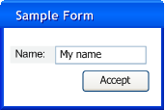
The AUI extension
ContainerObserves “enables / disables, show/hides” AbstarctContainer
FacetObserves “enables / disables” a Facet of an AbstarctInteractionComponent modifying its behavior.
MappingModel
facet
UserModel
Extension to the MappingModel
Notes:
Individuals affect the AUI model in the same way they have affected the task model.
However, the mechanism is different, as both of them belong to different layers, we have defined the relationship between Abstract Interaction Objects and Individual through InterModelRelationships.
So, there are two types of AIOs: Abstract Containers and Abstract Interaction Objects.
While Abstract Containers are directly “enabled or disabled” by Individuals through the Container Observes relationship, the AbstractInteractionObject is affected through the Facets.
By modifying the facets of a component changes its behaviour

Slide 10
The CUI extension
CUI extension
  Sensors & Interpreters (Polling and Event-driven)
Mapping extension
  Interpreter Updates (Interpreter -> Feature)
MappingModel
UserModel
CUI Extension
Extension to MappingModel
Notes:
The CUI extension goal is the description of the system is aware of the information on the user.
The Sensor and the Interpreter entities that are in charge of capturing, interpreting and providing information to be processed by the system
Two types of Sensors were defined according to their nature: EventDrivenSensor s and PollingSensors.
We have defined three types of Interpreter s: the PollingInterpreter that deals with information coming from a PollingSensor, the EventDrivenInterpreter that is in charge of interpreting information from an EventDrivenSensor, and the ComposedInterpreter that is responsible for the interpretation of information coming from several sensors.
The information processed by the CUI extension is propagated through the rest of the model by the mapping model extension.

Slide 11
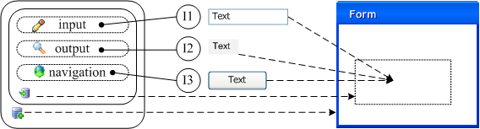

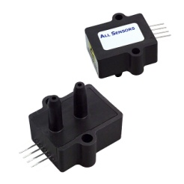

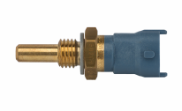
The transformation process and the FUI
AUI
CUI
ObserversIndivoduals
from Mapping
Observed by
Interpreters from CUI
Updates
UpdatesIndividual
from Mapping
Sensors from CUI
Individuals from T&C
Notes:
This slide shows how information flows through the system.
The Sensors, through the interpreters, updates the features of the individuals that are related by the UpdatesIndividual relationship.
These features update the state of the system and force the evaluation of the feature constraints attached to the individuals.
Thus, AUI components are notified of their change, and the AIOs are updates accordingly to the AIO -> CIO defined by the Concretization relationship defined by components.

Slide 12
The study case
The Healthy Menu
The goal of the application is the presentation of dishes according to the role and the biophysical state of the user.
The User Model
Notes:
The user model shows the User role defining three features (idNumber, roleName, userName).
Four specialization of these roles were defined Visitor, Doctor, Nurse and Patient.
Each of them with new features.
We will focus our attention of the Patient role.
It defines three features (age, temperature and glucose)
Five Individuals were defined for the patient Role.
aPatient (not characterized)
aPatientWhithFever (temperature above 38 degress)
aPatientWhithHyperGlycemia
aPatientWhithHipoGlycemia
aNormalPatient

Slide 13

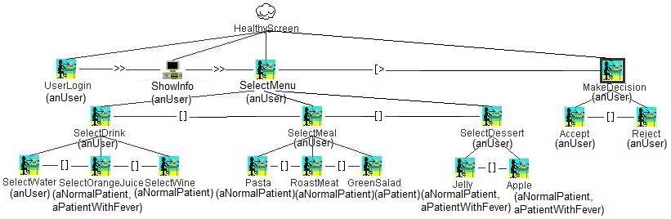
Task model and AUI
*
Notes:
The menu allows Users (Patients, in this case) to login and select a drink, a meal and a dessert according to their state.
NormalPatients are able to choose a Drink (3 options: Water, Orange, Juice and Wine)
However, the Organce Juice is forbidden for Patients with Gycemia (Hipo or Hyper)
(point out the zoom)
Show more example if time.

Slide 14
The Healthy Menu
Mapping model
AUI mappings
Containers
Oc(aPatient, PatientMenu)
Oc(aNurse, NurseMenu)
Oc(aDoctor, DoctorMenu)
Oc(aVisitor, VisitorMenu)
Facets
Of (anUser, nAccept) Of (anUser, oIdNumber)
Of (anUser, cAccept) Of (anUser, oDesease)
Of (anUser, nReject)
Of (anUser, cReject)
Of (aPatientWithHipoGlycemia, oDrink) Of (aPatientWithFever, iDrink)
Of (aPatientWithHipoGlycemia, oMeal) Of (aPatientWithFever, oMeal)
Of (aPatientWithHipoGlycemia, oDessert) Of (aPatientWithFever, iDessert)
Of (aPatientWithHyperGlycemia, oDrink) Of (aNormalPatient, iDrink)
Of (aPatientWithHyperGlycemia, oMeal) Of (aNormalPatient, iMeal)
Of (aPatientWithHyperGlycemia, oDessert) Of (aNormalPatient, iDessert)
Notes:
After defining the AUI, we define the mappings between the Task & Concepts layer and the AUI components.
Thus, we have defined the ContainerObserves mapping between Individuals and Abstract Containers.
As consequence, we define different containers for different roles.
[Next Slide]
Then, we define the FacetObserves mapping between Individuals and Facets.
As concequence, we are able to “change” the abstract behaviour of the component according to the entity “state” (Individual).

Slide 15

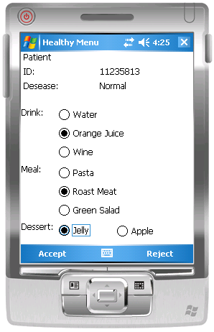
CUI – FUI (Normal Patient)
Temp. Sensor
Gluc. Sensor
interpreter
interpreter
isRefinedBy/isAbstarctedInto
isRefinedBy/isAbstarctedInto
isRefinedBy/isAbstarctedInto
isRefinedBy/isAbstarctedInto
isRefinedBy/isAbstarctedInto
isRefinedBy/isAbstarctedInto
isRefinedBy/isAbstarctedInto
Notes:
Lets see how it works,
First, sensors perceive the bio-physical conditions of the user.
[step]
Then, interpreters process this information and is sent to the “user model”
[step]
Afterwards, the individual propagates the user “state” to the components
[step]
Finally, the information is represented into the FUI through the refine/abstract mappings.

Slide 16

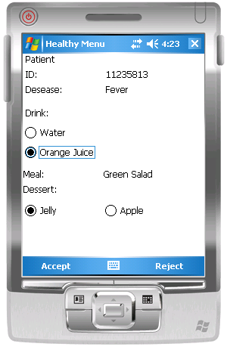
CUI – FUI (Patient With Fever)
Temp. Sensor
interpreter
isRefinedBy/isAbstarctedInto
isRefinedBy/isAbstarctedInto
isRefinedBy/isAbstarctedInto
Wine is out!
isRefinedBy/isAbstarctedInto
Green Salad Only!
isRefinedBy/isAbstarctedInto
isRefinedBy/isAbstarctedInto
isRefinedBy/isAbstarctedInto
Notes:
Again, lets see how it works,
First, sensors perceive the bio-physical conditions of the user.
[step]
Then, interpreters process this information and is sent to the “user model” (note that the Individual has changed due to the definition of the “temperature above 38,5ºC” feature constraint)
[step]
Afterwards, the individual propagates the user “state” to the components (there were two changes, that we will explain afterwards)
[step]
Finally, the information is represented into the FUI through the refine/abstract mappings.
Thus, the changes we have mentioned are the following:
The fist one affects the (drink) component.
It is due to the Task Model (SelectWine is not associated to aPatientWithFever)
Thus, the (drink) component is modified. So, Wine is out!
The second one affects the (meal) component
It is due to the change on the Facet
Thus, the (meal) component changes according to the facet
From Radio Button to Label.
Therefore, the patient cannot choose the meal (green salad only)

Slide 17
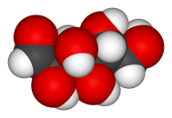
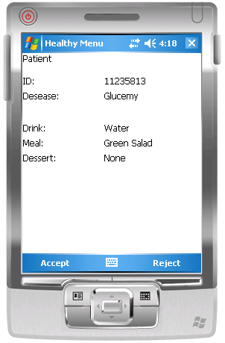
CUI – FUI (Patient With Hipo/Hyper glucemy)
Gluc. Sensor
interpreter
isRefinedBy/isAbstarctedInto
isRefinedBy/isAbstarctedInto
isRefinedBy/isAbstarctedInto
isRefinedBy/isAbstarctedInto
isRefinedBy/isAbstarctedInto
Strict Diet!
isRefinedBy/isAbstarctedInto
isRefinedBy/isAbstarctedInto
Notes:
Finally, lets see how it works for HyperGlycemia
First, sensors perceive the bio-physical conditions of the user.
[step]
Then, interpreters process this information and is sent to the “user model” (note that the Individual has changed due to the definition of the “glucose above 110” feature constraint)
[step]
Afterwards, the individual propagates the user “state” to the components.
[step]
Finally, the information is represented into the FUI through the refine/abstract mappings.

Slide 18
Conclusions
This work exposes a model-based approach to develop user-aware multi-platform and multi-modal UIs following the UsiXML framework
This approach encourages the separation of the user modeling from the application domain to improve the model reuse
It covers from the conceptual modeling of the user environment to the specification of the sensing infrastructure
The user modeling is divided in two levels of abstraction
  The specification of User Features (Roles)
  The quantification of User Features (Individuals)
  Providing designers the ability to define custom features of user profiles / Roles

Slide 19
Future Work
The definition of an extension of the user awareness to model the social awareness of UIs
The inclusion of the location awareness as part of the UI specification
The definition of a common feature-based framework allowing designers to express characteristics that are related to the combination of the social and location features of context-aware UIs, such as the co-location of users

Slide 20


Thank you very much for your attenttion!
Questions, Suggestions, Critics and Comments are always welcomed!
Ricardo Tesoriero¹²
ricardo.tesoriero@uclm.es
Jean Vanderdonckt¹
jean.vanderdonckt@uclouvain.be
¹ Université catholique de Louvain
² University of Castilla-La Mancha
This work was founded by:

