Slide 1
Assessing Lag Perception in Electronic Sketching
Ugo Braga Sangiorgi
Vivian G. Motti
François Beuvens
Jean Vanderdonckt
Louvain Interaction Laboratory,
Université catholique de Louvain - Belgium
Notes:
This paper is entitled Assessing Lag Perception in Electronic Sketching

Slide 2
Agenda
The lag problem
Sketching on many devices
Experiment
Results
Conclusion
Notes:
So this is the agenda of this presentation. I will talk about the lag problem
And the motivation which is Sketching on different devices
Then I will talk about the experiment we conducted to address the problem into that context,
Our findings and conclusion

Slide 3
What makes a device un/suitable for sketching?
Notes:
This paper was motivated by the question “What makes a device suitable or unsuitable for sketching?”.
There are probably a lot of factors we could analyze to answer that question,
one of them is LAG

Slide 4
Lag
Notes:
What is LAG? I have prepared a video to explain it.
I will refer to Lag as the moment between the actual stroke drawing and what the system underneath is capable of rendering.
I will use FPS to refer to the speed in frames per second. The different speeds we are using here are set using the scrollbar at the top, and we can see how the rendering differs.
This difference can occur in different platforms, because they have different processing capabilities or due to other processes running on the system,

Slide 5
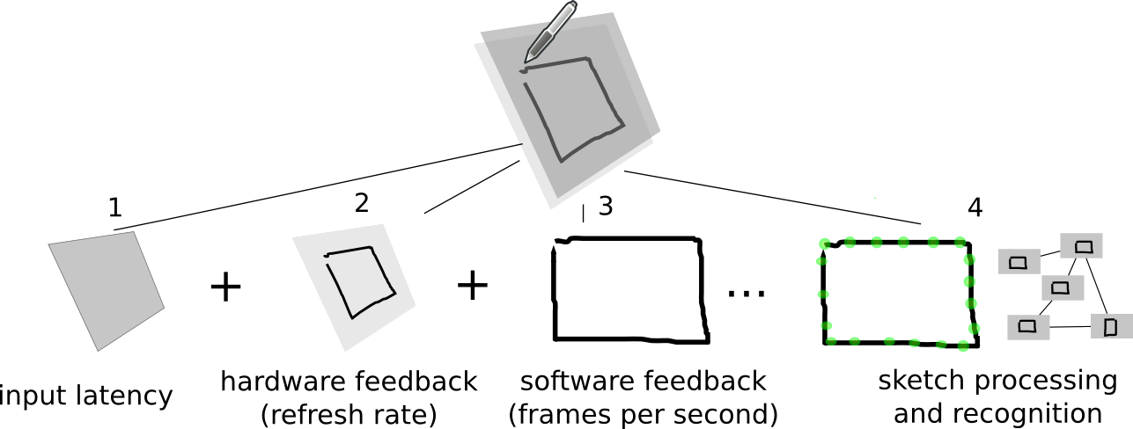
Lag in electronic sketching
133 points
per second
60 Hz
75 Hz
…
60 FPS
75 FPS
…
Notes:
So lag In electronic sketching is composed by mainly three parts, first the input latency: the time it takes for the device to capture the movement
Then the hardware feedback: its the refresh rate usually expressed in HZ, for instance I have in my laptop screen a refresh rate of 60 HZ. That gives us a practical upper limit of 60 Frames per second.
And the software feedback, which we can control programatically, This component is the focus of this work.

Slide 6
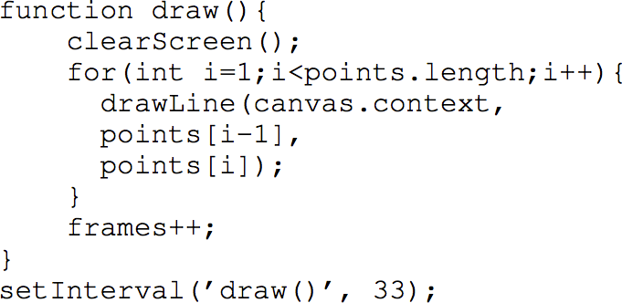
Refresh rate
Example: http://frames-per-second.appspot.com/
30 FPS
(1000/30) = 33 miliseconds
Notes:
So how to control the refresh rate in a program? We divide one second by the desired ammount of frames per second, then we know how often we have to refresh the screen.
This is a very simple function in Javascript that updates the screen based on a set of captured points, each 33 miliseconds.
We are trying to discover with this work what is the lower possible number for the sketching activity to be comfortable for the users.

Slide 7
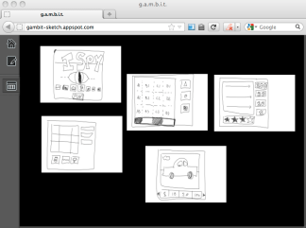
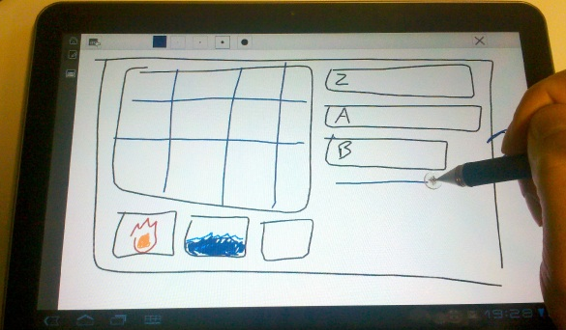
Sketching on many devices
HTML5
Notes:
This paper was motivated by the research im currently conducting on sketching in a multi-platform context. We could call it cross-device sketching.
Its possible to create a system that offers flexibility for designers to use whatever device they want
So they can sketch and prototype interfaces.
The goal is to also allow designers to test solutions directly on the device they want the application to be used.
And I’m using HTML5 for doing that. So if a device has a browser, a designer could use it.

Slide 8
Sketching on many devices
HTML5
1.4 devices per person by 2016 ¹
1 - CISCO’s Visual Networking Index
http://www.ciscovni.com/vni_forecast/index.htm
Notes:
There is an estimate made by CISCO that by the end of 2016 there would be more devices than people in the world.

Slide 9
Sketching on many devices
HTML5
1.4 devices per person by 2016 ¹
Design interfaces
Diverse context
Weight, screen types
E-paper?
1 - CISCO’s Visual Networking Index
http://www.ciscovni.com/vni_forecast/index.htm
Notes:
That creates a huge pressure on Designers, that will need to address a lot more things than today. Those devices will be tablets, smartphones, foldable-display devices, who knows?
So by using a cross-device system for prototyping, a designer would be able to perceive if an idea would work or not on a specific device, or in specific context,
some sort of in the wild prototyping

Slide 10
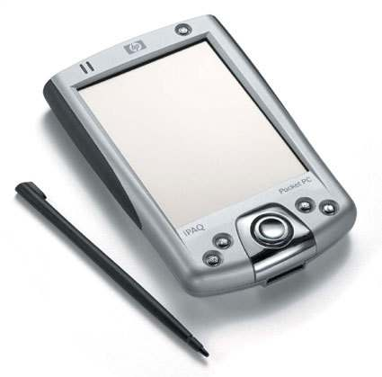
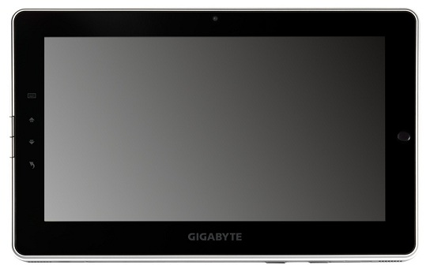
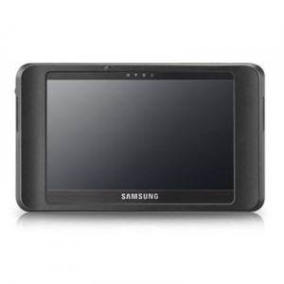
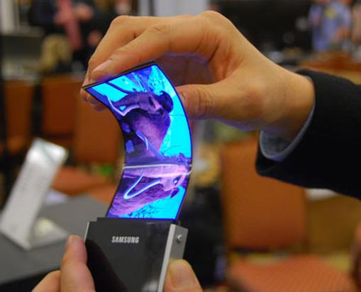
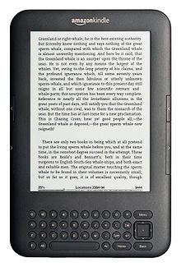
Devices
10 FPS
25 FPS
45 FPS
15 FPS
21 FPS
Notes:
We know that the devices will perform differently, for a same system. Devices might have different processors, different operating systems. The question is “Can we use those devices for sketching?”

Slide 11
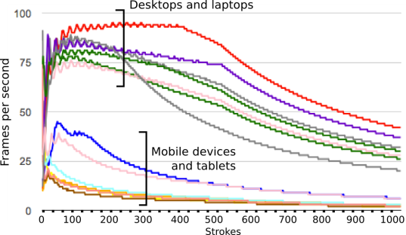
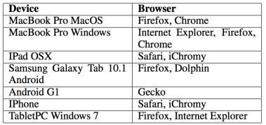
Benchmark
Notes:
We ran a very simple benchmark on some devices available today to see how they differ. We’ve performed a function that drew one thousand lines three times and calculated the average.
We set the refresh rate to a very high value and calculated how many frames per second the device was actually able to render.
This chart shows in the X axis 0 to 1000 strokes and the Y axis shows how many fps each device was able to display.
We can see that there is a difference between mobile devices and desktops, as we would expect. We didn’t expect this difference to be that big.

Slide 12
Why?
Developers would know what to do
Respond accordingly
Keep the refresh rate low
Discard some devices
Activities
User profiles
Notes:
Why is it important to identify a minimum fps rate?
Developers would know how to make the sketching application respond when the performance drops to an unnaceptable rate, eventually
or even maintain the refresh rate as low as possible, saving battery for instance
Or we can even discard some devices for specific types of activity or user profiles if they are not able to refresh the screen at an acceptable rate.

Slide 13
Experiment
What is the FPS rate at which the users start to perceive the system as ‘too slow’?
Three phases
Draw squares and grade the speed.

Slide 14
Subjects
35 users recruited around the campus.
16 women, 19 men
Avg. 28 years old
Different nationalities
Different fields of expertise
Biology, Psychology, Computer Science, Management, etc.

Slide 15
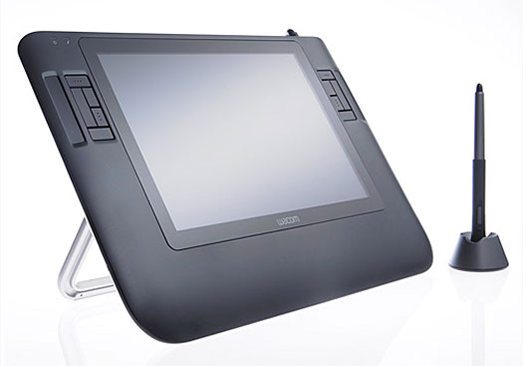
Material
Wacom Cintiq12
75 Hz (upper limit of 75 FPS)
MacBook pro 2.9GHz
http://exp.gambit-sketch.appspot.com (be nice)
Notes:
We used a Wacom Cintiq with a refresh rate of 75Hz, so qw could vary the FPS response from 0 to 75 FPS.

Slide 16
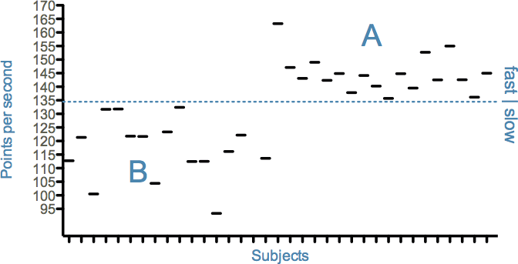
Two groups
Notes:
We separated the subjects into two groups, based on the average “points per second” they produced. In other words, we separated them by their drawing speed.
We’ve calculated the speed based on all the samples they produced during the experiment.
Since the subjects had different profiles, we thought that the speed would vary,
So This helped us to better analyze the data.

Slide 17
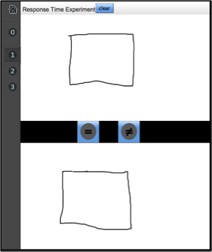
1st phase
A vs B comparison
“Are the response rates different?”
Goal: find out if users perceive small or large differences
Notes:
In the first phase we asked subjects to draw a square on each part of the screen and then click the buttons EQUAL or DIFFERENT. Each screen had a different FPS value, chosen in a random order.
The goal was to find out how subjects would perceive differences of 2, 5 and 10 FPS.
Our hypotesis is that subjects would perceive big differences more often than small differences.

Slide 18
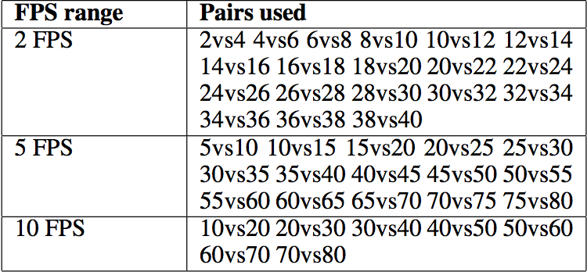
1st phase
Notes:
Those are the comparisons made for the different FPS ranges. They vary from 0 to 75 FPS since this was the physical limit of the display.

Slide 19
1st phase
Notes:
The subjects had to draw a square on each part of the screen and click a button that said EQUAL or DIFFERENT

Slide 20
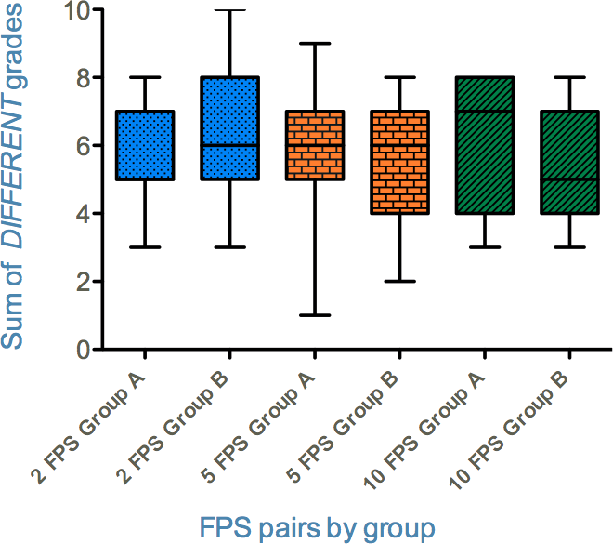
Results: 1st phase
Notes:
This chart shows how many times subjects clicked DIFFERENT for the different pairs of FPS. In the Y axis.
I the X axis show the FPS pairs (2, 5 and 10) and the groups A and B

Slide 21
Results: 1st phase
Not conclusive
Notes:
The result of this phase was not conclusive in the sense that we cannot say that subjects perceive differences of 10 FPS more often than 2 FPS.
Perhaps what we thought was a big difference in the end was too small to be perceived.
The difference was not significative between FPS groups nor between FAST and SLOW groups

Slide 22
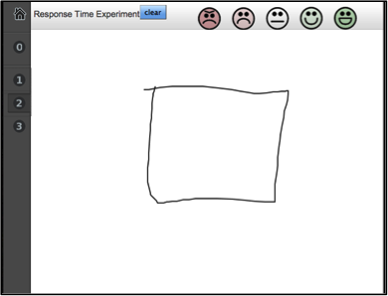
2nd phase
Likert scale grading
“How happy are you with this response rate?”
Goal: find out when the users start to grade as “bad” and “really bad”
Notes:
However the second phase gave us very sound results. It was based on Likert scale grading of the fps rates. Subjects would asked to raw a square and grade the speed presented by the system. The grades were “Really BAD, BAD, NEUTRAL, GOOD and REALLY GOOD” . As you can see in the small faces on top.
The question was “how happy are you with this response rate?”
We expected subjects to grade as BAD the lower range of FPS and as GOOD the high FPS’s.
Our hypotesis was that there would be a given range of FPS in which subjects would stop grading good and really good, that would mean there is a “turning point”

Slide 23
2nd phase
Notes:
The FPS rates were shown in a random order.

Slide 24
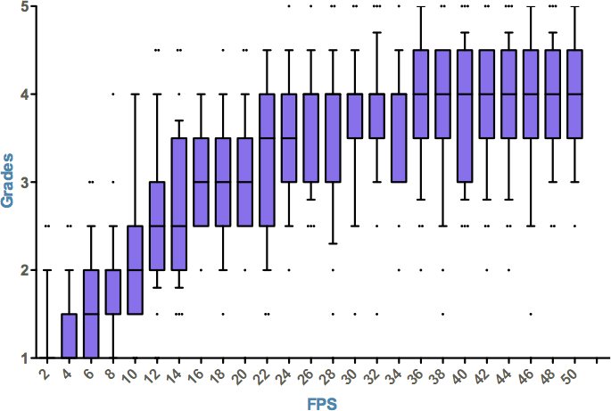
Results: 2nd phase
Notes:
Each grade had a value from 1 to 5 (in the Y axis) and we can see that the grades increased with the FPS values, in the X axis.
This is a consistent result and confirmed the hypotesis that lower FPS values would receive lower grades, and high FPS high grades.
Now we are interested into knowing when the grades started to stabilize, that would mean “from this FPS on, there is not a significant difference”

Slide 25
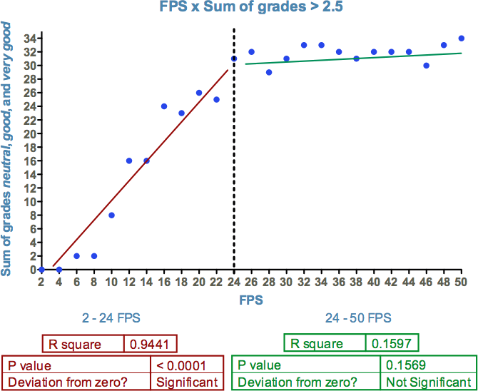
Results: 2nd phase
Notes:
So we summed up the values neutral, good and really good and this is what we got. We can see that the acceptance result varies a lot between 0 and 24, and from that point on users are pretty much satisfied. So we would have a range of aceptance from 24 FPS on.

Slide 26
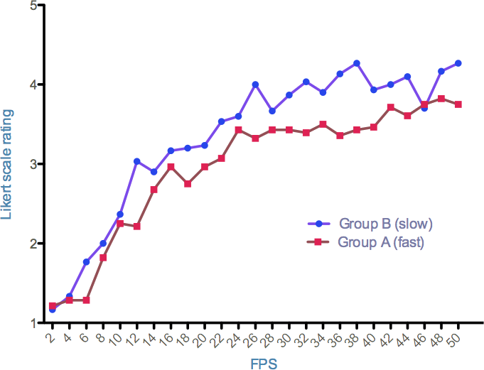
Results: 2nd phase
Notes:
Another interesting result is that the slow group gave more good grades than the fast group. The fast group was less satisfied with the FPS rates than the slow group.

Slide 27
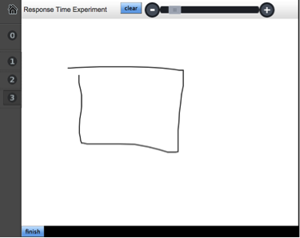
3rd phase
Active selection of a preferred response rate
“What is the minimum in your opinion?”
Goal: cross-validate the 2nd phase
Notes:
The third phase was the active selection. Here subjects could control the speed, like in the first video I showed, with the scrollbar.
We asked “Whats the minimim in your opinion?” This was totally subjective
and the goal was to join the results with the second phase.

Slide 28
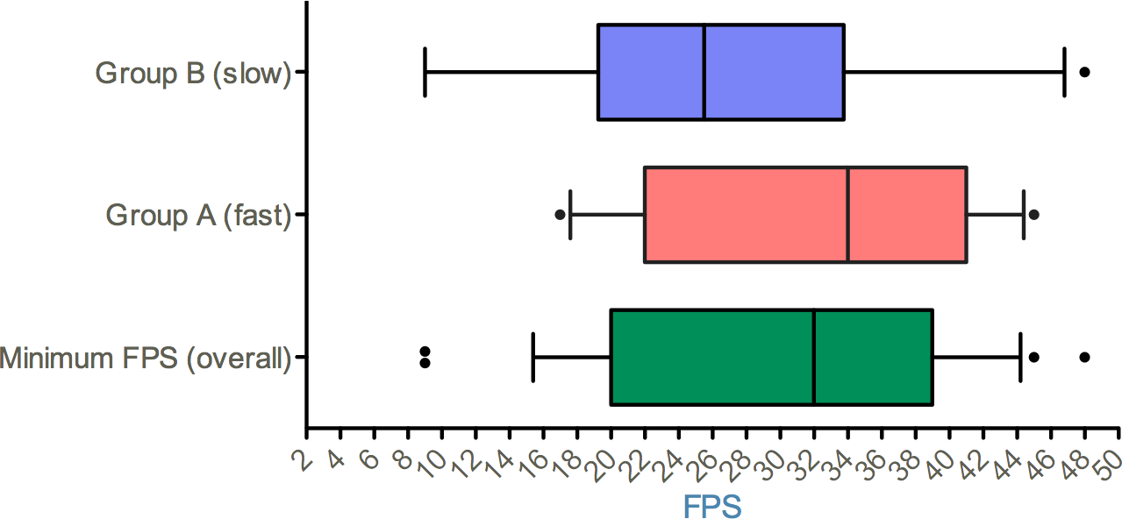
Results: 3rd phase
Notes:
In the Y axis we have the groups, and in the X axis we have the FPS values they have chosen.
Again, we see the consistency, the slow group were really satisfied with lower FPS rates, from 20 to 34.
And the fast group were satisfied with a higher fps range, of 23 to 41.
When we joined the two groups, we got an overall minimum result of 20 FPS excluding the outliers.

Slide 29
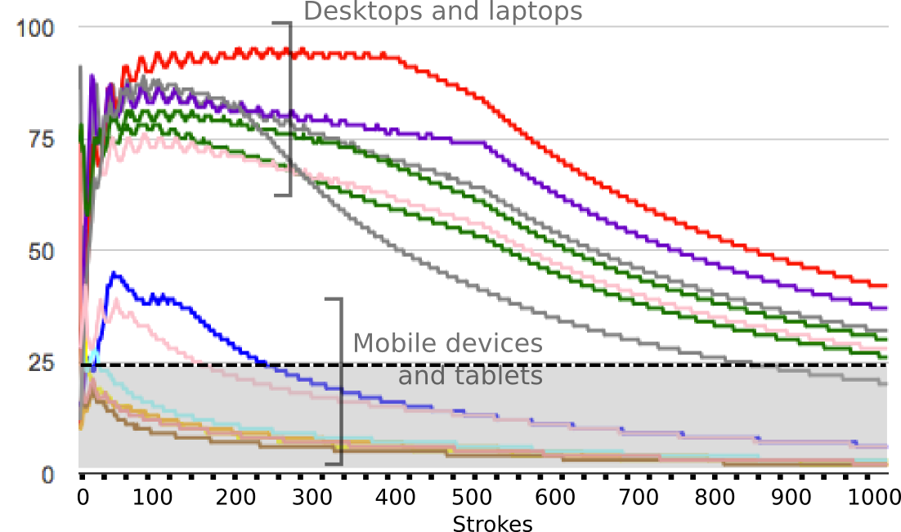
Findings
The range below 20 FPS was rejected by users;
The difference between grades is not significant above 24 FPS
No conclusive evidence that subjects perceived differences of 2, 5 and 10 FPS when testing pairs of rates
Notes:
So the summary of the findings is that “the range below 20 fps was rejected, and the grades were not significantly different above 24 FPS”
That would give us a range of 20 to 24 FPS as a minimum.
And based on the first phase, we found no conclusive evidence that subjects perceived differences of 2, 5 and 10.

Slide 30
Next steps
Writing activity
Specific types of professionals
Designers
Architects
Non-drawing professionals

Slide 31
Thank you
Ugo.Sangiorgi@uclouvain.be
@ugosan

