Slide 1
Building an ergonomic guide for multi-platform interfaces
Louvain-la-Neuve, 27th June 2011
Nguyen Thanh-Diane

Slide 2
Table of Contents
Motivations
Goals of the thesis
Research Methodology
Review of the state of the art
References selection
Base of the ergonomic guide : DESTINE
The OO-Method
Examples of applications : Android and iOS
Conclusion

Slide 3
Motivations
Problems:
Huge variety of devices, software/hardware
Large quantity of available guidelines
Limitations of current works about ergonomic guidelines
Incompleteness
Heavy description
Difficult interpretation
Conflicting issues
Out of date information
The lack of classification of guidelines
Examples:
Guideline: “Impose a style in using CSS” vs Guideline : “Let the user to choose its policy” (Norcier ,2008)
Guideline for desktop computer : “Design a page in order to be readable in 800 x 600 resolution” (Norcier ,2008)
Guideline for widescreen: “Design for 1024x768 minimum resolution” (Michele McDonough ,2010)

Slide 4
Goals of the thesis
Main Goal
Provide user interface designers and developers with support for designing multi-platform user interfaces.
Sub-Goals
Know the state of the art related to guidelines for multi-platform interfaces.
Create the ergonomic guide
Disseminate the ergonomic guide among research groups devoted to improve usability of software systems.
Verify the usefulness of guidelines by an application

Slide 5
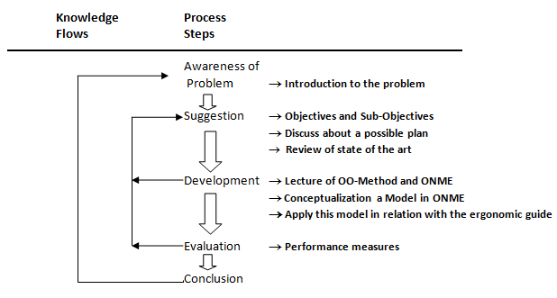
Research Methodology
Methodology based on the design cycle research

Slide 6
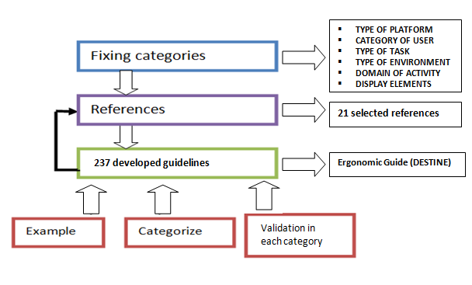
Review of the state of the art

Slide 7
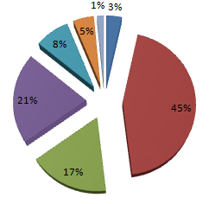
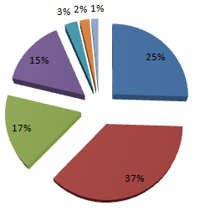
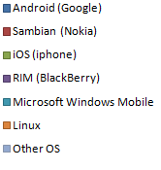
Smartphones
Worldwide Smartphone Sales to End Users by Operating System
2009 year
2010 year
Selected Smartphones:
Android by its great increase in sales and using
iOS : The first iPhone has revolutionized the design (own patterns and guidelines) of electronic devices that surround us.

Slide 8
Motivation of the references selection to extract guidelines
Main Motivations in selection of references:
Up-to-date guidelines
How to avoid the most current mistakes in applications or websites
Complete and illustrated content
Related to categories
Credibility by experiments
The popularity
Examples : - Jakob Nielsen
- Articles with the agreement of the U.S. Department of Health and Human Services

Slide 9
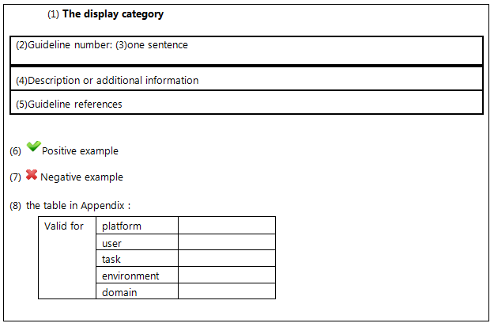
Ergonomic guideline template

Slide 10
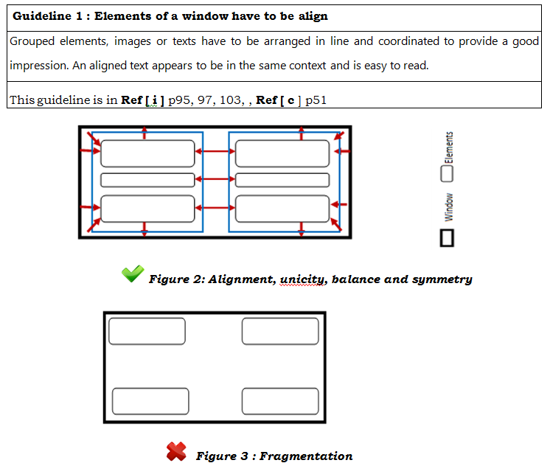
Example of an ergonomic guideline

Slide 11
Base of the ergonomic guide: DESTINE
DESTINE : Design & Evaluation STudio for INtent-based Ergonomic web sites
Compatible XML language called GDL
Description of categories
237 available ergonomic guidelines for multi-plaforms in the database.
List, name, description, resume, illustration of each guideline
Structured and complete view on each guideline related to own categories

Slide 12
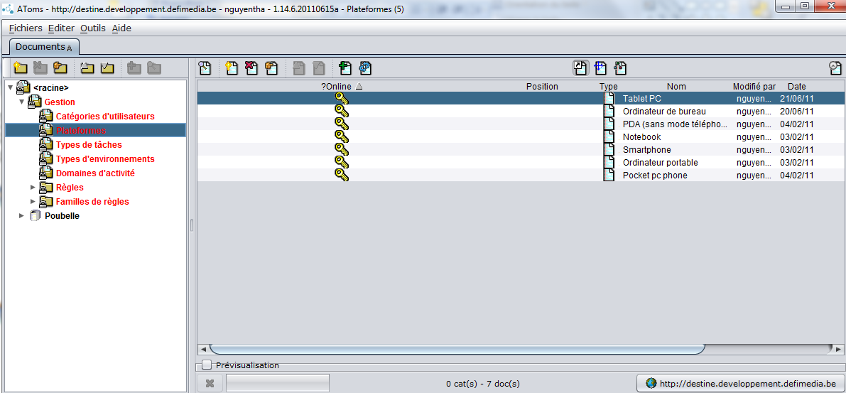
Destine

Slide 13
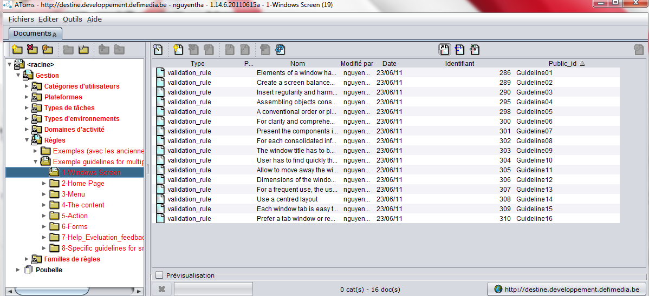
Destine

Slide 14
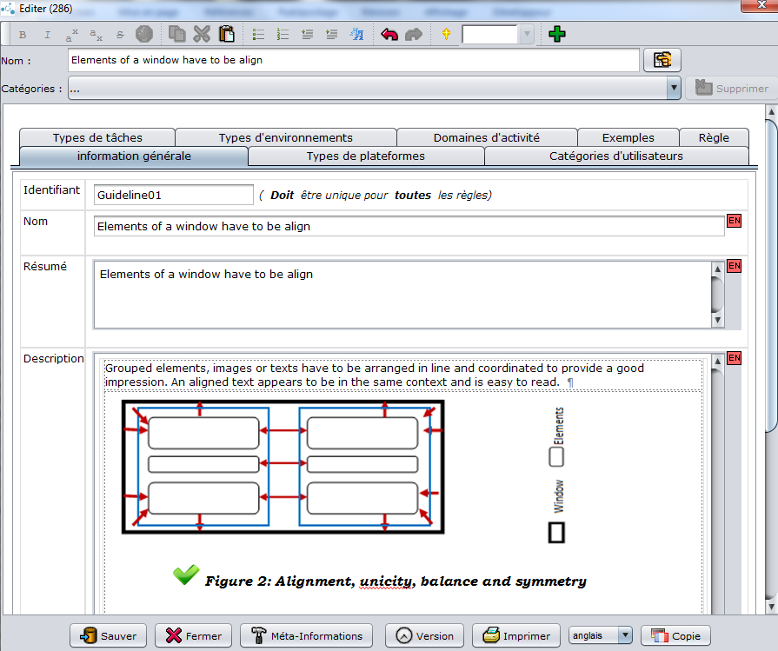
Destine

Slide 15
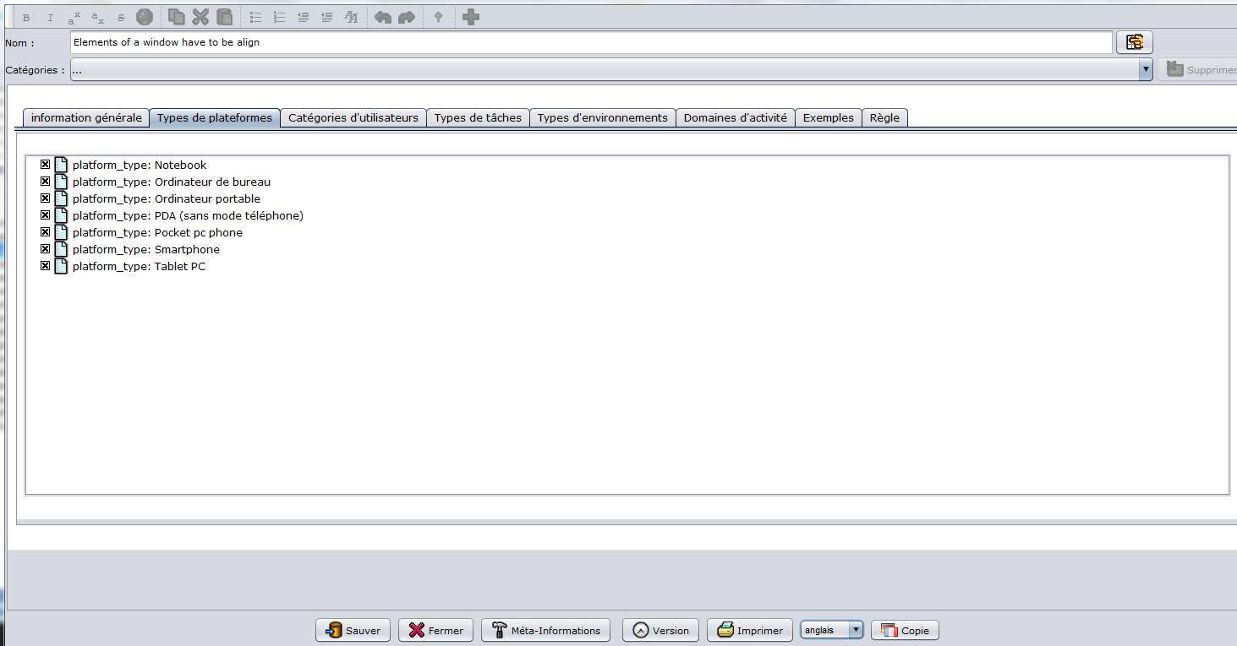
Destine

Slide 16
Development step : the OO-Method learning
The Interaction Model of OO-Method

Slide 17
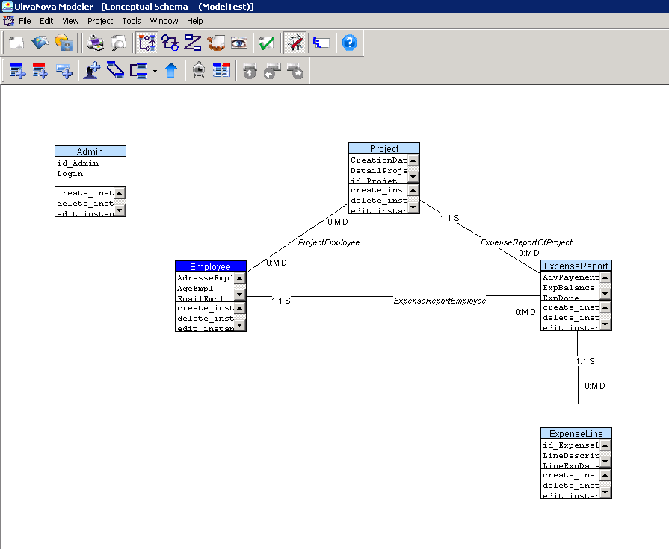
Conceptual Model : example

Slide 18
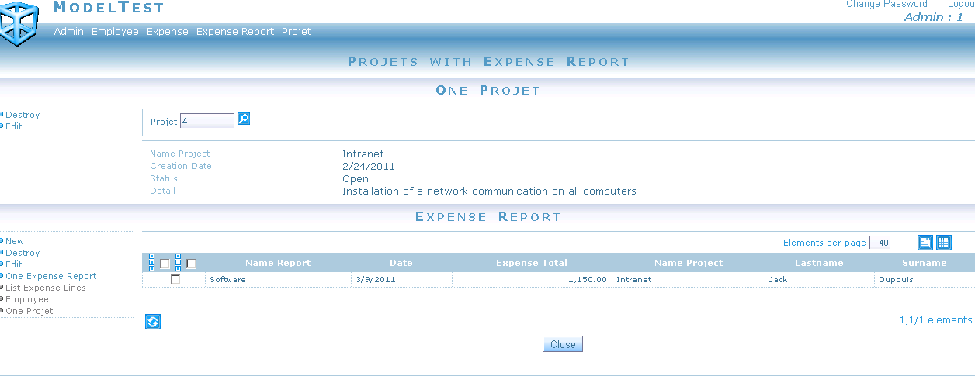
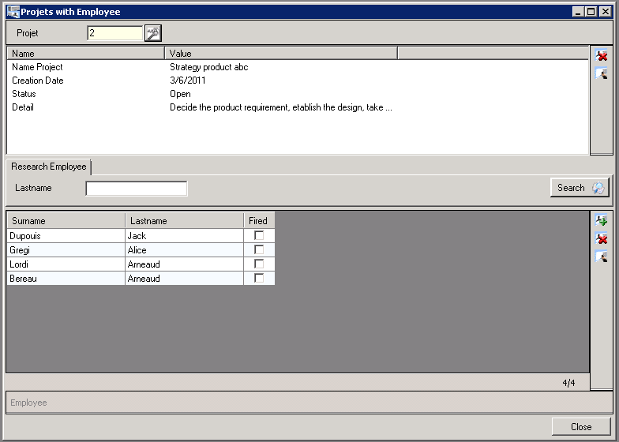
Web View and Office View generated by OLIVANOVA software

Slide 19
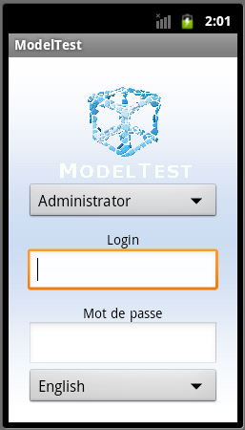
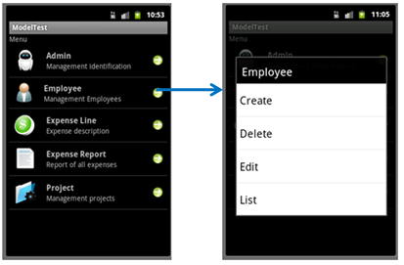
Application of the ergonomic guide on Android:HAT

Slide 20
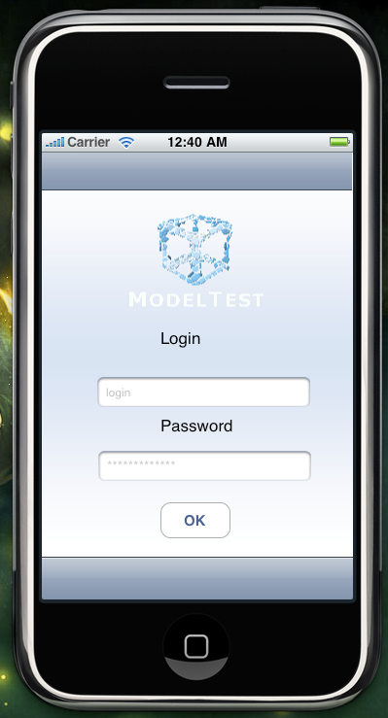
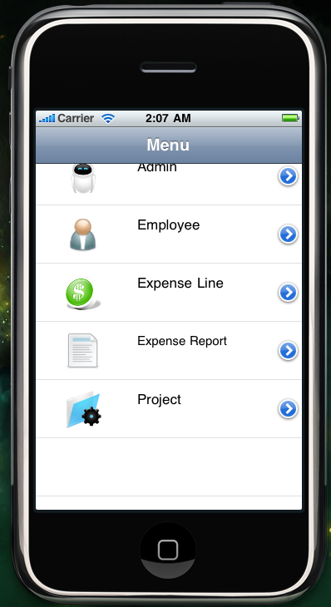
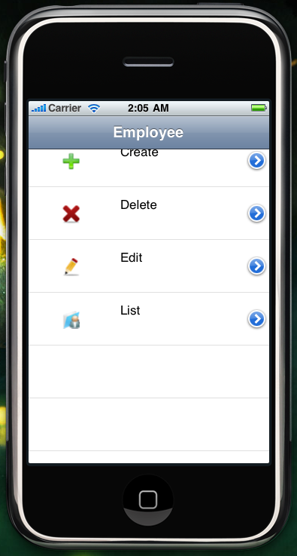
Application of the ergonomic guide on iOS:HAT

Slide 21
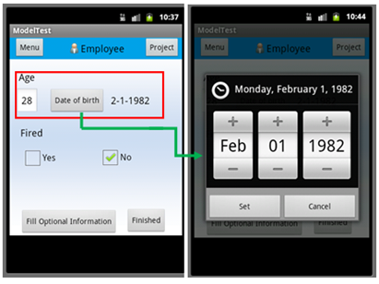
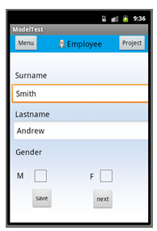
Application of the ergonomic guide on Android:SIU

Slide 22
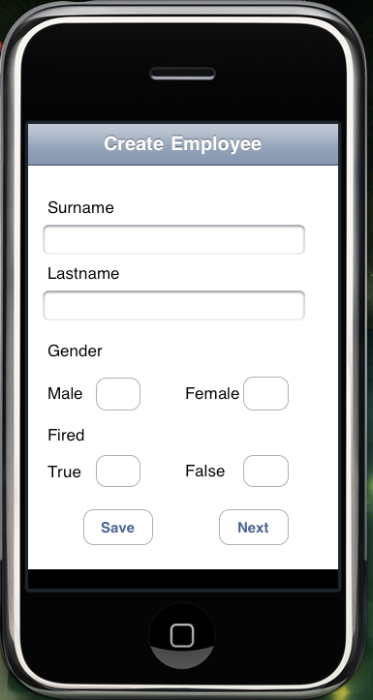
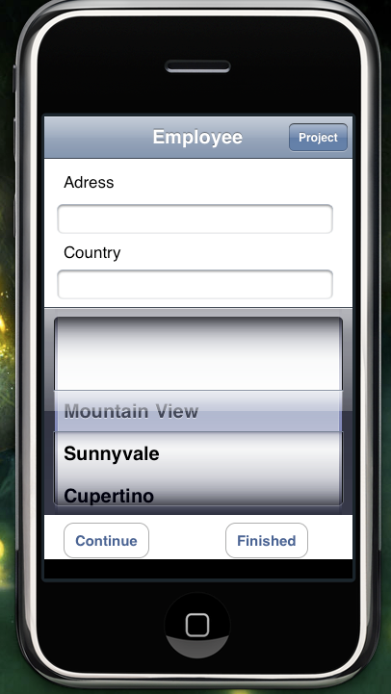
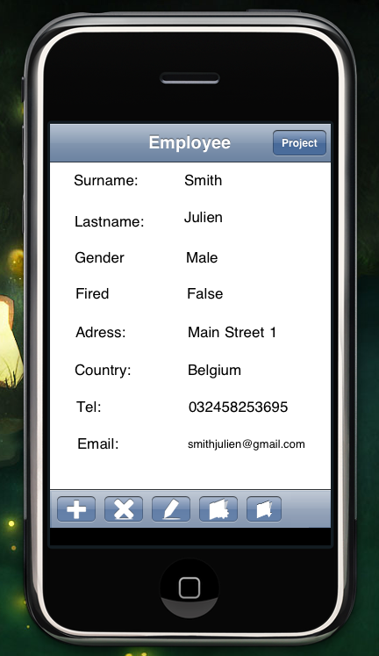
Application of the ergonomic guide on iOS:SIU

Slide 23
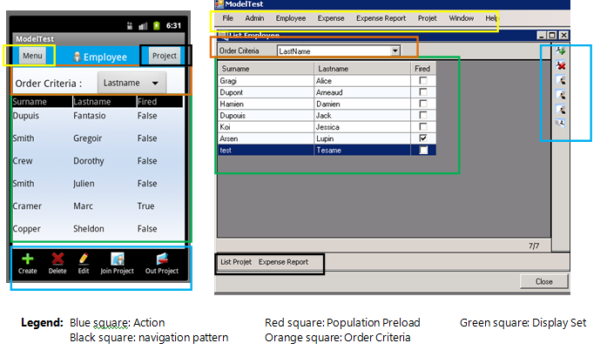
Application of the ergonomic guide on Android:PIU

Slide 24
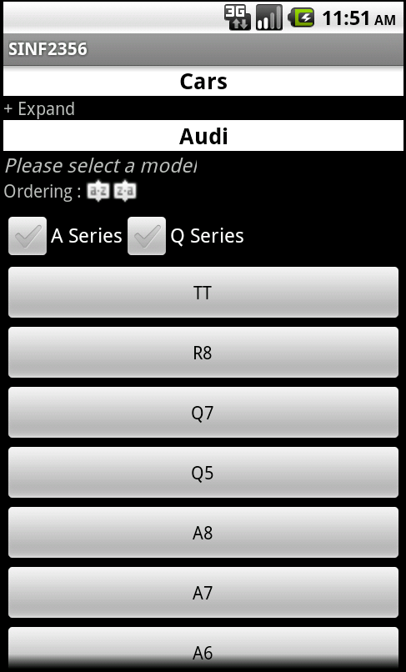
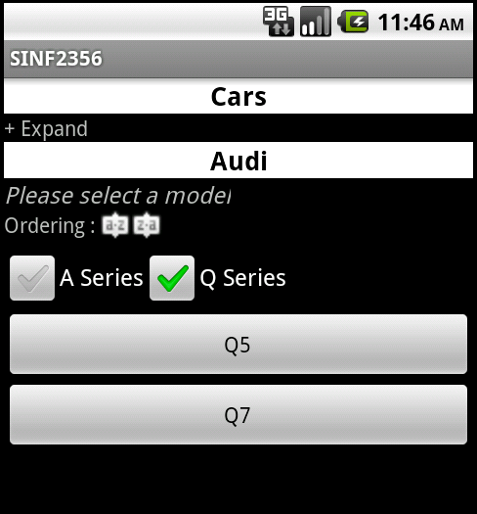
Application of the ergonomic guide on Android:PIU
Model selection, filtering

Slide 25
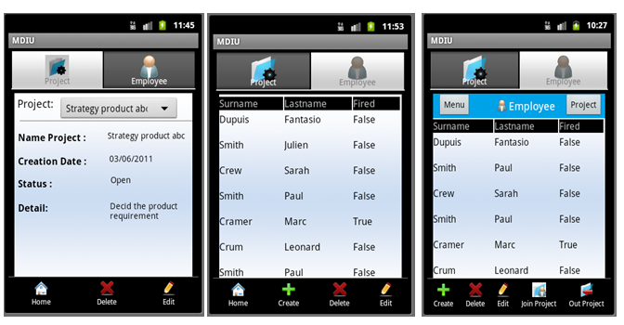
Application of the ergonomic guide on Android:Master Detail Interaction Unit

Slide 26
Conclusions
The support for designing multi-platform user interfaces is defined in the software DESTINE with 237 guidelines.
Challenge of unknown tools for Android and iOS
Diversity of collaboration and partners
Evolutions
Future collaboration in OO-Method domain with other international researchers
Experimentations: to determine the percentage of developer that will follow the rules of the guide

Slide 27
Thank you for your attention

