Slide 1
Modelling and Developing Distributed User Interfaces based on Distribution Graph
Jérémie Melchior, Jean Vanderdonckt and Peter Van Roy
Jeremie.Melchior@uclouvain.be
Researcher at LiLab, http://www.lilab.be
Université catholique de Louvain (BELGIUM)

Slide 2
Content
Motivations
Distributed User Interfaces: what and how?
Lacks in other works
Contribution: distribution graph
Case study: a distributed Pictionary
Conclusion

Slide 3
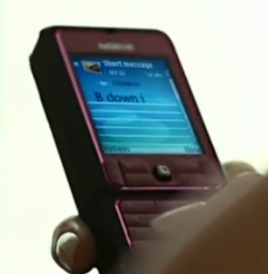
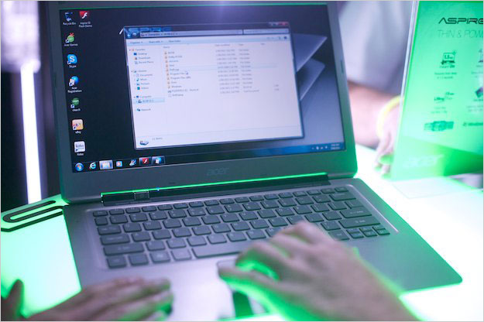
Motivations
1 or more desktops
1 or more phones
Mobile phone
Smartphone
1 or more laptops
And maybe more !
Xbox
Playstation
TV
…

Slide 4
Motivations
Lots of devices
High need of visualization of the distribution state
Only pre-programmed disposition & static environment
No support for platform leaving or joining at run-time

Slide 5
Distributed User Interfaces
Definition:
“any application UI whose components can be distributed across different displays of different computing platforms that are used by different
users (co-located or remote collaboration)”

Slide 6
Distributed User Interfaces
Any UI could be distributed
Example: Paint (not distributed by default)

Slide 7
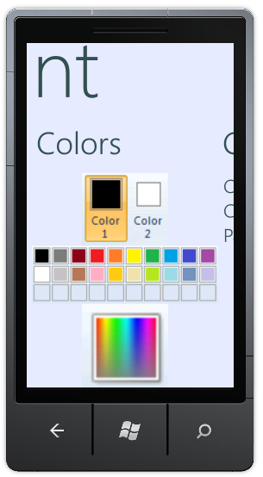
Distributed User Interfaces
Any UI could be distributed
Example: Paint (distributed)
Windows: drawing area
Windows Phone: all buttons, bars, …

Slide 8
Distribution State
Distribution state of the whole system
Snapshot of the system at a certain moment of time in a stable distribution state
Context = set of platforms, set of users and one environment)
Visual representation:
Example:
Adrien is in distribution state DS1, which means he is in the context of use C1
C1_{adrien} = ({desktop}, {Adrien}, quiet)
Adrien’s distribution state = C1_{adrien}
C1_{adrien}

Slide 9
Distribution Shared State
Sum of all individual states
Example:
C1_{bastien} ₌ ({desktop, laptop}, {Bastien}, quiet)
Distribution shared state = {C1_{adrien}, C1_{bastien}}
Visual representation:
C1_{adrien}
C1_{bastien}

Slide 10
How ?
Need to know the distribution state
Distribution Graph

Slide 11
How ?
Need to know the distribution state
Need to trigger the distribution
Distribution Primitives
Distribution Script

Slide 12
How ?
Need to know the distribution state
Need to trigger the distribution
Need to know « what » to distribute
Part or whole of the UI

Slide 13
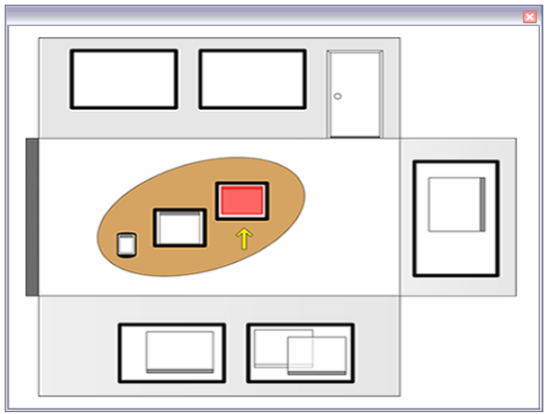
Example of existing works on DUI
ARIS: visualisation of devices and windows
Meta-UI
Static environment
States: ?
[BIE04] Biehl & Bailey ARIS: An Inferface for Application Relocation in an Interactive Space

Slide 14
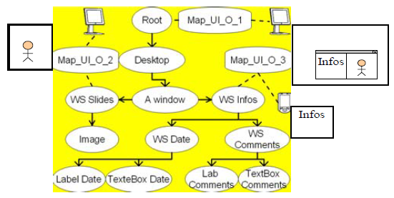
Example of existing works on DUI
A Reference Model for DUIs
Widgets:
An image: (WS Slides)
A text: « Infos » (WS Infos)
Conceptual level
States: ?
[DEM05] Demeure, Calvary, et al.
A Reference Model for DUIs
Notes:
WS = workspace

Slide 15
Our contributions
Idea: state-transition diagram
Allow modelling of the distribution
Dynamic evolution of the distribution
Ability to join or split models
Need of some concepts:
Distribution state
Distribution shared state
Distribution graph
Distribution primitive
Distribution script

Slide 16
Distribution Graph
State diagram/state chart model
Node
Individual states of entities involved in the distribution
→ Distribution State
Collective representation of their synchronization
→ Distribution Shared State
Transitions =
Event-condition-action:
Action = Distribution Script
At conceptual level
Evolution at run-time

Slide 17
Distribution Graph
C1_{adrien} = ({desktop}, {Adrien}, quiet)
C1_{bastien} = ({desktop, laptop}, {Bastien}, quiet)
Event: Adrien changes platform
Action: Replace(C1_{a}, C2_{a})
C2_{adrien} = ({laptop}, {Adrien}, quiet)
C1_{bastien}
C2_{adrien}
C2_{bastien} = ({desktop}, {Bastien}, quiet)
Event: Bastien changes platform
Action: Replace(C1_{b}, C2_{b})
Notes:
L in L_ui means « Laptop »

Slide 18
Distribution Script
Distribution Script:
Set of distribution primitives
Distribution Primitive
Definition: basic operations that manipulates parts or wholes of a user interfaces at run-time
Part of a catalog
Example of distribution primitive:
{Display td(name:p1 button(name:b_c glue:e text:"Create:"))}
{Display entry(name:e_c glue:w bg:white init:"Own game"
handle:HEntry return:R) #p1}
Operation – Widget - Property:Value - #Location

Slide 19
Catalog of operations
Name | Effect
Display | Display an item in one or more UIs
Undisplay | Hide an item from one to many UIs
Move | Move an item from a UI to another one
Copy | Copy an item of an UI to another one
Insert | Insert an item in a container of a UI
Switch | Exchange two components in the same or different UIs
Merge | Merge two UIs together
Separate | Explode a UI in two or more separated UIs

Slide 20
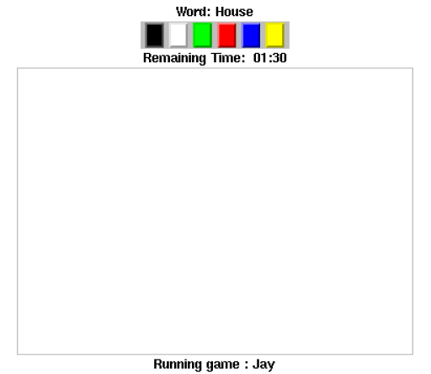
Case Study
A distributed Pictionary:
3 roles:
The drawer
The observer
The guesser

Slide 21
Case Study
A distributed Pictionary:
3 roles:
The drawer: allowed to draw in the application (+drawing bar)
The observer: allowed to see the drawing
The guesser: allowed to see the drawing and suggest words

Slide 22
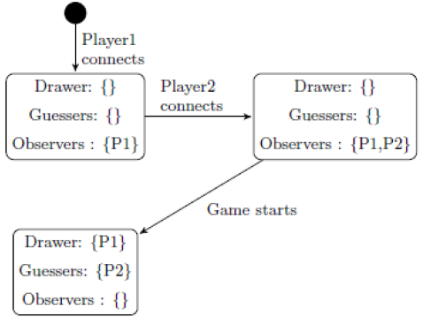
Case Study
A distributed Pictionary:
Event: Player2 connects
Action: execute Distribution Script 1
Event: Player1 connects
Action: execute Distribution Script 1
Player connects
No game started
Condition: More than 2 players connected
Game started

Slide 23
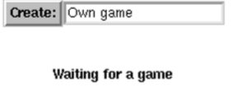
Case Study
Distribution Script 1:
{Display td(name:p1 button(name:b_c glue:e text:"Create:"))}
{Display entry(name:e_c glue:w bg:white init:"Own game”
handle:HEntry return:R)
#p1}
{Display lr(name:create_game b_c e_c)#p1}
{Display td(name:p1 create_game td(name:join)
label(name:status glue:swe text:"Waiting for a game“
bg:white) )
}
for I in {DiscoverGames} do
{Display button(name:b#I glue:nswe text:"Join "#I} #join}
end

Slide 24
Case Study
A distributed Pictionary:
Event: Player2 connects
Action: execute Distribution Script 2
Player connects
No game started
Condition: More than 2 players connected
Game started

Slide 25
Case Study
Distribution Script 2:
{Copy p1 td(name:p2)}

Slide 26
Case Study
A distributed Pictionary:
Event: Player1 or 2 starts the game
Action: execute Distribution Script 3
Player connects
No game started
Condition: More than 2 players connected
Game started

Slide 27
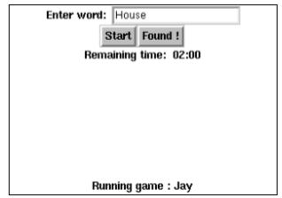
Case Study
Distribution Script 3:
{Undisplay create_game#p1}
{Update status "Running game: "#Name}
{Display td(name:observer
lr(name:enter_word glue:nwe bg:white
label(bg:white text:"Enter word: ")
entry(glue:w bg:white init:"House“ handle:HEW))
lr(name:start_found bg:white glue:new
button(glue:e text:"Start")
button(glue:w text:"Found !"))
lr(name:remaining_time bg:white glue:swe
label(glue:e bg:white text:"Remaining time: ")
label(glue:w bg:white text:"02:00")))
#p1}
{Display td(name:p1 create_game observer status)}

Slide 28
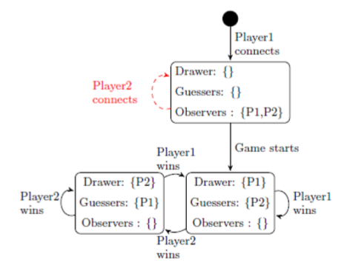
Case Study
A distributed Pictionary:
Simple example
Only 2 players

Slide 29
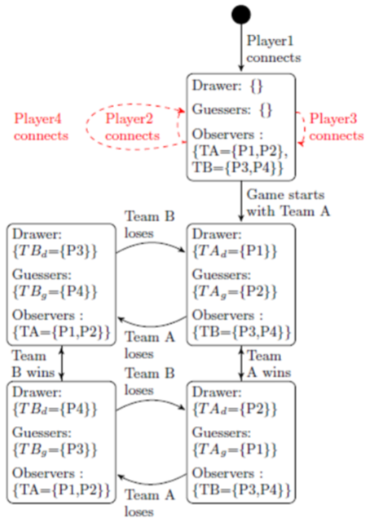
Case Study
A distributed Pictionary:
Complex example
4 players
2 teams (A - B)
2 players in Team A
2 players in Team B

Slide 30
Conclusion
Concepts
Distribution Graph
Distribution State
Distribution Primitive (distribution operation)
Distribution Script
Complex concepts with several items:
Devices
User Interface components
Roles
Reusable: others can reuse the idea or extends the concepts
Need for validation with a real game/application

Slide 31
Questions ?

