Slide 1
Distributed User Interfaces in Space and Time
Jérémie Melchior Université catholique de Louvain
Doctoral Consortium at EICS2011
Notes:
Faut-il garder les noms de tous ? Est-ce ok comme ça ?

Slide 2
It begins with…
Motivations
Drawbacks of Related Work
Ideas for solutions
Implementation
Case Studies (3)
Validation
Future Work and Conclusion
Notes:
Que dois-je dire là-dessus ? W3C .. Oki .. Mais OASIS Nexof… ?

Slide 3
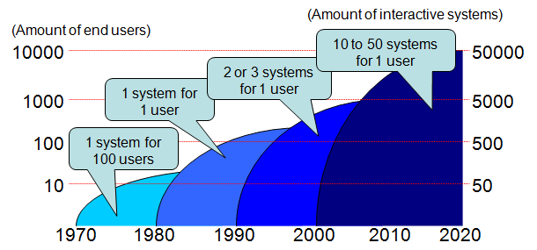
Motivations
Mobile devices (iPad, iPhone,...)
Smartphones are popular
Focus of researchers for distribution
Limitations of the user's space
Independence between the UI and the application

Slide 4
Drawbacks of Related Work
No publicly released toolkit
Limited support for multi-platform
Lack of customization
Closely connected devices (often in the same room)
Predefined distribution
Lack of real-time distribution, reusability, modeling, feedback and control

Slide 5
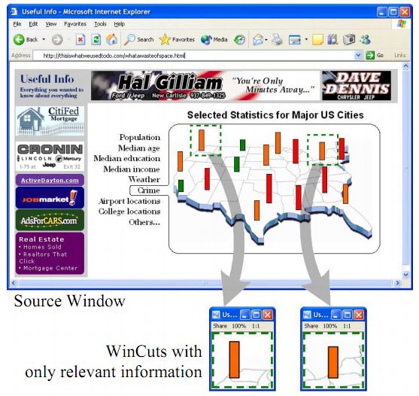
Drawbacks of Related Work
Predefined distribution

Slide 6
Ideas for solutions
Unification of the techniques (toolkit)
Model-based approach defining the distribution
Open language supporting the distribution
Real-time feedbacks for local and global distribution and interaction
Real-time control on every single component of the UI
Distribution of a whole, a part or a custom group of widgets
Multi-platform support (computer + tablets + smartphones)

Slide 7
Implementation
Issues:
distribution mechanisms
centralized VS decentralized
control of the behavior
distribution of the UI
UI and behavior
UI and a new behavior
communication
through messages
through a DHT
multi-platform support

Slide 8
Concepts
Under-lying concepts:
Distribution primitives
Distribution scenario
Distribution graph
EBNF grammar + language
3 Models: CUI, Platform and, User and Environment
A catalogue of primitives
Multi-platform environment (e.g. Android)
Selectors mechanism (universal, type, class and id)

Slide 9
Concepts 1/8
Distribution primitives
4 categories :
simple primitives (widget in container)
basic primitives (reshuffle the widget)
advanced primitives (widgets)
management primitives (complex system)

Slide 10
Concepts 1/8
Distribution primitives
Simple Primitives
Set, Display, Undisplay, Expose (display without control)
Basic Primitives
Copy, Move, Switch, Permute (in both directions)
Advanced Primitives
Merge / Separate, Replace, Distribute / Reset, Append (merge in FIFO order), Transform
Management Primitives
Save, Restore (UNDO-REDO), Import/Export

Slide 11
Concepts 2/8
Distribution scenario
To apply several primitives sequentially
Small example of scenario:
{Undisplay create_game#p1}
{Update status "Running game: "#Name}
{Display td(name:observer lr(...) lr(...) lr(...))#p1}
{Display td(name:p1 create_game observer status)}

Slide 12
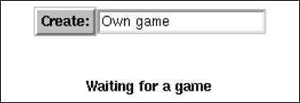
Concepts 2/8
Distribution scenario
{Undisplay create_game#p1}
{Update status "Running game: "#Name}

Slide 13
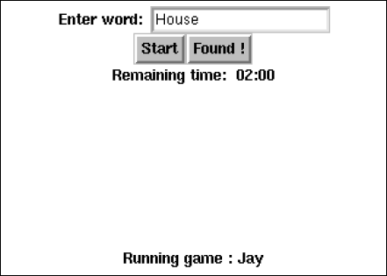
Concepts 2/8
Distribution scenario
{Display td(name:observer lr(...) lr(...) lr(...))#p1}
{Display td(name:p1 create_game observer status)}

Slide 14
Concepts 2/8
Distribution scenario
{Undisplay create_game#p1}
{Update status "Running game: "#Name}
{Display td(name:observer lr(...) lr(...) lr(...))#p1}
{Display td(name:p1 create_game observer status)}

Slide 15
Concepts 3/8
Distribution graph
Platforms involved in the system
CUI model associated to the laptop

Slide 16
Concepts 4/8
EBNF grammar + language
statement = operation , source , ”TO” , target ;
operation = "SET" | "DISPLAY" | "UNDISPLAY" | "COPY" | "MOVE" | "REPLACE" | "TRANSFORM" | "MERGE" | "SWITCH" | "SEPARATE" | "DISTRIBUTE";
source = selector ;
target = displays | selector , “ON” , displays ;
displays = display_platform , { “,” , display_platform}
display_platform = display , [ “OF” , platform] ;
selector = identifier , { “,” , identifier } | universal ;
display = identifier ;
platform = identifier ;

Slide 17
Concepts 5/8
3 models:
CUI model
Platform model
User and environment model

Slide 18
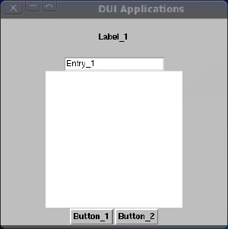
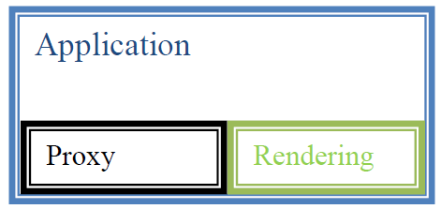
Concepts 5/8
3 models:
CUI model (rendering)

Slide 19
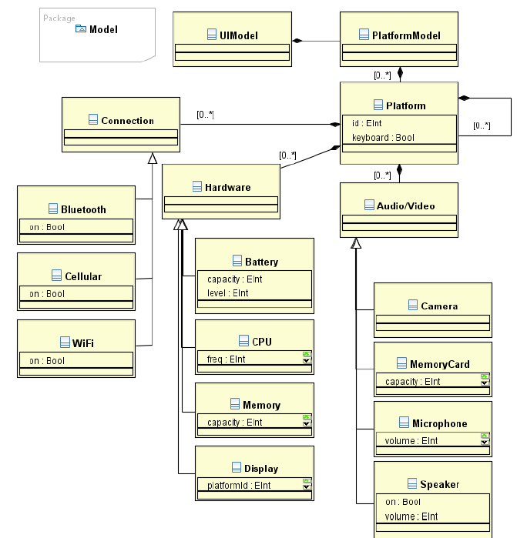
Concepts 5/8
3 models:
Platform model

Slide 20
Concepts 5/8
3 models:
User and environment model
Description of the user: U = (Pi, Vi)
through properties (Pi)
and values (Vi)
Description of the environment: E = (Pi, Vi)
through properties (Pi)
and values (Vi)

Slide 21
Concepts 6,7,8/8
Under-lying concepts:
A catalogue of primitives
Multi-platform environment:
Android, Windows, Linux, iOS and Mac OS X
Selectors mechanism
universal: to all UI elements
type: to all UI elements corresponding to the type
class: to all UI elements belonging to the class
id: to the only UI elements corresponding to the id

Slide 22
Case Studies
DeTransDraw
Decentralized, Transactional Drawing tool
Pictionary
a distributed pictionary
Game of the Goose
an evolutive game through real-time redistribution
Each square is a game
Game is a DUI that automatically distributes itself to the right players
The board can be controlled in real-time in order to remove, add, change games.

Slide 23
Validation
Small end-user survey on Distribution primitives (done)
Big survey on Distribution primitives (planned)
Survey on reactivity of the feedbacks
Real world experiences

Slide 24
Contributions
Conceptual:
Distribution primitives
Distribution scenario
Distribution graph
EBNF grammar + language
Methodological:
CUI, Platform and, User and Environment models
A catalogue of primitives
Tool:
Development of JayTk based on EBL and Qtk
UsiDistrib is included in UsiXML language

Slide 25
Future Work and Conclusion
Finalization and publication of the catalog
Finalization and release of preliminary versions of the toolkit
Validation as cited in the previous slide
Combination with cloud computing power

Slide 26
Future Work and Conclusion
Finalization and publication of the catalog
Finalization and release of preliminary versions of the toolkit
Validation as cited in the previous slide
Combination with cloud computing power
QUESTIONS ???

Slide 27
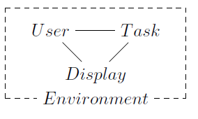
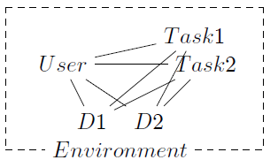
User-Task-Display-Environment

