Slide 1
An Open Source Workbench for Prototyping Multimodal Interactions Based on Off-The-Shelf Heterogeneous Components
www.openinterface.org/platform
Jean-Yves Lionel Lawson, Université catholique de Louvain;
Ahmad-Amr Al-Akkad, Fraunhofer FIT;
Jean Vanderdonckt and Benoit Macq, Université catholique de Louvain

Slide 2
Outline
Motivations
Goals, Motivations & Scenario
How
Requirements
Design overview
Progress
Questions

Slide 3
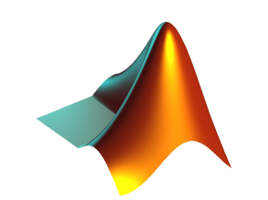
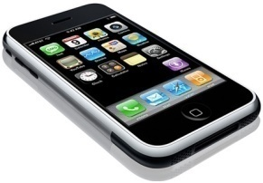
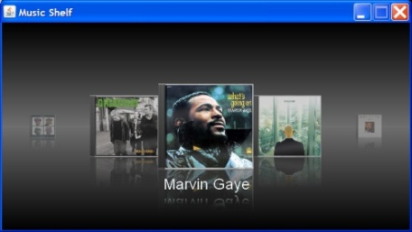
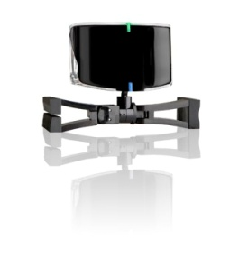

Slide 4
Goals & Motivations
Multimodal Interactions Exploration Tool
Effective prototyping (iterative, designer-centered)
Enhanced developers-designers collaboration
Laziness
Benefit from numerous existing open source code, APIs, tools, etc: “Off-The-Shelf components”
Reuse and share

Slide 5
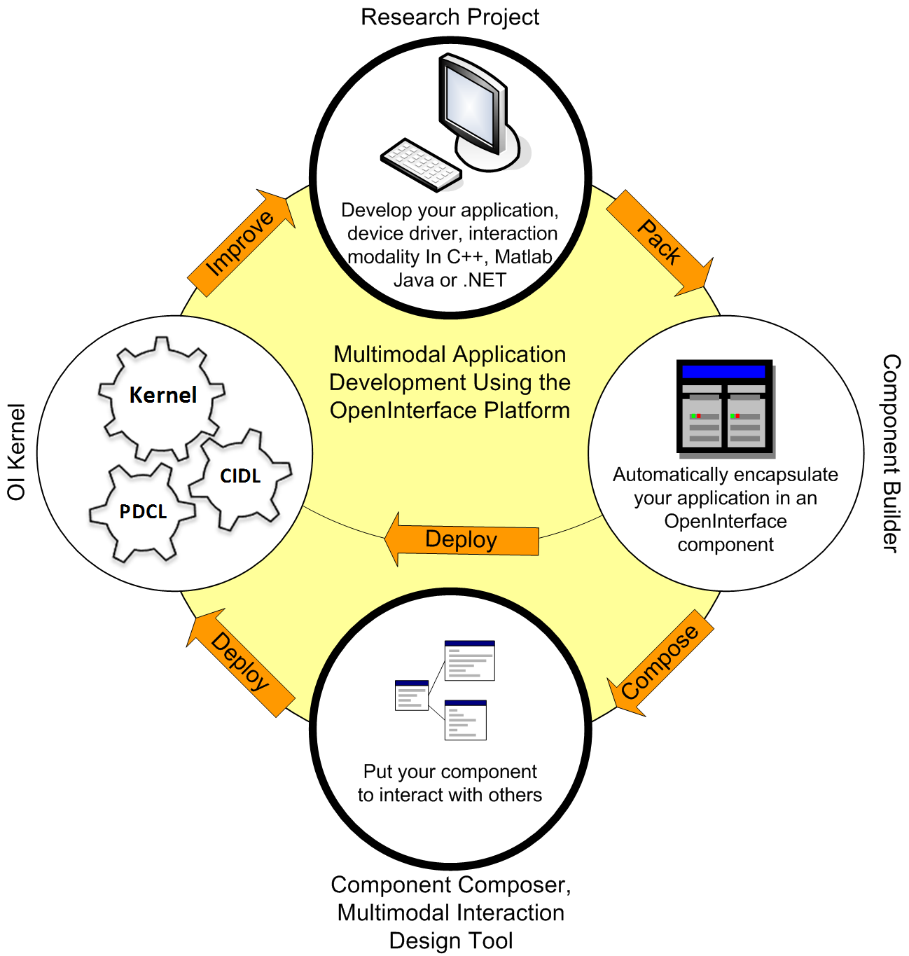
Usage Scenario
Fast high-fidelity prototyping
Available Materials:
Several interaction devices and miscellaneous libraries as heterogeneous software code (Matlab, C/C++, Java,.NET…)‏
Don’t want to:
Spend too much time on theory
Build glue code yourself
Reinvent the wheel

Slide 6
Workbench Scope
Runtime:
Facilitate efficient integration of heterogeneous software
Lightweight middleware
Allow rapid composition of multimodal interactions
Bundled generic connectors: “fusion”, multicast, smoothing, conditions, OSC, precision, conversion, etc.
Seamless software connection

Slide 7
Workbench Scope (contd.)
Design time:
Support designer ⇔ programmer collaboration
Allow dynamic exploration
Runtime evaluation
Runtime reconfiguration

Slide 8
Outline
Motivations
Goals, Motivations & Scenario
How
Requirements
Design overview
Platform Progress
Questions

Slide 9
Runtime Platform Requirements, Overview
Useful high level programming language support:
C/C++, Java, Matlab, .NET …
“Plug n Play” behavior
Lightweight skeleton platform.

Slide 10
Runtime Platform Design, Overview
Component Oriented.

Slide 11
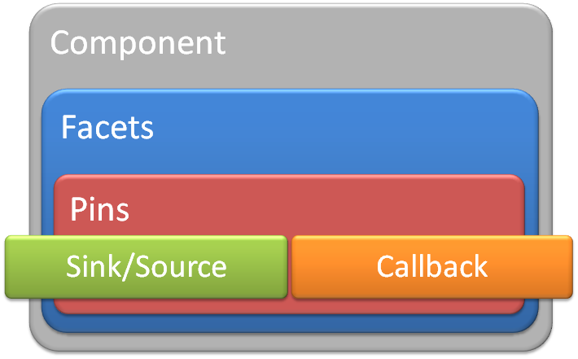
Runtime Platform Design, Overview
Component Oriented
Software
With API
With installation/configuration doc
Without explicit dependencies with other components
Dependency Injection Pattern

Slide 12
Runtime Platform Design, Overview
Component Oriented
Semi-Automatic Heterogeneous Components Integration
Component Interface Description Language
Generated from source code
Proxies and Stubs
Generated from CIDL

Slide 13
Heterogeneous Components Integration
Standard description of interfaces and properties.
Finger Tracker
Speech
Component
Component
C++
CIDL
Java
XML
C++
CIDL
Automatic conversion of data towards a common language.
CIDL
OpenInterface
CIDL
XML
XML
C++
Kernel
C++
XML
C++
Image Viewer
Component
Java
CIDL
CIDL
XML
XML
Image Server
Component
Component
Matlab

Slide 14
OpenInterface Runtime Kernel: Design Overview
Component Oriented.
Semi-Automatic Heterogeneous Components Integration
Component Interface Description Language
Generated from source code
Proxies and Stubs
Generated from CIDL
Multimodal interaction and data oriented features
Extensible set of fusion and data transformation component (plugins)‏
Software Component Composition
Pipeline Description and Configuration Language.
Generated by front-ends or by applications

Slide 15
OpenInterface Design Platform: Requirements ?
Participatory design exercise
Support for:
Sketching and Dataflow programming
Components development and tailoring
Documentation, annotation
Debugging (also as documentation)
Dynamic reconfiguration
Syntactic sugar

Slide 16
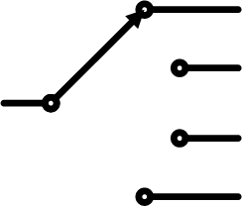
OpenInterface Design Platform: SKEMMI
Interaction Design Exploration
Dataflow programming
Select
CDShelf
Navigate
Java
B
Wiimote
MP3 Player
C++
acc
Event
Java
SetVolume
Volume Control
A
-
+
setLevel
C#

Slide 17
OpenInterface Design Platform: SKEMMI
Interaction Design Exploration
Dataflow programming
Design-by-example
Visualization tools
Signal processing components
Dynamic-Time-Warping (time --)
Hidden Markov Model, Bayesian Network (model --)
Model-free learning algorithms (experimental)

Slide 18
OpenInterface Design Platform: SKEMMI
Interaction Design Exploration
Dataflow programming
Design-by-example
Unifies Sketch and Implementation design levels
Integrated support for component implementation

Slide 19
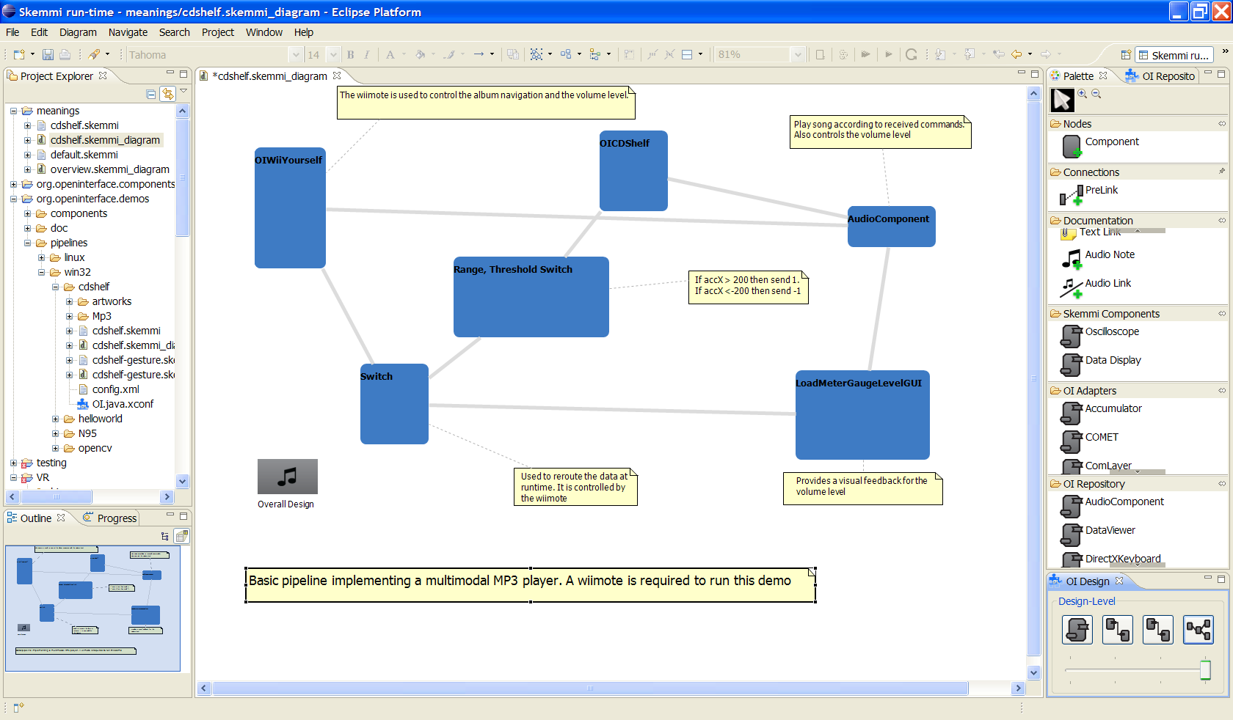
SKEMMI: Sketch design level

Slide 20
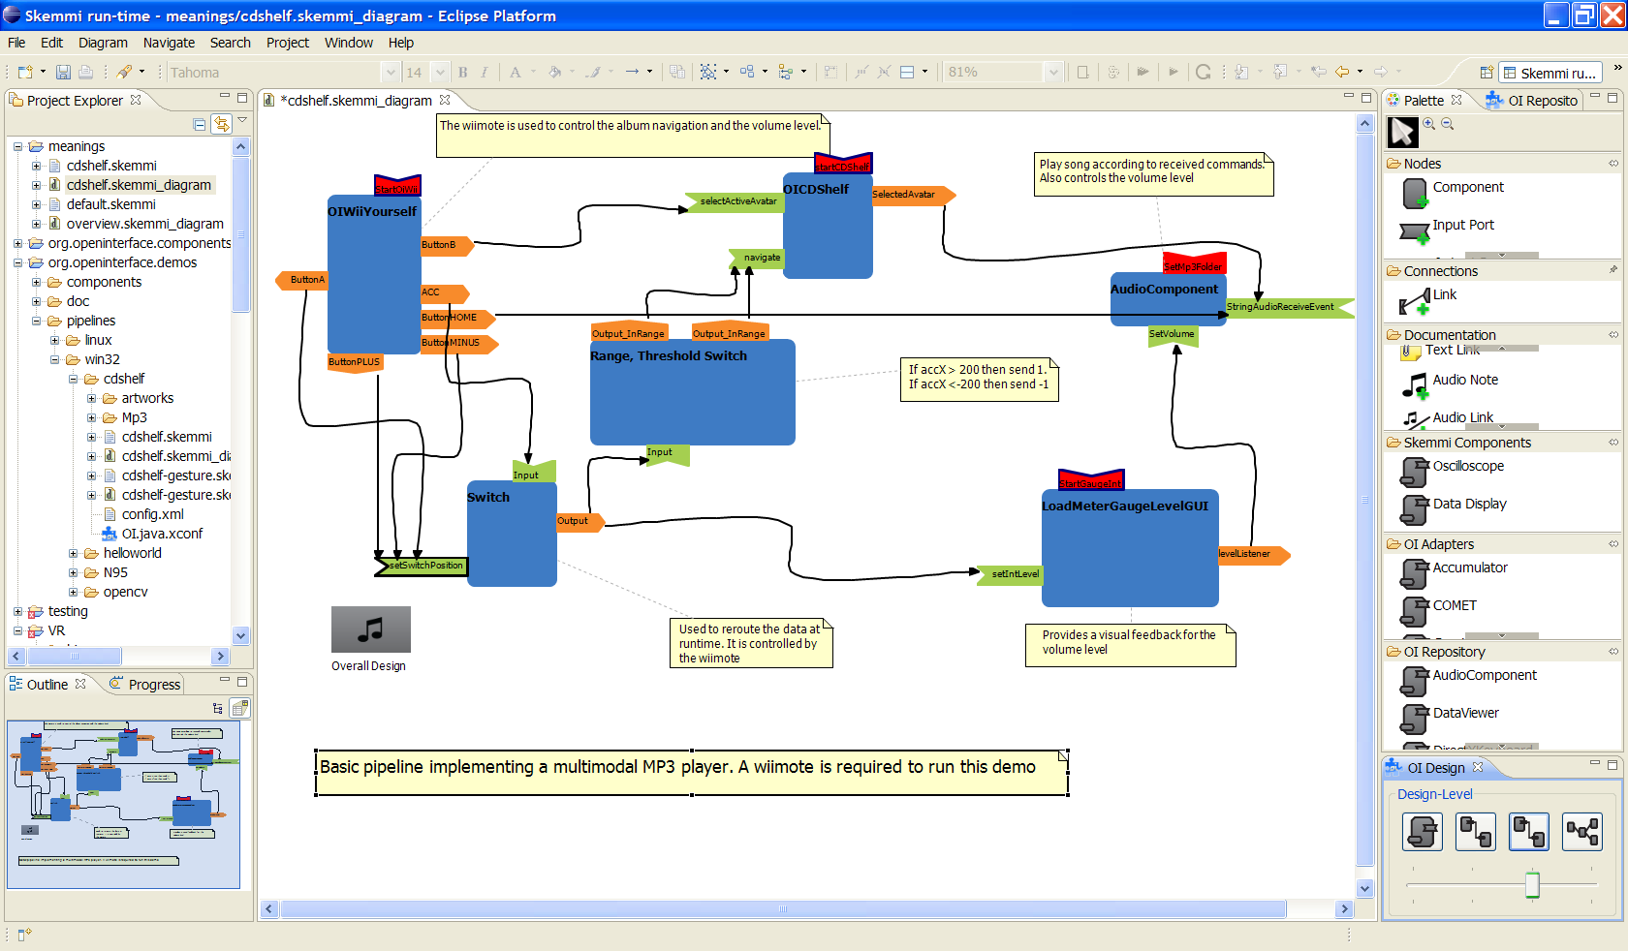
SKEMMI: Dataflow design level

Slide 21
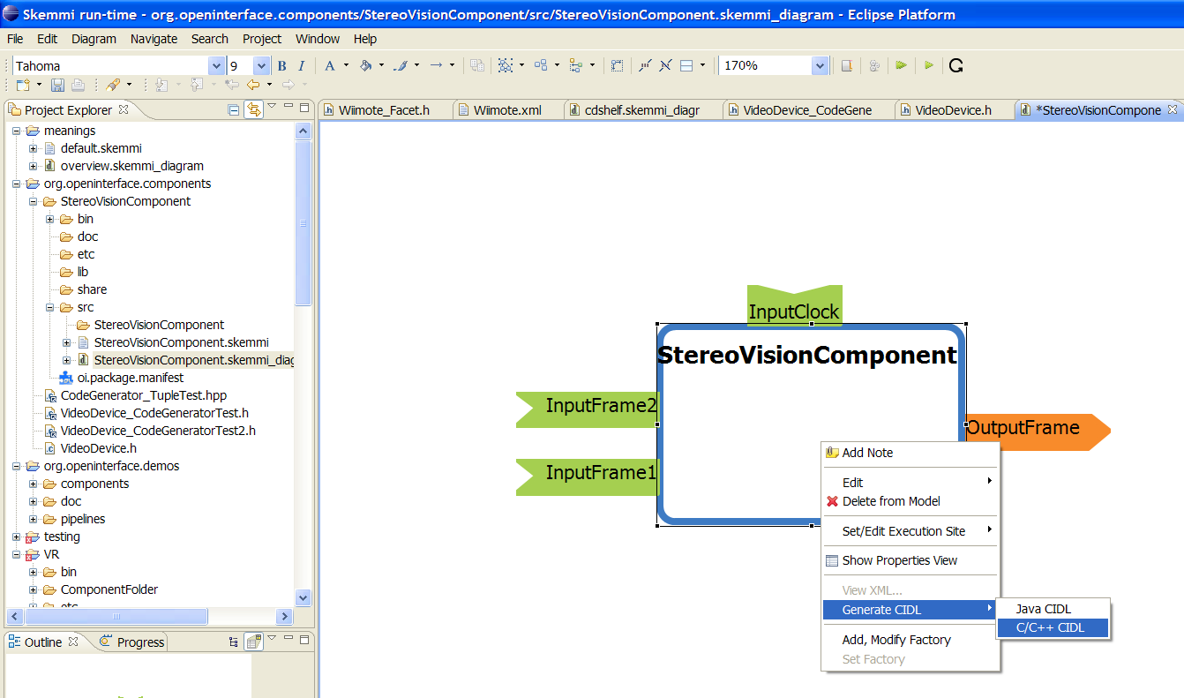
SKEMMI: Component design level
Re-design of existing components
Design of new components

Slide 22
OpenInterface Design Platform: SKEMMI
Interaction Design Exploration
Dataflow programming
Design-by-example
Unifies sketch and implementation design levels
Integrated support for component implementation
Audio and text annotation
Runtime manipulation of pipelines
Integration with component repository

Slide 23
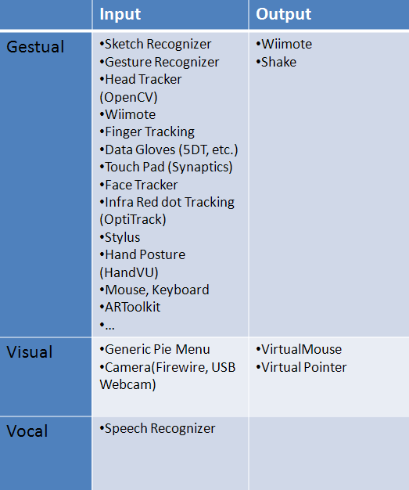
Public Components Database (incomplete)
https://forge.openinterface.org

Slide 24
Performance of OpenInterface Workbench
OpenInterface Runtime: OIKernel
~5% Memory overhead
~3% CPU overhead
Manual component integration
~one hour
OpenInterface Design Platform: SKEMMI
Initial Experts Evaluation (6 Designer and Programmers)
Audio Annotation
Multi-level design
Component tailoring
Debug --
Advanced pipeline visual complexity --

Slide 25
Future Work
Interaction Task design-level (on-going)
Reusing existing task-model plug-in (from DAI-Labor)
Advanced debugging and performance analysis tools
High and low level logging
Step-by-step
Process monitoring
Device and interaction evaluation tools
[Schedlbauer et al.]
Formal user evaluation

Slide 26
www.openinterface.org

Slide 27
Questions?

Slide 28
Runtime, Pipeline
Pipeline description language to setup a running application.
Rewiring through API and connectors

Slide 29
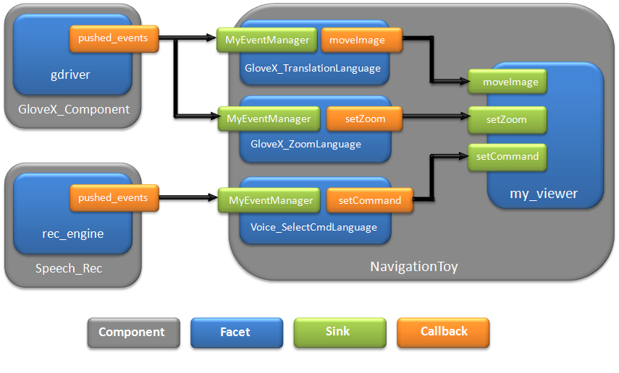
Runtime, Pipeline

Slide 30
Pipeline configuration
Components
Remote or local
Connections
Simple direct link(cross-language method call)‏
Multicast, Publisher/Subscriber
(Temporal) Fusion
Rewiring
Custom (plugin)‏
Execution
Initialization
Threaded execution

Slide 31
OIRuntime Current Features
Supported Platform
Linux and Windows and Mac OS/X
Online component repository: https://forge.openinterface.org
Supported Languages
Java,C/C++,Matlab, .NET
Description languages&API
CIDL, interfaces description
PDCL, pipeline description
Runtime API
Temporal Fusion components
Simple components distribution
Users and developers Documentation.

Slide 32
OIDesign-Time Current Features
Supported Platform
Eclipse (Linux and Windows and Mac OS/X)
Component Design
Dynamic composition
Runtime debugging and evaluation

Slide 33
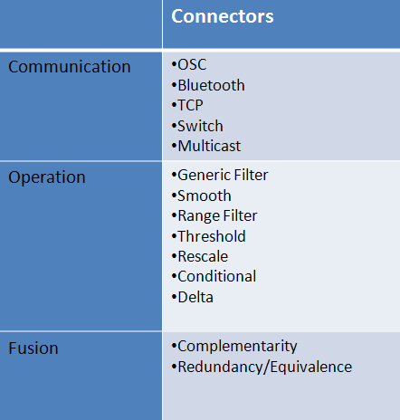
Public Connectors Database (incomplete)

Slide 34
Pipeline
Select
CDShelf
Navigate
Java
B
Wiimote
MP3 Player
C++
acc
Event
Java
SetVolume
Volume Control
A
-
+
setLevel
C#

Slide 35
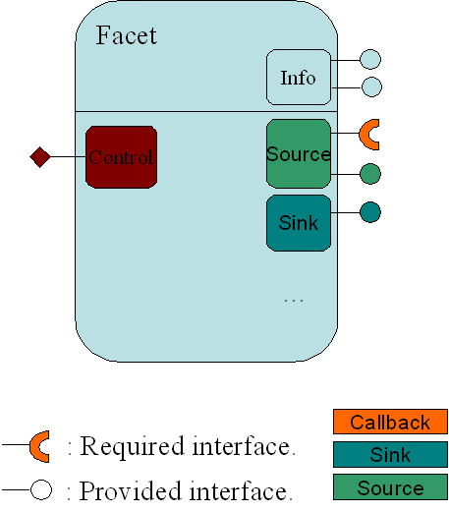
Component: OI point of view
Facets can be seen as services provided by a component
A Component is a set of facets
This is how any external software is seen by the Kernel

Slide 36
OpenInterface CIDL
Designed to describe Independent and Reusable component.
(Intentionally)Not as expressive as WSDL (etc.)‏
Restricted on purpose to cover common attributes of various programming languages
Describes component interface using a programming language independent description(XML).
Not intended to be written by human (but must be readable more debug or customization)
Generation tools are available though‏

Slide 37
Exported/Imported IO
Components only declare communication interface
Enforce the requirement for « independence »
Export IO (functions, etc…) when providing a functionality
Display an image, …
Import IO for requesting a functionality
An event handler

Slide 38
Dynamic Pipeline
Connect and disconnect components at runtime
Cannot force a device/component to implement disconnection logic
Logic will be provided within platform
Adapter vs. embedded in proxies, shared access issue
Switch
Callback
Callback
Mouse
Disconnectable mouse

Slide 39
Runtime API
Simple XML oriented API to control a pipeline from a third-party software
C++ API
Bindings to a wide range of languages using SWIG
Java, Matlab, JavaScript, Perl, Tk, Python, etc.
Java bindings used by SKEMMI
Networked pipeline control
API Overview
Proxies Generator API
Generate & compile proxies
Kernel Registry API
Install, Register Components
Pipeline API
Pipeline runtime
Debug API
Debug and error information retrieval

Slide 40
Current Results
Flexible Adapter/Connector model
For extending the pipeline semantic
Captures the generic aspect of highly reusable component
Operation defined on a set of data, rather than fixed parameters
Example: Switch, Bus, Stream, Data filter, Synchronization, Fusion
Dynamic Pipeline
Use the above model to implement a highly reusable switch adapter
API provided
Component Generator and Packager
Standard storage of OI Component
Automatic Component installation

