Slide 1


Flippable User Interfaces for Internationalization
Iyad Khaddam and Jean Vanderdonckt
LILAB – Louvain Interaction Laboratory
Université catholique de Louvain
Belgium
Pisa, June 13th - 16th, 2011

Slide 2
Content
Internationalization
Flippable UI: An Interaction technique To language adaptation
Flippable UI: Design Principles
Tool Architecture
Demo

Slide 3
Internationalization
Localization
Globalization
Software
Software
EU
ASIA
ME
EU
ASIA
ME
FR
JP
AR
FR
JP
AR
Notes:
Localization is the process of adapting software to culture, continent, country, region or a set of them. The software copy is created for each adaptation. Changes can be just for one copy (colors), or can be unified for the different copies (orange).
Globalization is the process of creating UI the accommodates the common ground of largest possible audience from different cultures, continents, countries, regions. This means one single UI.

Slide 4
Internationalization
User Preferences: End user can adapt the UI (Adaptability)
Localization factors:
  Color
  Format
  Metaphor
  Screen
  Layout
  Image
  Structure
  Language
  …
Adaptation logic will handle culture awareness (Adaptive)

Slide 5
Internationalization
Language:
A critical localization factor.
Translation of content, layout adaptation to reading direction
Other less critical lexical aspects: color, font, size.
Other high-level, hard to predict aspects: metaphors, organization.

Slide 6
Content
Internationalization
Flippable UI: An Interaction technique To language adaptation
Flippable UI: Design Principles
Tool Architecture
Demo

Slide 7
Flippable UI
An Interaction technique To language adaptation.
3 Fields of research:
  Adaptation to Cultural background:
  technical adaptations (alphabet, character set), national Adaptation (add nation-relevant information), cultural adaptation (habits, attitude, conventions and meanings).

Slide 8
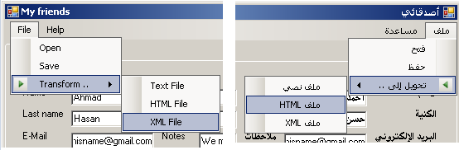

Slide 9
Flippable UI
An Interaction technique To language adaptation.
3 Fields of research:
  Adaptation to Cultural background
  Interaction Techniques:
  Flipping a page of a book.
  Increase end user’s subjective satisfaction and naturalness of interaction.

Slide 10
Flippable UI
An Interaction technique To language adaptation.
3 Fields of research:
  Adaptation to Cultural background
  Interaction Techniques
  Animated Transitions:
  Convey the change of display

Slide 11
Content
Internationalization
Flippable UI: An Interaction technique To language adaptation
Flippable UI: Design Principles
Tool Architecture
Demo

Slide 12
Flippable UI: Design Principles
Principles:
  #1: Provide Handles for direct flipping

Slide 14
Flippable UI: Design Principles
Principles:
  #1: Provide Handles for direct flipping
  #2: Perform Adaptation according to flipping

Slide 15
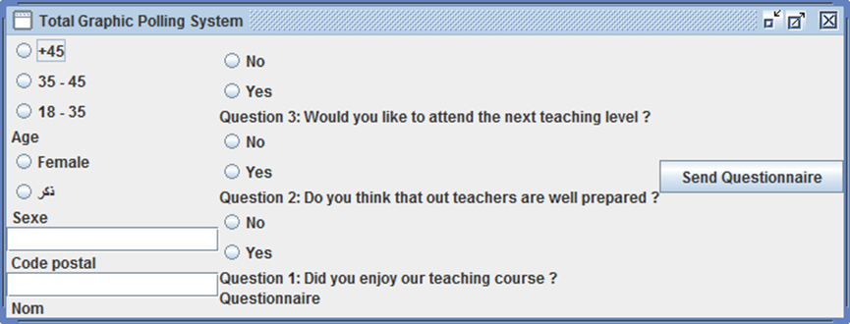
Left To Right, Top To Bottom
Right To Left, Top To Bottom
Left To Right, Bottom To Top
Right To left, Bottom To Top

Slide 16
Flippable UI: Design Principles
Principles:
  #1: Provide Handles for direct flipping
  #2: Perform Adaptation according to flipping
  #3: Ensure smooth transition for adaptation

Slide 18
Content
Internationalization
Flippable UI: An Interaction technique To language adaptation
Flippable UI: Design Principles
Tool Architecture
Demo

Slide 20
Content
Internationalization
Flippable UI: An Interaction technique To language adaptation
Flippable UI: Design Principles
Tool Architecture
Demo

Slide 21

Acknowledgments
LILAB

Slide 22
Questions?
Thank You.
Iyad Khaddam (iyad.khaddam@student.uclouvain.be) and Jean Vanderdonckt (jean.vanderdonckt@uclouvain.be)

