Slide 1
Showing User Interface Adaptivity by Animated Transitions
Charles-Eric Dessart, Vivian Genaro Motti, Jean Vanderdonckt
Louvain Interaction Lab
Université catholique de Louvain
www.lilab.be
{Vivian.GenaroMotti, Jean.Vanderdonckt}@uclouvain.be

Slide 2
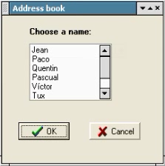
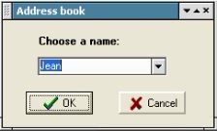
The problem
What happens when a GUI is adapted?
Nothing between
End user disruption
Cognitive perturbation

Slide 3
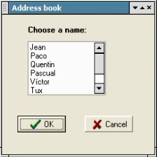
Potential solution
Use animated transition

Slide 4
Potential solution
Use animated transition to ensure a smooth transition between the initial UI and the final (adapted) UI
Backward animation
Forward animation
Skip
Break
Initial UI before adaptation
Transient UI being adapted
Transient UI being adapted
Transient UI being adapted
Final UI after adaptation
…
…
Return
i^{th} adaptation
operation
Restart
Transition time for
i^{th} adaptation operation
Total transition time for transition scenario

Slide 5
Related work on Animated Transitions
Use animation
  to draw the audience's attention to a single element out of several, or to alert people to updated information
  to indicate the function of a hot spot (for example, a moving hiker could indicate the current location of Mungo Park adventurers)
  to draw attention to changes from one state to another (for example, animated map area changes could indicate deforestation over time).
  to demonstrate navigation in a particular direction (for example, a simple page-flip animation could easily distinguish forward from backward movement
  to create icons for actions that can't be adequately expressed with a flat, static picture
  Permanently moving (looping) animations should rarely be included on a Web page because they will make it very hard for your audience to concentrate on other page content. Research suggests that movement in our peripheral vision can dominate our attention. Research also indicates that moving text is harder to read than static text
[Baecker, Small, Mander ,2001]

Slide 6
Related work on Animated Transitions
A number of visual effects are available. For global changes to the entire screen these are the cut, fade in and fade out, dissolve, wipe, overlap, and multiple exposure. Locally, within a region of the screen, pop on and pop off, pull down and pull up, flip, and spin can be used.
Note: Visual effects should be used carefully. When employed too often, they will be fatiguing or even annoying or distressing to the user.
Animation covers a range of creative techniques and media, from three-dimensional figures captured on film to wholly computer-generated images. Typical for animation is the rapid and continuous change of the graphical objects making up the animation
The dynamic of animation can be used to direct the user's attention to a specific point.
  Time and movement can be visualised by animation.
  Animation can be used to show an invisible process. It enables the simulation of processes which are too dangerous or difficult to perform directly.
  Animation of structures is useful for the exploration of complex environments.
  Animation can be used for gradual illustration of a content.
  Complex contents (e.g. process, function) can be simplified by animation.
  Animation can be used to show the reaction on an interaction.
[Baecker, Small, Mander ,2001]

Slide 7
How to do an animated transition?
Design:
  An animation sequence should be short.
  The direction of movement influence the meaning of the information conveyed.
  Animation should be supported by sound.
  Animation techniques for global changes to the entire screen are cut, fade in and fade out, dissolve, wipe, overlap, and multiple exposure.
  Animation techniques for local changes within a region of the screen are pop on and pop off, pull down and pull up, flip, and spin.
[Ware,2004]

Slide 8
How to do an animated transition?
Interaction:
  The user should be able to interrupt the animation sequence at any time
  The user should be able to repeat parts of the animation
  The user should be able to control the animation playing speed (e.g. fast forward)
  The user may manipulate an animated object

Slide 9
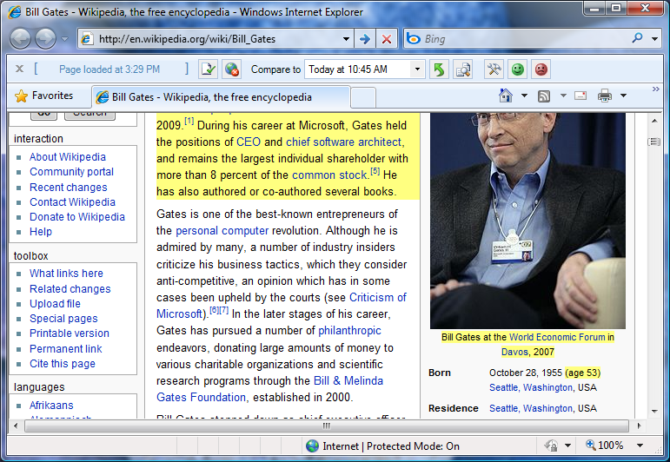
Related work
DiffIE
New to you
Always on
Non-intrusive
Changes to page since your last visit
In-situ
[Teevan, Dumais, Liebling, Hughes,2010]

Slide 10
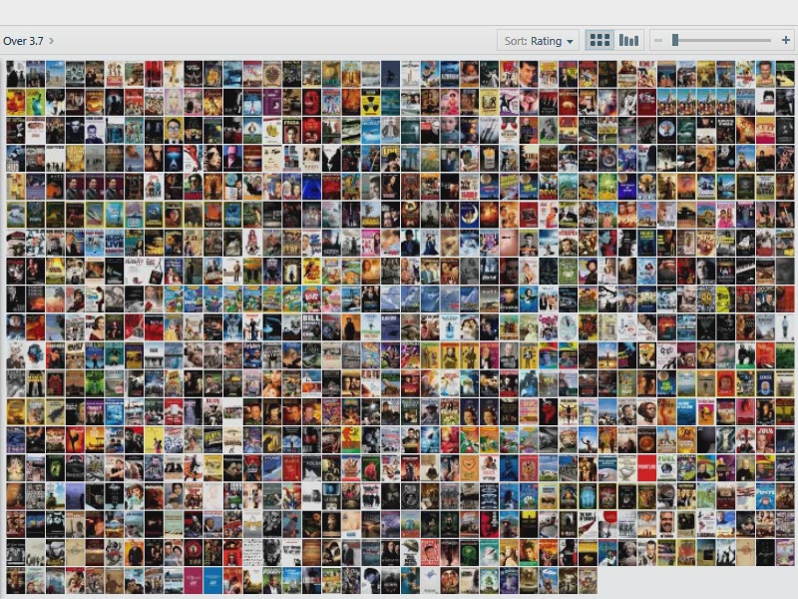
Related Work
PivotViewer
[www.silverlight.net/learn/pivotviewer/]

Slide 11
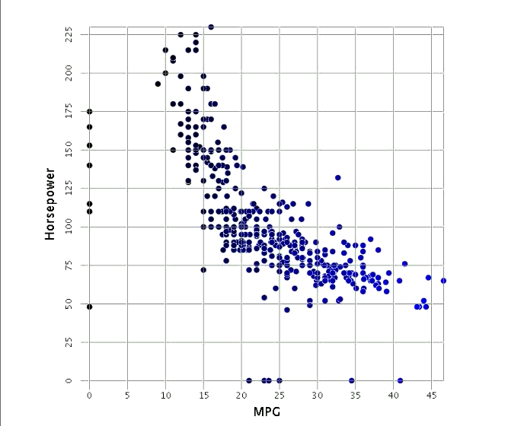
Related Work
[Elmqvist et al., 2008]

Slide 12
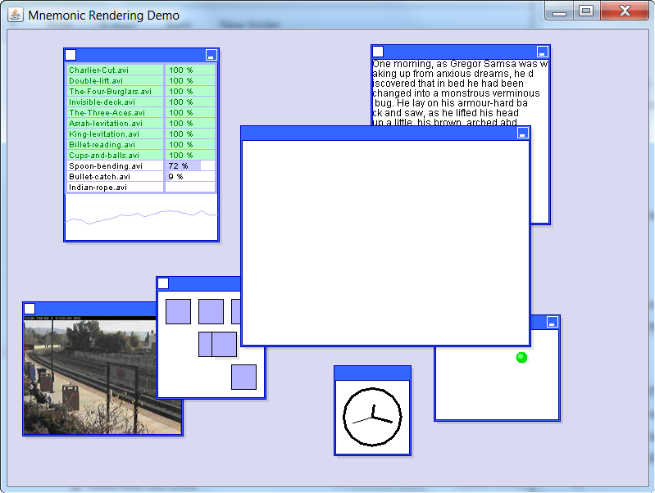
Related Work
Mnemonic rendering
[Bezerianos, Dragicevic, Balakrishnan, 2008]

Slide 13
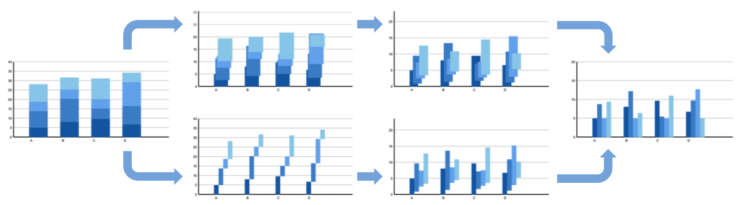
Related Work
Spatial Aspects
Initial Image
Final Image
?
?
[Heer, Robertson, 2007]

Slide 14
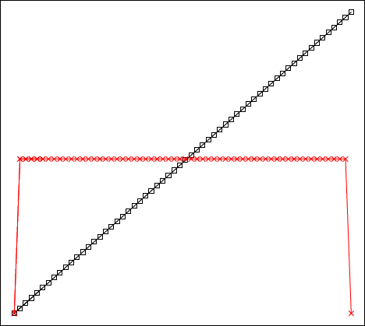
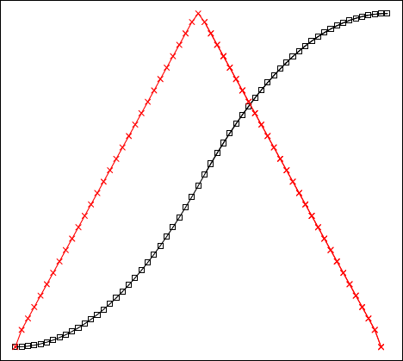
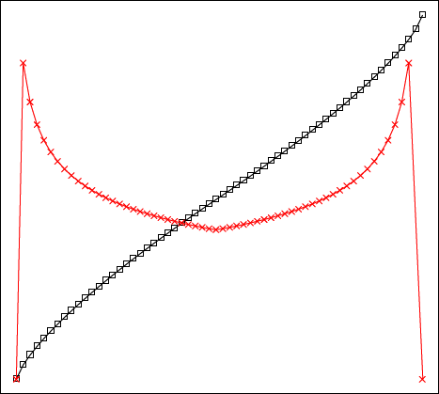
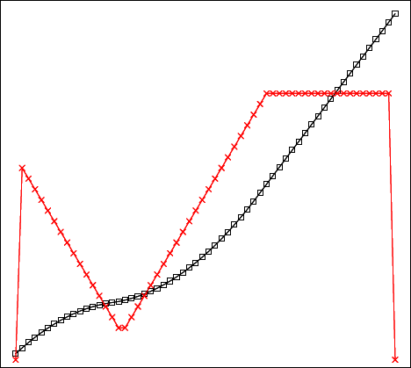
Related Work
Temporal Aspects
  Slow In/Slow Out is better in all regards
  Adaptive speed performs best when complexity found at endpoints
Slow In
Slow Out
Fast In
Fast Out
Constant
Adaptive
Fast
Fast
Slow
→
t
Speed
Slow
time →
[Dragicevic, Bezerianos, Javed, Elmqvist, Fekete, 2011]

Slide 15
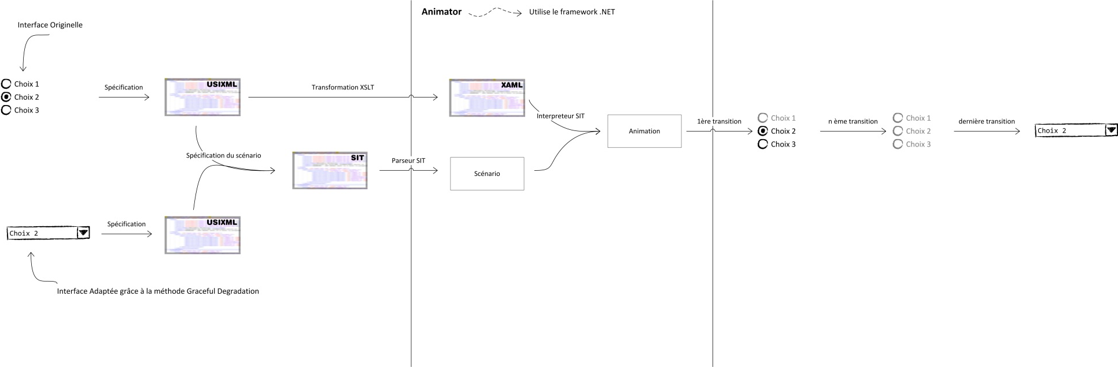
Architecture of the system
Flow

Slide 16
Adaptation operatons
Resizing operations: are aimed at changing a widget size in order to optimize screen real estate, aesthetics, and visual design
  For instance, an edit field could be enlarged/shortened in height and/or length to take less space and to be subject to various alignments.
Relocating operations: are aimed at changing a widget location in order to reduce the screen space consumption
  For instance, “Ok”, “Cancel”, and “Help” push buttons could be relocated to the bottom of a dialog box.
Widget transformations: are aimed at replacing one or a group of widgets by another widget or another group of widgets ensuring the same task, perhaps with some degradation
  For instance, an accumulator that consists of list boxes with possible values and chosen values could be replaced by a multi-selection list, which could be in turn replaced by a multi-selection drop-down list.
Image transformations: are aimed at changing the size, surface, and quality of an image in order to accommodate the constraints imposed by the new context of use, namely the display/platforms constraints.
Splitting rules: are aimed at dividing one or a group of widgets into one or several other groups of widgets that will be displayed separately. For instance, a dialog box is split into two tabs in a tabbed dialog box

Slide 17
How to associate an animated transition to an adaptation operation
Adaptation operation | Animation family, animated transition with justification
SET that modifies the length of a UI element into a larger value (absolute or relative) | Horizontal scroll/wipe from left (F1): this operation minimizes the visual change since only the right part resulting from the enlarging is changing. For edit fields, for instance, this is particularly appropriate because it gives the feeling that the field is really expanding
SET that modifies the height of a UI element into a larger value (absolute or relative) | Vertical scroll/wipe from bottom (F1): this operation minimizes the visual change since only the right part resulting from the enlarging is changing
DISPLAY that displays a new UI element at a certain position | Uncover (F3), Box out (F4), or Iris open (F4): these operations all induce a progressive display of a new UI element at once, thus creating the illusion that it is coming from the empty.
UNDISPLAY that undisplays a new UI element at a certain position | Cover (F3), Box in (F4), or Iris close (F4): these operations all induce a progressive disappearing of a existing UI element at once, thus creating the illusion that it is shrunk to an empty/white region.
REPLACE that substitutes a UI element by another one | Barn door open (F2): this operation affects the entire visual aspect of the previous one and the new one.
DISTRIBUTE that computes a distribution of a series of UI Elements into a series of UI Containers | Bam door open (F2) or Iris open (F4): these operations enable the visualization of an entire group at once, instead of showing every little display change individually
MOVE that moves a UI element to a new location indicated by its coordinates x and y, possibly in a fixed amount of steps | Ideally, the UI movement could be represented by an animation depicting the movement itself. But practically, this would induce a very long animation, thus increasing again the lag. Therefore, we preferred to adopt a disappearing of the UI element from its original location and an appearing to its target location. Depending on these locations, vertical, horizontal or diagonal replacements (F1) are selected. For instance, when a UI element disappears from a top left location to a bottom right location, a diagonal replacement from top/­bottom left corner is selected, thus creating the illusion that the element moves from one location to another. If a UI element should only move linearly, that is either vertically or horizontally, then a vertical or horizontal scroll is selected instead according to the movement direction, thus creating again the illusion of object movement.

Slide 18
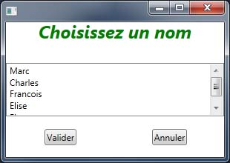
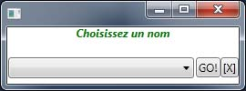
Example #1
SUBSTITUTE #listbox_component_19 BY @ComboBox IN #box3 ("newComboBox") WHERE ROW 0, COL 0;
CONTRACT #newComboBox OF 90 50;
CHANGEBOX #button_1 TO #box3 WHERE ROW 0, COLINSERT 1;
SET #button_1->Content TO "GO!";
CHANGEBOX #button_0 TO #box3 WHERE ROW 0, COLINSERT 2;
SET #button_0->Content TO "[X]";
SET #label_0->FontSize TO 12;
CONTRACT #window_0 OF 40 120;

Slide 19
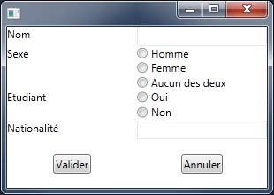
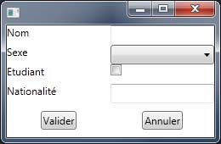
Example #2
SUBSTITUTE %SelectRadioGroup "groupeType" BY @ComboBox IN #box110 ("newComboBoxType") WHERE ROW 0, COL 0;
SUBSTITUTE %SelectRadioGroup "groupeEtudiant" BY @CheckBox IN #box120 ("newCheckBoxEtudiant") WHERE ROW 0, COL 0;
CONTRACT #window_0 OF 50 50;
CHANGEROWS #box1 TO 25 25 25 25;

Slide 20
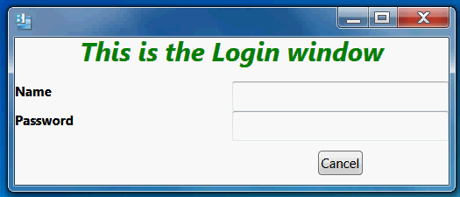
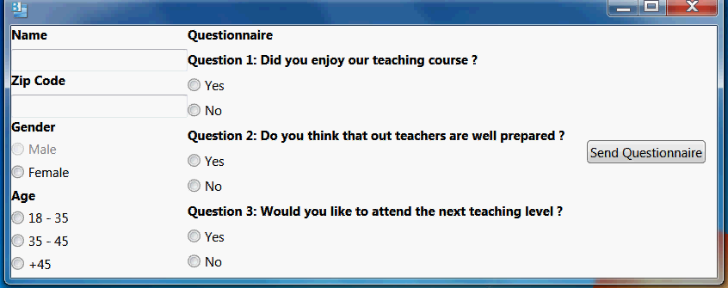
User study
Design setup
20 participants
3 transition scenarios
12 questions on a
5-point Likert scale
I liked the animation process
I liked the animation interface
I preferred the animation over no animation at all
The animation is easy to use
The animation is easy to control
The animation is easy to understand
The animation is easy to follow
The animation is easy to progress (forward animation)
The animation is easy to revert (backward animation)
The animation represents the adaptation
The animation is fast
I would recommend using the animation
(1 = strongly disagree,
five = strongly agree)

Slide 21
User study
Results and discussion
I liked the animation process
I liked the animation interface
I preferred the animation over no animation at all
The animation is easy to use
The animation is easy to control
The animation is easy to understand
The animation is easy to follow
The animation is easy to progress (forward animation)
The animation is easy to revert (backward animation)
The animation represents the adaptation
The animation is fast
I would recommend using the animation
Notes:
Statement #1: nobody had a negative feeling about having an animation of the transition scenario (neither orange nor red areas).
Statement #2: some participants were concerned about the Animator UI (some orange area)
Statement #3: follows a similar trend. Participants appear to show a preference for the animation over no animation at all.
Statement #4: the animation should always come automatically, participants seemed to appreciate the animation effects, but do not appreciate the time consumed by the animation, especially when the total animation time is long.
Statement #5: users prefer to keep control over the transition scenario with user actions, but it turns out that they do not know exactly what user action to undertake since they do not know what the next adaptation operations are.
Statement #8: Forward animation is perceived in a better way that the backward animation (statement #9).
Statement #12: verifies the results of the global perception responses by asking the participants to respond to a recommendation statement: three quarters of the participants were confident in recommending the animation transition as a mechanism for showing the adaptation. These results are more moderate than the initial statements.

Slide 22
Conclusion
Animated transition is a viable approach provided that
  Appropriate animated transitions are adequately mapped onto adaptation operations
  Time and space are properly regulated
To work on:
  Minimize the lag effect that is still there
  Group similar, small adaptation operations

Slide 23


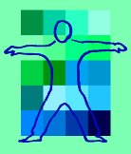
Thank you very much!
User Interface eXtensible Markup Language
http://www.usixml.org
FP7 Serenoa project
http://www.serenoa-fp7.eu
For more information and downloading,
http://www.lilab.be

