Slide 1
Methodology for the Development of Vocal User Interfaces
David Céspedes-Hernández
Juan Manuel González-Calleros
Josefina Guerrero-García
Jean Vanderdonckt
Liliana Rodríguez-Vizzuett
October 4th, 2012

Slide 2
Why Vocal Interfaces?
Universal accesibility
Easy software development for non-experts
User centered vocal interaction
Allow natural interaction

Slide 3
Objective
The objective for sample paper is to establish a methodology and to describe a set of rules that might be used for developing a software tool to generate code for multiplatform vocal User Interfaces from models.

Slide 4
State of the art
The evolution of interactive systems reached a point where today’s research is centered in the development of NUIs, this is evident from the observation of tools and new technologies offered in the market.

Slide 5
What is already done?
Speech Recognition
Speech Synthesis
New languages
Platforms that support vocal interaction
Methodologies for other interaction modalities

Slide 6
Methodology
Understand Model Driven Approach (MDA)
Establish the methodology
Enumerate the elements that conform the methodology

Slide 7
MDA
Models
Language
Software
Approach (Cameleon Reference Framework)

Slide 8
Cameleon Reference Framework
Tasks & Concepts
Reification
Abstraction
Abstract Interface
Reification
Abstraction
Concrete Interface
Reification
Abstraction
Final Interface

Slide 9
Establishing the methodology (1)
The first step consists on compare the elements that form each one of them.
Voice-XML | XHTML + Voice | Kinect with speech synthesizer
<audio> | <audio> | Speak()
<prompt> | <prompt> | Prompt()+Speak()
<record> | <record> | Start()+Stop()
<field> | <field> | Start()+Stop()

Slide 10
Establishing the methodology (2)
The second step consists of detecting the main components and analyzing their function, as in step 1, when a tool does not support a function qualified as important in an explicit way, it was necessary to join two or more methods or attributes for performing and establishing the bases for the methodology.

Slide 11
Establishing the methodology (3)
Voice-XML | XHTML + Voice | Kinect with speech synthesizer | Function
<audio> | <audio> | Speak() | Synthesizes Audio form a source
<prompt> | <prompt> | Prompt()+Speak() | Synthesizes a given message
<record> | <record> | Start()+Stop() | Records the audio input
<field> | <field> | Start()+Stop() | Waits for the user´s audio input

Slide 12
Establishing the methodology (4)
Once the comparison and the analysis are made, it is possible to propose a model that represents how vocal interaction could be applied and how vocal UIs can be developed by having the tasks’ model.

Slide 13
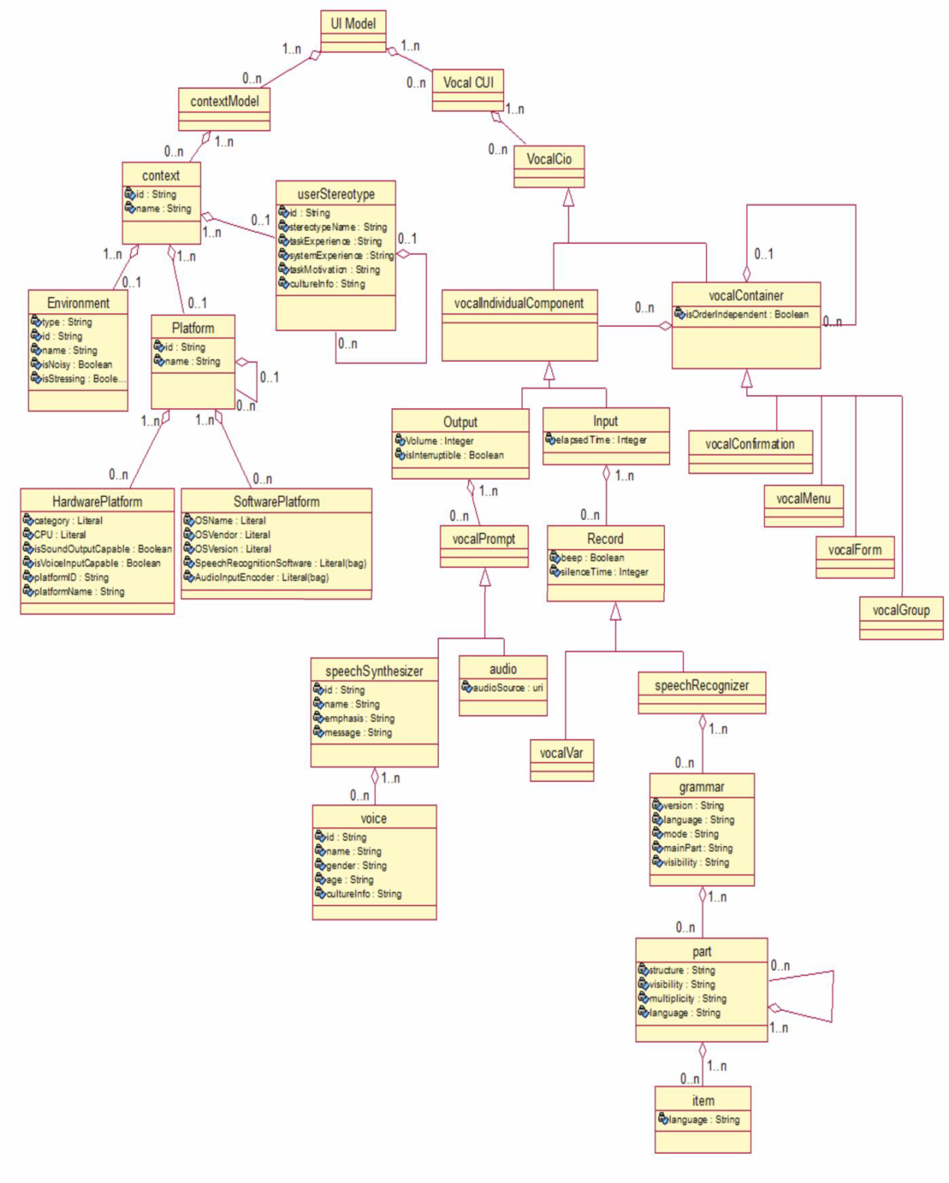

Slide 17
Case studies (1)
As a test for the proposed model and for a better understanding of it, graphical examples representing dialogs between the system (S) and the user (U) are shown:

Slide 18
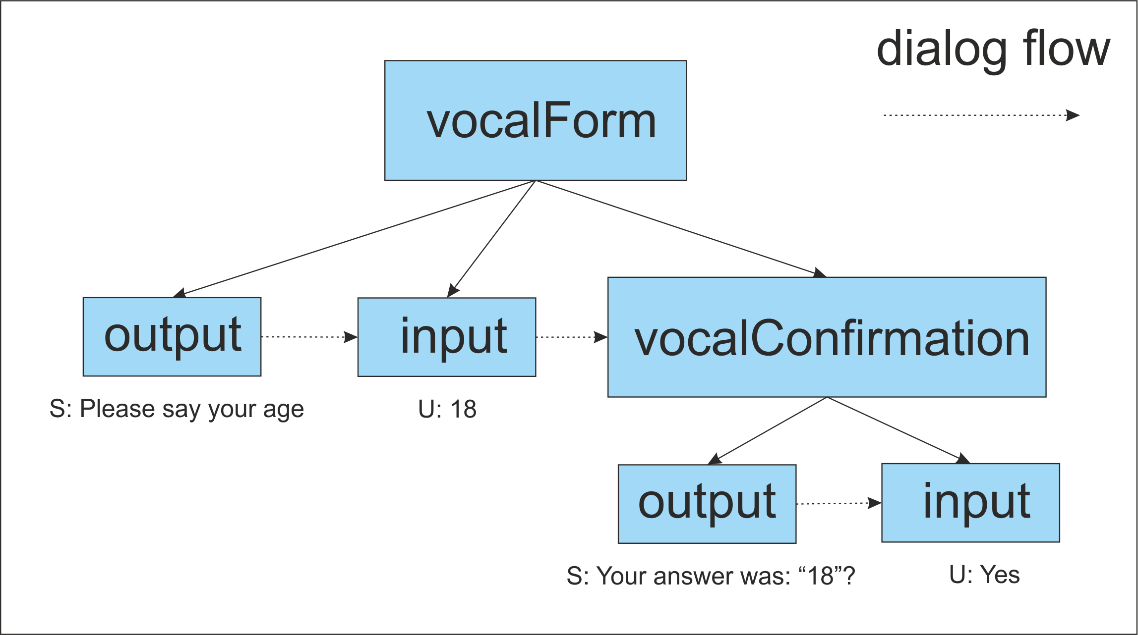
Case studies (2)

Slide 19
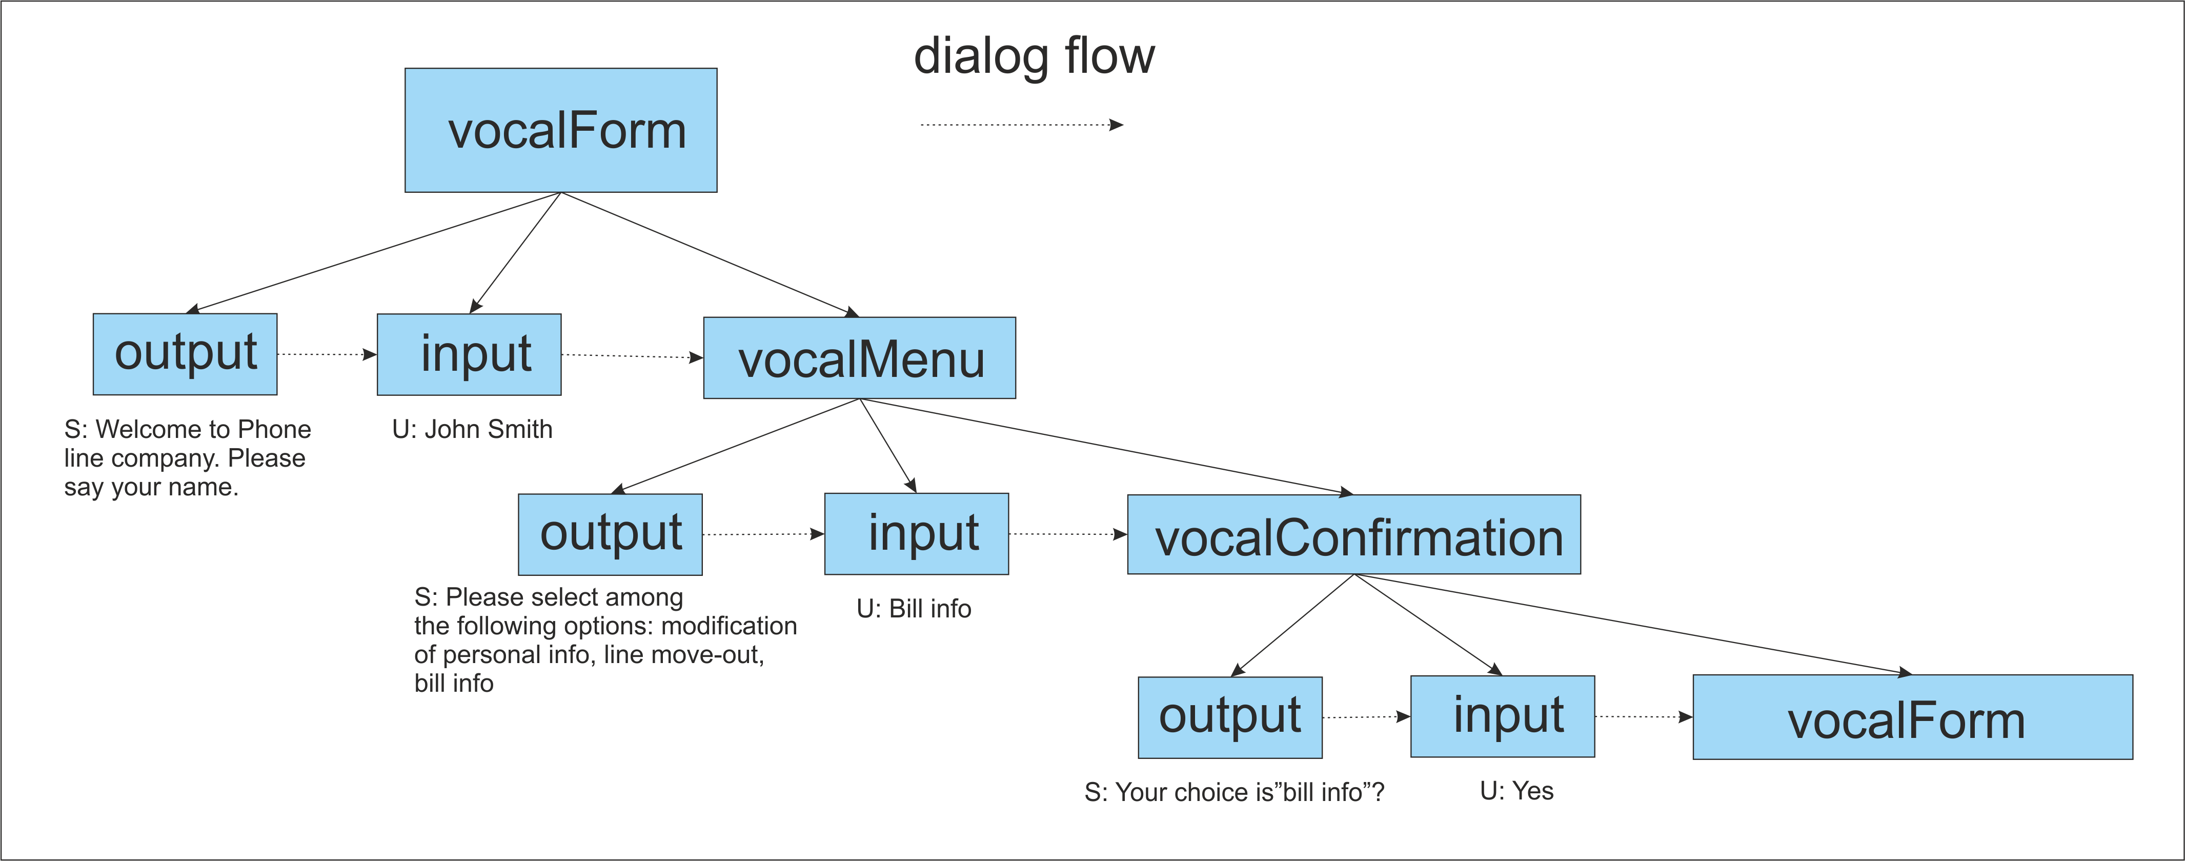
Case studies (3)

Slide 20
Conclusions
In this paper, the establishment of the methodology for development of vocal UI settled the bases for a software tool so it might be possible for designers and non expert developers in the vocal UI area to design and create this kind of interfaces by only abstracting the components needed for it. Along with the transformation rules, the developer can do migration of already existing projects from one of the analyzed languages to one another or apply reverse engineering for this purpose.

Slide 21
Near future
In the near future, the objective is to implement the software tool that supports the model and transformation rules as well as apply a reverse engineering process to existing applications and recreate them for a multiplatform context.

Slide 22
Thank you for the attention!
We gratefully acknowledge the support of the ITEA2 Call 3 UsiXML project under reference 20080026, the Mexican PROMEP/103.5/12/4367 project, and the Computer Sciences Faculty of the University of Puebla.

Slide 23
References
[1] Calvary, G., Coutaz, J., Thevenin, D., Limbourg, Q., Bouillon, L., Vanderdonckt, J.: A Unifying Reference Framework for Multi-Target User Interfaces. Interacting with Computers, Vol. 15, No. 3, June 2003 289–308.
[2] Cuppens, E., Raymaekers, Ch., Coninx, K, A Model-Based Design Process for Interactive Virtual Environments, Proc. of Int. Workshop on Design, Specification, and Verification of Interactive Systems DSV-IS'2005 (Newcastle upon Tyne, 13-15 July 2005), Lecture Notes in Computer Science, Vol. 3941, Springer, Berlin, 2005, pp. 225-236.
[3] De Boeck, J., Raymaekers, C., Coninx, K. A Tool Supporting Model Based User Interface Design in 3D Virtual Enviroments.GRAPP 2008: 367-375
[4] Flor, T.: ”Experiences with Adaptive User and Learning Models in eLearning Systems for Higher Education” In: Journal of Universal Computer Science, volume 10 (2004)
[5] González-Calleros J., Vanderdonckt J., Muñoz Arteaga J., A Method For Developing 3D User Interfaces Of Information Systems. CADUI 2006: 85-100
[6] Guerrero, J., Vanderdonckt, J., Gonzalez Calleros, J.M., FlowiXML: a Step towards Designing Workflow Management Systems, Journal of Web Engineering, Vol. 4, No. 2, 2008, pp. 163-182.
[7] Guerrero-García, J., González-Calleros, J.M., Vanderdonckt, J., Muñoz-Arteaga, J. A Theoretical Survey of User Interface Description Languages: Preliminary Results. In Proc. of LA-Web/¬CLIHC'2009 (Merida, November 9-11, 2009), IEEE Computer Society Press, Los Alamitos, 2009, pp. 36-43.
[8] Laurent Bouillon, Reverse Engineering of Declarative User Interfaces, Ph.D. thesis, Université catholique de Louvain, Louvain-la-Neuve, Belgium, 21 June 2006.
[9] Limbourg, Q., Vanderdonckt, J., Michotte, B., Bouillon, L., Lopez, V.: UsiXML: a Language Supporting Multi-Path Development of User Interfaces. In: Proc. of 9th IFIP Working Conference on Engineering for Human-Computer Interaction jointly with 11th Int. Workshop on Design, Specification, and Verification of Interactive Systems EHCIDSVIS’2004 (Hamburg, July 11-13, 2004). Springer-Verlag, Berlin (2005).
[10] Medina, J-L., Chessa, S., Front, A., A Survey of Model Driven Engineering Tools for User Interface Design Proceedings of 6th International Workshop on Task Models and Diagrams TAMODIA’2007 (November 7-9, 2007), Springer, Berlin.

Slide 24
[11] Molina, J.P., Vanderdonckt, J., González, P., Fernández-Caballero, A., Lozano, M.D., Rapid Prototying of Distributed User Interfaces, Proc. of 6th Int. Conf. on Computer-Aided Design of User Interfaces CADUI'2006 (Bucharest, 6-8 June 2006), Chapter 12, Springer-Verlag, Berlin, 2006, pp. 151-166.
[12] Pellens, B., Bille, W., De Troyer, O., Kleinermann, F.: "VR-WISE: A Conceptual Modelling Approach For Virtual Environments", CD-ROM Proceedings of the Methods and Tools for Virtual Reality (MeTo-VR 2005) workshop, Gent, Belgium (2005)
[13] Schaefer, R., Steffen, B., Wolfgang, M., Task Models and Diagrams for User Interface Design, Proceedings of 5th International Workshop, TAMODIA'2006 (Hasselt, Belgium, October 2006), Lecture Notes in Computer Science, Vol. 4385, Springer Verlag Berlin, 2006.
[14] Stanciulescu, A., A Methodology for Developing Multimodal User Interfaces of Information Systems, Ph.D. thesis, Université catholique de Louvain, Louvain, Belgique, 2008.
[15] Stanciulescu, A., Limbourg, Q., Vanderdonckt, J., Michotte, B., Montero, F., A Transformational Approach for Developing Multimodal Web User Interfaces based on UsiXML, Working Paper IAG n°06/02, Université catholique de Louvain, Louvain School of Management, Louvain-la-Neuve, 2006.
[16] Stanciulescu, A., Vanderdonckt, J., Macq, B., Automatic Usability Assessment of Multimodal User Interfaces Based on Ergonomic Rules, Proc. of E-Mode Joint Workshop on Multimodal Interfaces 2007 (Paris, 27-28 September 2007), S. Praud (ed.).
[17] Thevenin, D., Adaptation en Interaction Homme-Machine: le cas de la Plasticité, Ph.D. thesis, Université Joseph Fourrier, Grenoble, France, 2001. Available online: http://iihm.imag.fr/publs/2001.
[18] Vanderdonckt, J., Model-Driven Engineering of User Interfaces: Promises, Successes, Failures, and Challenges. . In S. Buraga and I. Juvina, editors, Proc. of 5th Annual Romanian Conf. on Human-Computer Interaction ROCHI'2008, (Iasi, 18--19 September 2008), pages 1--10. Matrix ROM, Bucarest, 2008.
[19] Vanderdonckt, J., A MDA-Compliant Environment for Developing User Interfaces of Information Systems, Proc. of 17th Conf. on Advanced Information Systems Engineering CAiSE'05 (Porto, 13-17 June 2005), O. Pastor & J. Falcão e Cunha (eds.), Lecture Notes in Computer Science, Vol. 3520, Springer-Verlag, Berlin, 2005, pp. 16-31.
[20] Vanderdonckt,J., Calvary, G., Coutaz, J., Stanciulescu, A., Multimodality for Plastic User Interfaces: Models, Methods, and Principles, in “Multimodal user interfaces: from signals to interaction”, D. Tzovaras (ed.), Chap. 3, Lecture Notes in Electrical Engineering, Springer-Verlag, Berlin, 2007, pp. 79-105..

