Slide 1

Designing Graphical User Interfaces
Integrating Gestures
http://www.slideshare.net/jeanvdd/designing-graphical-user-interfaces-integrating-gestures
François Beuvens and Jean Vanderdonckt
francois.beuvens@uclouvain.be
Researcher at LiLab, http://www.lilab.be
Université catholique de Louvain (Belgium)

Slide 2
Roadmap
Context
A method for designing graphical user interfaces integrating gestures
Underlying model
Supporting tool
Ongoing and future works

Slide 3
Roadmap
Context
A method for designing graphical user interfaces integrating gestures
Underlying model
Supporting tool
Ongoing and future works

Slide 4



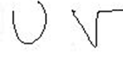
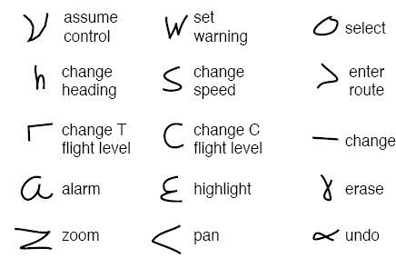
Motivations for pen-based gestures
Gestures are quick to learn and easy to reproduce
Stylus amplifies the hand movement and is comfortable to use
Offers high precision
Gives a direct output and visual feedback
Allows recording meta-data
  Pressure
  Inclination
  Orientation
  ...

Slide 5
Motivations for gesture recognition integration in UI development
Many existing datasets and algorithms
  Developers have little or no time to investigate all these different algorithms, datasets and variations
Some platforms for gesture recognition are helpful, yet hard for algorithm selection
Lack of availability
Lack of extensibility and flexibility

Slide 6
Roadmap
Context
A method for designing graphical user interfaces integrating gestures
Underlying model
Supporting tool
Ongoing and future works

Slide 7
UI creation process
4 categories of contributors
  Engineer/architect: requirements analyser
  Designer: in charge of aesthetics
  Gesture specialist: devoted to recognition mechanisms
  Programmer: coder of the UI
Work together around a tool/system

Slide 8
Method: definition of 3 roles
Interface Users (IU)
  End users of the interface
System Users (SU)
  Use the system to produce the user interface
System Feeders (SF)
  Feed the system with knowledge

Slide 9
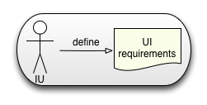
Method
Interface Users define user interface requirements.

Slide 10
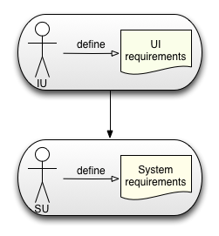
Method
Based on the UI requirements, System Users define system requirements.

Slide 11
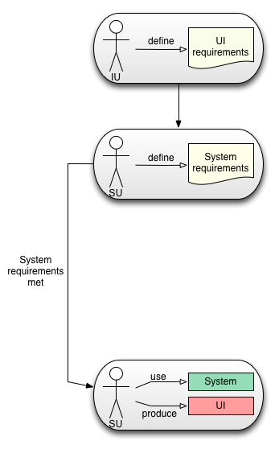
Method
If system requirements are met, System Users use the system to produce the user interface.

Slide 12
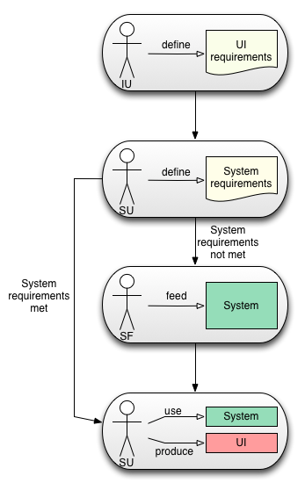
Method
If system requirements are not met, based on the system requirements, System Feeders feed the system.

Slide 13
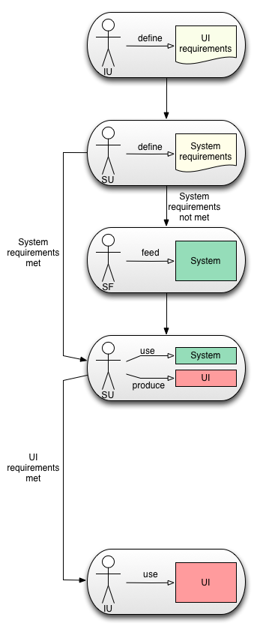
Method
If UI requirements can be met, System Users can produce the interface so that Interface Users can use it.

Slide 14
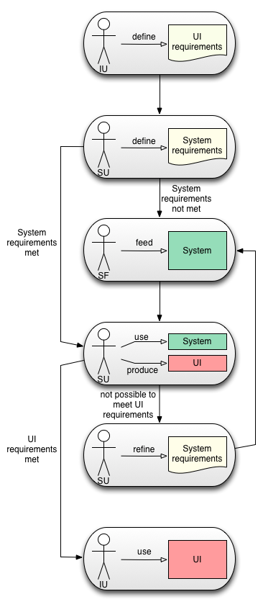
Method
If UI requirements cannot be met, System Users refine system requirements, then go back to system feeding.

Slide 15
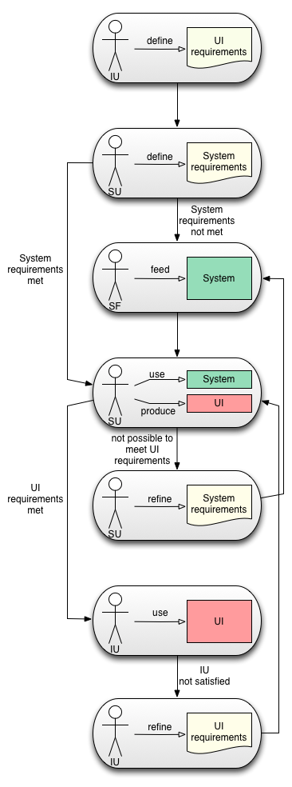
Method
If Interface Users are not satisfied, Interface Users refine their requirements, then go back to system use.
Otherwise, the process ends up

Slide 16
Roadmap
Context
A method for designing graphical user interfaces integrating gestures
Underlying model
Supporting tool
Ongoing and future works

Slide 17
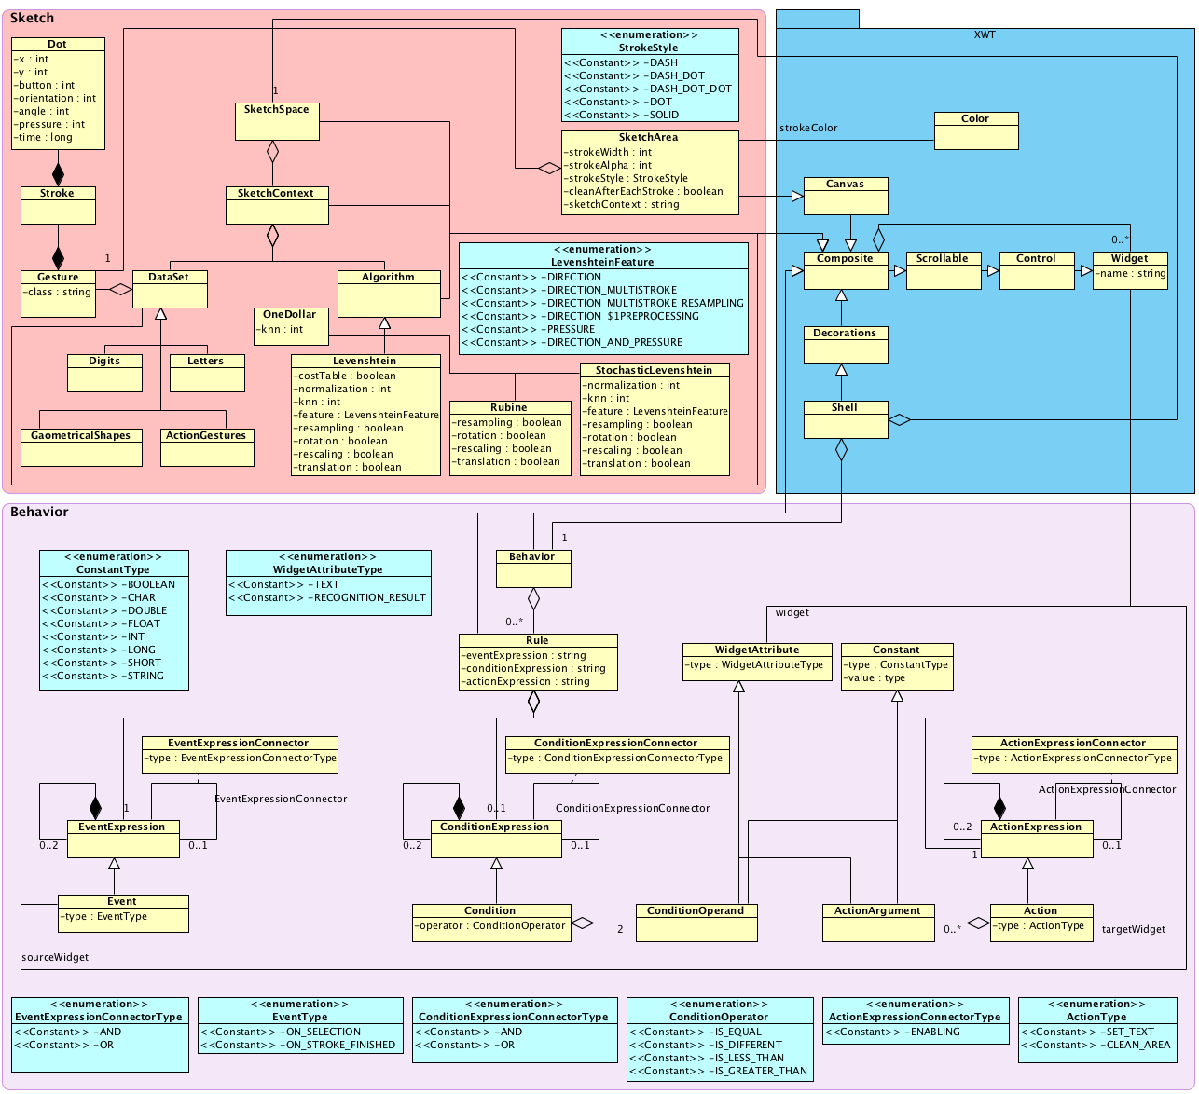
Model

Slide 18
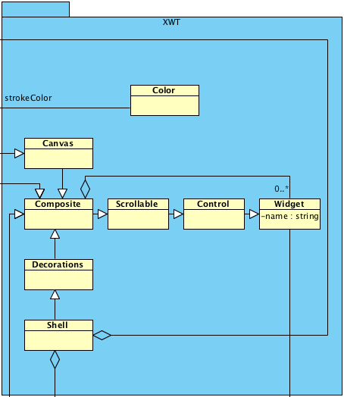
Model

Slide 19
Model

Slide 20
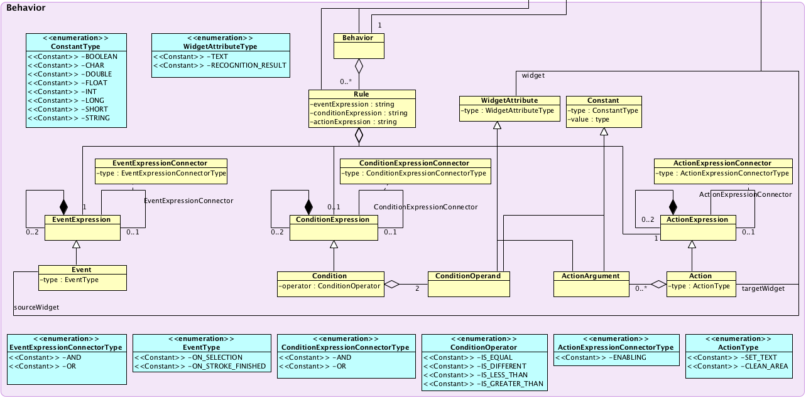
Model

Slide 21
Model

Slide 22
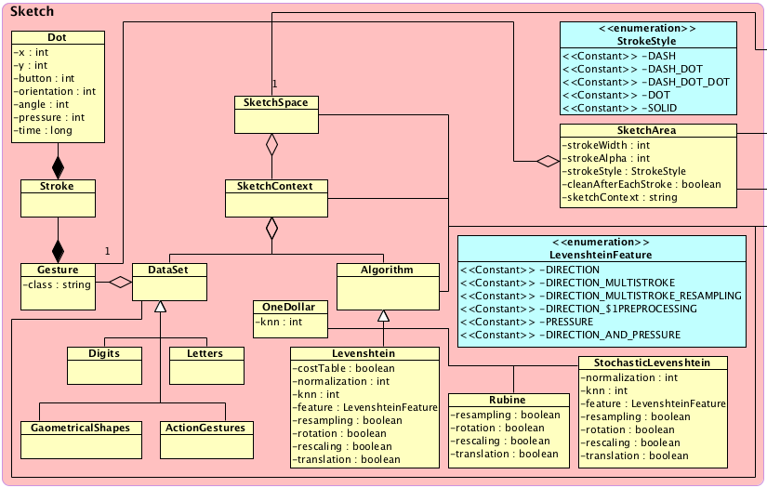
Model

Slide 23
Roadmap
Context
A method for designing graphical user interfaces integrating gestures
Underlying model
Supporting tool
Ongoing and future works

Slide 24
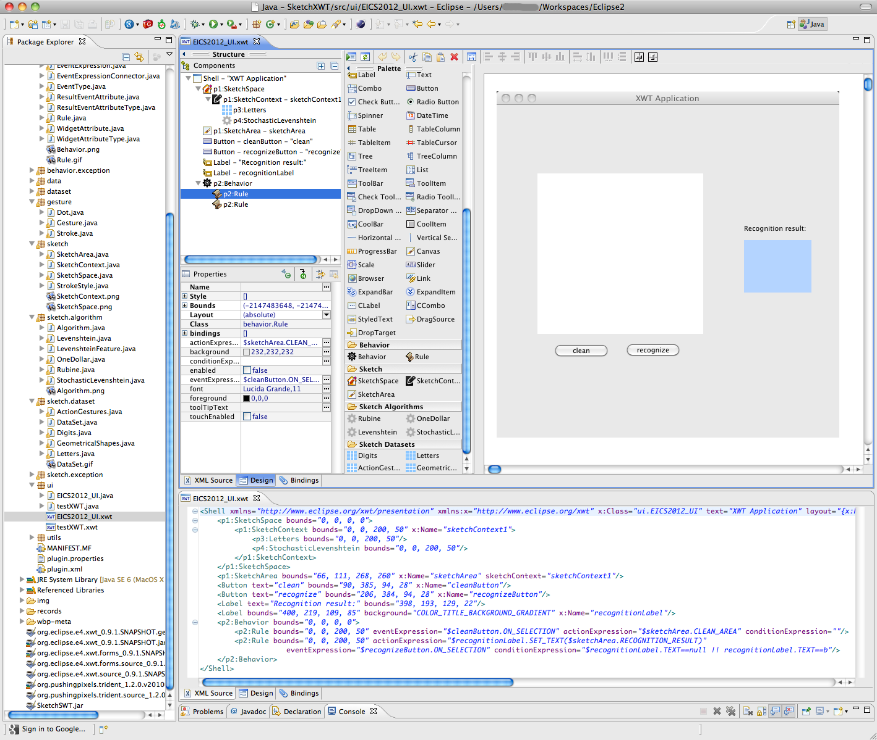
UsiGesture demo: https://vimeo.com/49746767 or http://youtu.be/CZGPbUA8rgs

Slide 25
Contributions
Theoretical
  Conceptual modeling of 2D pen-based gestures for GUIs
Methodological
  Integration into UsiXML, a XML User Interface Description Language (www.usixml.org)
  Define the role of the System Users, etc.
Empirical
  User study on user satisfaction with gesture integration
  Development benefits estimation

Slide 26
Future work
Empirical: with respect to
  System Feeders: to what extent is it expensive to incorporate new knowledge in UsiGesture
    A new algorithm (recognizer)
    A calibration of an algorithm
    A new variant of an existing algorithm
  System Users: to what extent is it straightforward to design a GUI based on UsiGesture
  Interface users: do they perceive a better recognition when the right algorithm is used

Slide 27
Thank you very much for your attention!
Any question?
See more at:
www.usixml.org, www.usixml.eu
www.lilab.eu, www.lilab.be

