Slide 1
UsiGesture: an Environment for Integrating Pen-based Interaction in User Interfaces
François Beuvens and Jean Vanderdonckt
francois.beuvens@uclouvain.be
Researcher at LiLab, http://www.lilab.be
Université catholique de Louvain (Belgium)

Slide 2
Roadmap
Context
An open platform for benchmarking gesture recognition algorithms
Including the results in user interfaces
Ongoing and future works

Slide 3
Roadmap
Context
An open platform for benchmarking gesture recognition algorithms
Including the results in user interfaces
Ongoing and future works

Slide 4
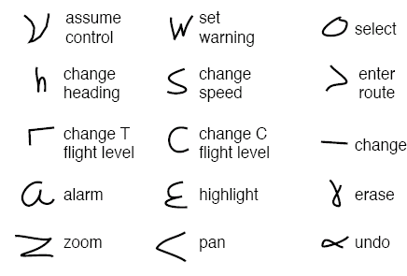
Context
Scope: 2D pen-based gestures
Needs of pen-based gesture recognition
PDAs – Graffiti
Mouse gestures plug-in for Firefox
Games
…

Slide 5
Motivations
No « One fits all » algorithm
Needs of algorithms comparison
Same data and conditions
Data acquisition
Enhancements of existing algorithms

Slide 6
Roadmap
Context
An open platform for benchmarking gesture recognition algorithms
Including the results in user interfaces
Ongoing and future works

Slide 7
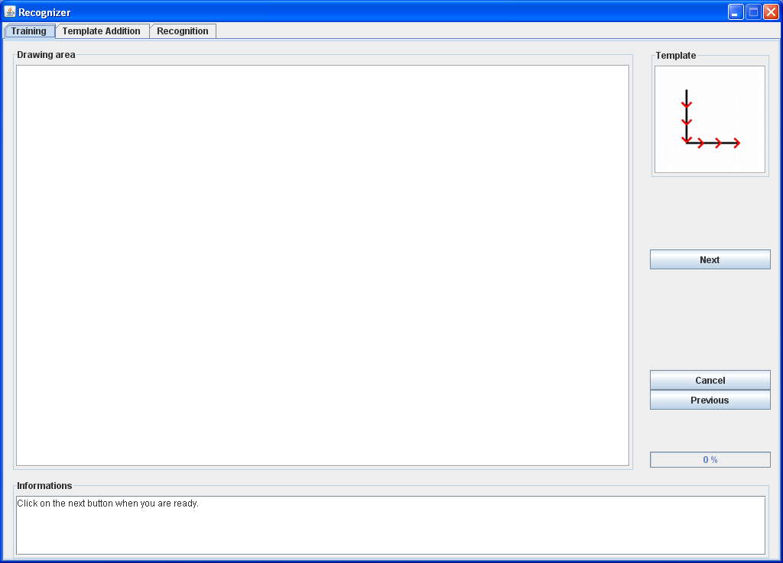
Gesture database acquisition

Slide 8
Gesture database acquisition
30 participants
16 men and 14 women with average age of 28
60 gestures to reproduce
26 lower case letters, 10 digits, 16 action commands, 8 geometrical shapes
10 reproductions of each gesture by participant
More information: https://sites.google.com/site/comparativeevaluation/data-collection

Slide 9
Comparison study: analysis criteria
Training types
User dependent, user independent (2 methods)
Gesture types
Letters, digits, actions, geometrical shapes
Algorithms
Rubine, One Dollar, Levenshtein, stochastic Levenshtein

Slide 10
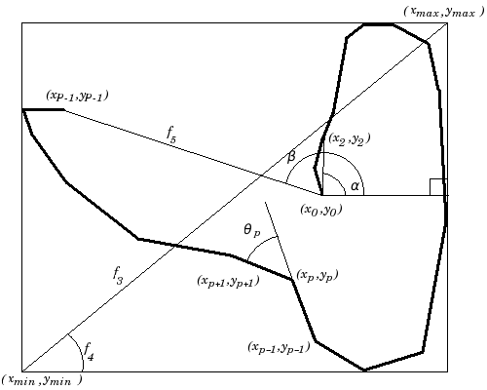
Rubine
Training
Compute mean vector of features and weights for learning classes
Recognition
Compute vector of features
Scalar product of weights and vector
Best score is chosen

Slide 11
One Dollar
Training
Preprocessing: resampling, rotation, rescaling, translation
Recognition
Preprocessing
Comparison to all training examples
Finding optimal angle
Evaluating point-to-point Euclidean distance
Smaller distance chosen

Slide 12
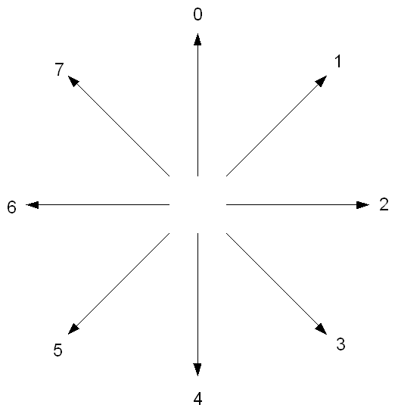
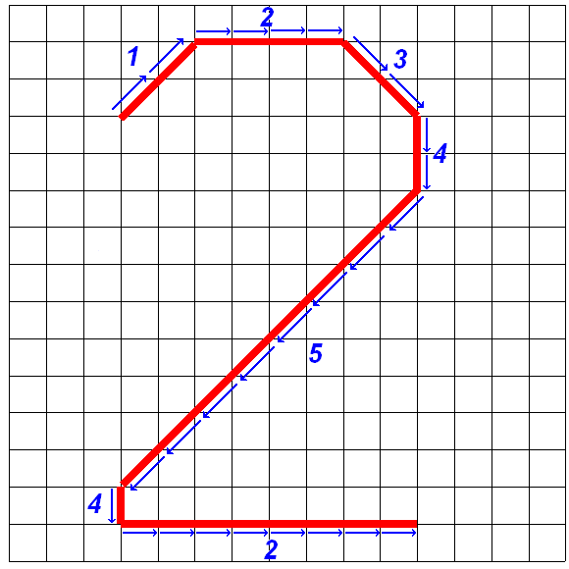
Levenshtein
Training
Transformation into strings
Recognition
Comparison to all training examples
Computing Levenshtein distance
Smaller distance chosen

Slide 13
Stochastic Levenshtein
Training
Transformation into strings
Creation of a string pairs set
Optimization of the primitive edition costs
Expectation-maximization algorithm
Recognition
Comparison to all training examples
Evaluating distance based on probabilities
Smaller distance chosen

Slide 14
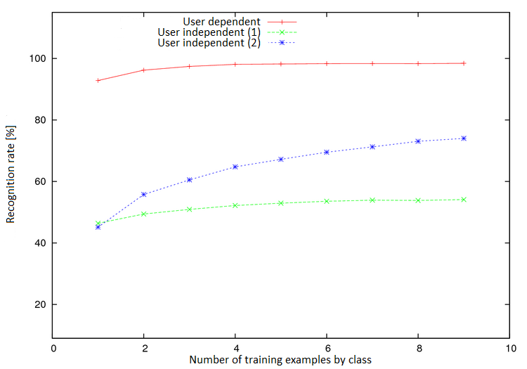
Results – initial version
Training types for Levenshtein on digits

Slide 15
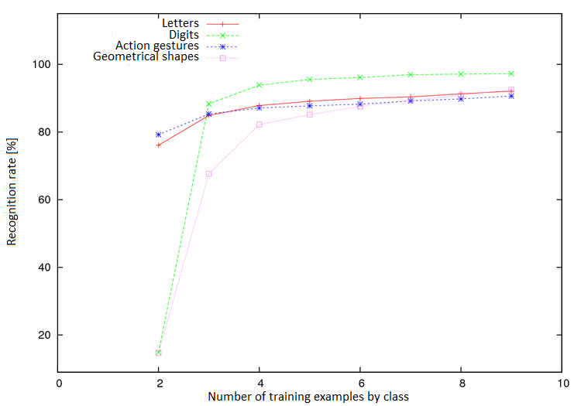
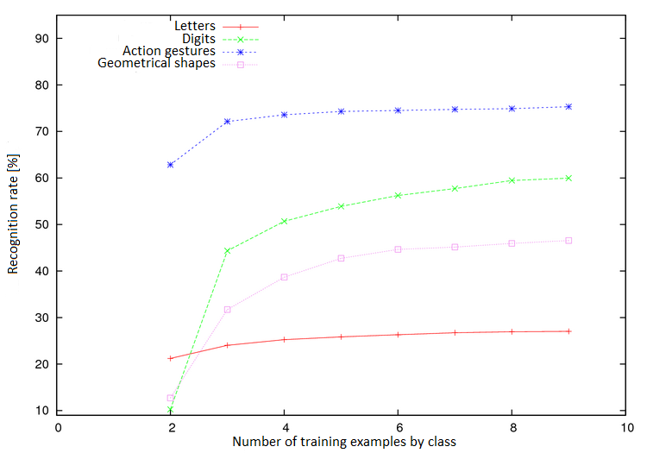
Results – initial version
Gesture types for Rubine with user dependent training and user independent training

Slide 16
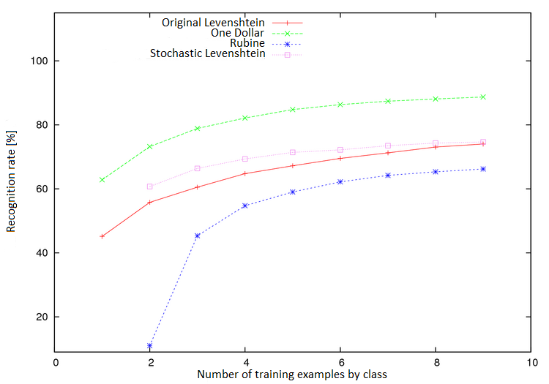
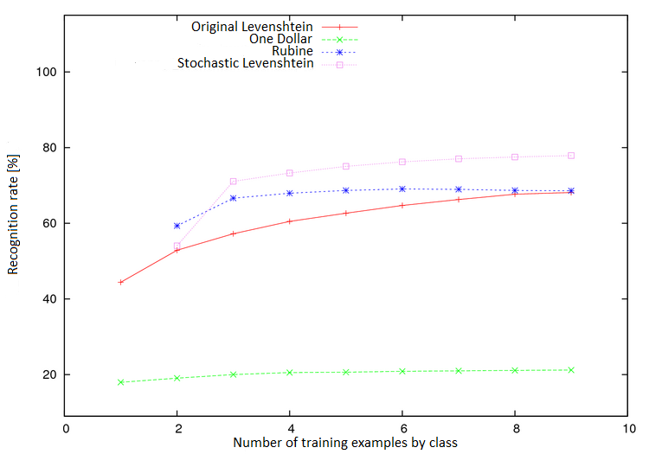
Results – initial version
Algorithms on digits and actions with user independent training

Slide 17
Results – initial version
Summary
More Information: https://sites.google.com/site/comparativeevaluation/results

Slide 18
Extensions
Rubine
Preprocessings
One Dollar
kNN
Levenshtein
Preprocessings, kNN, normalisations, multi-strokes gestures, other features handling, costs matrix
Stochastic Levenshtein
Idem except costs matrix

Slide 19
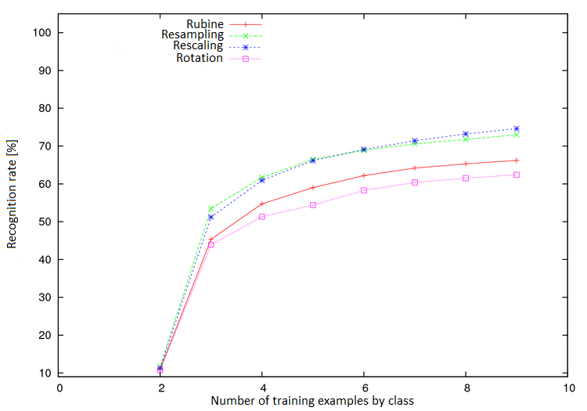
Results - Rubine’s extensions
Preprocessings: resampling, rotation, rescaling

Slide 20
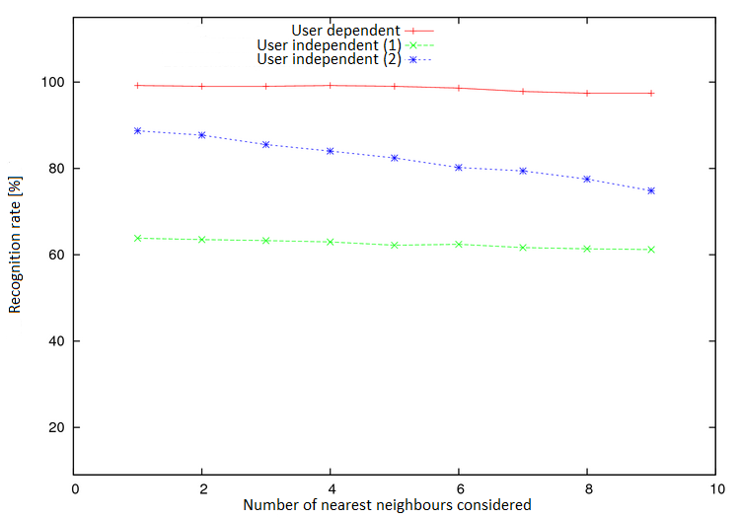
Results - One Dollar’s extensions
kNN

Slide 21
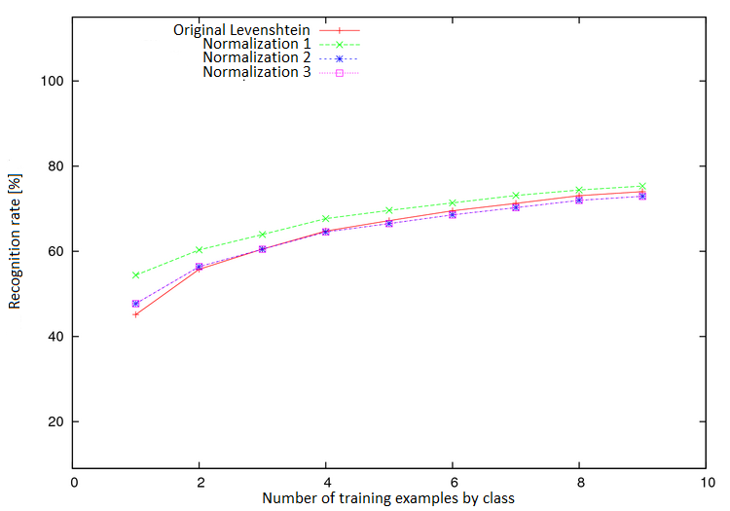
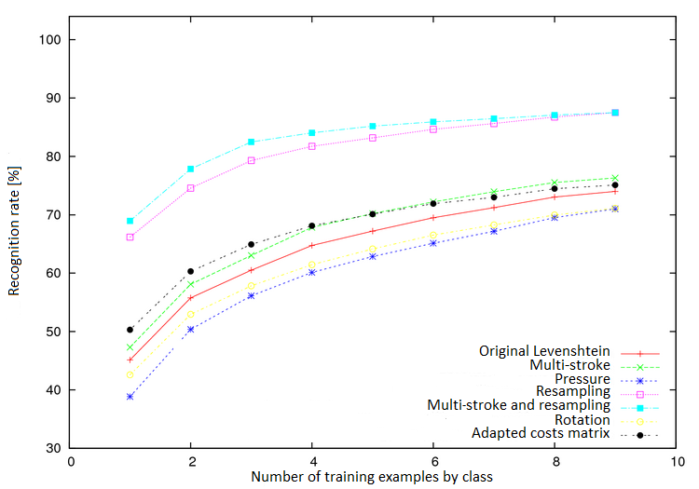
Results - Levenshtein’s extensions
Normalizations, pre-processings, kNN, multi-strokes, pressure inclusion, costs

Slide 22
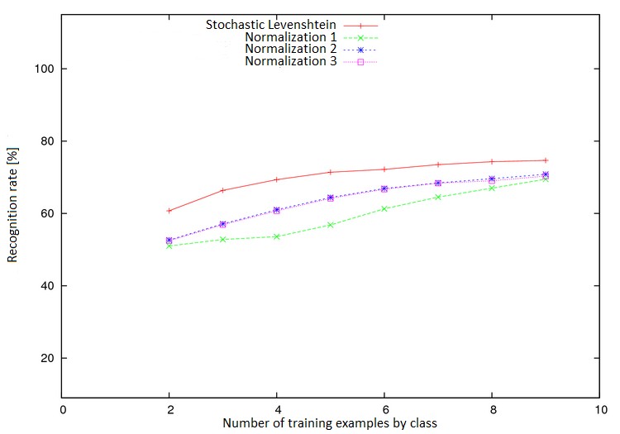
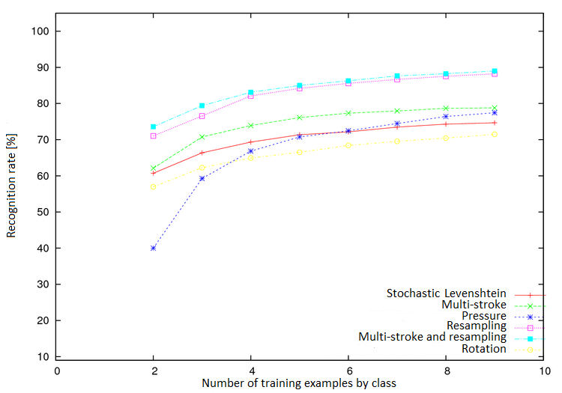
Results - Stochastic Levenshtein’s extensions
Normalizations, preprocessings, kNN, multi-strokes, pressure inclusion

Slide 23
Results – extensions
Summary
More Information: https://sites.google.com/site/comparativeevaluation/results

Slide 24
Roadmap
Context
An open platform for benchmarking gesture recognition algorithms
Including the results in user interfaces
Ongoing and future works

Slide 25
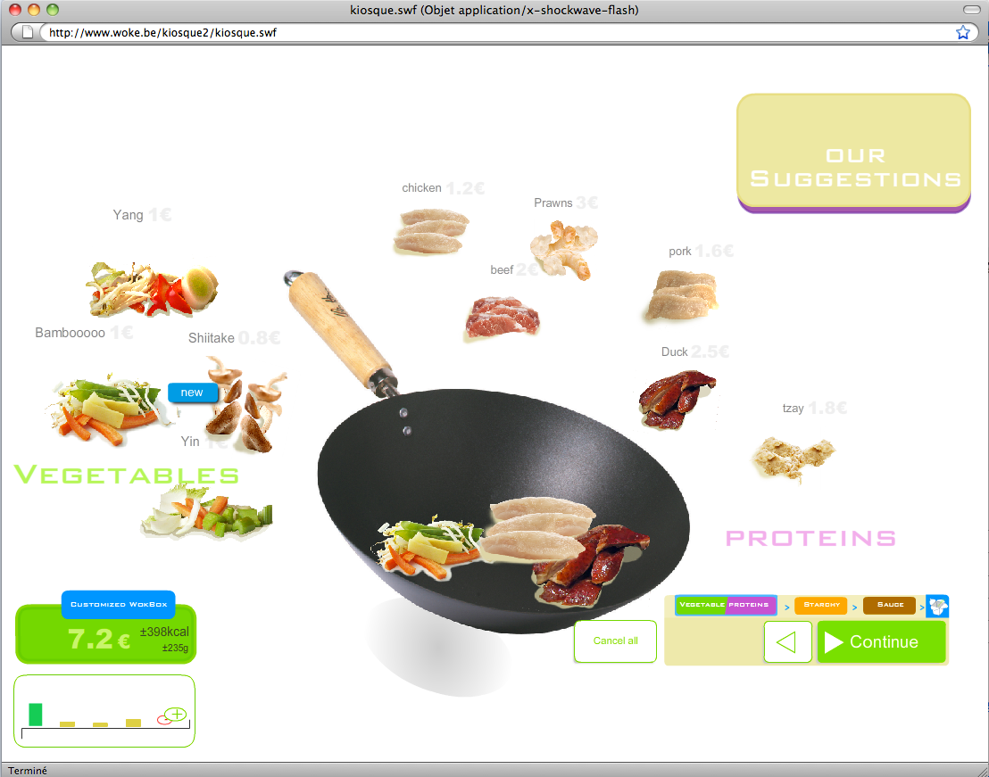
Woke example (before)

Slide 26
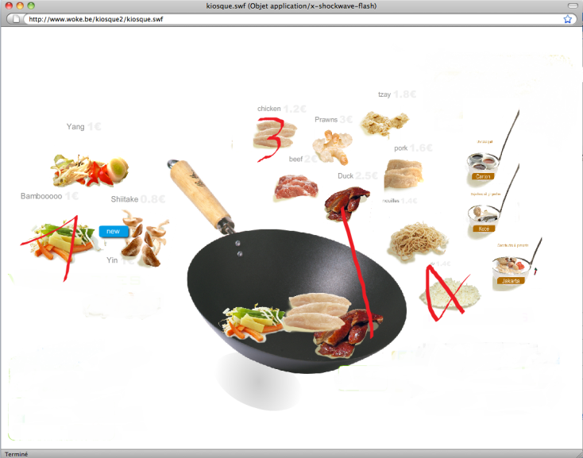
Woke example (after)

Slide 27
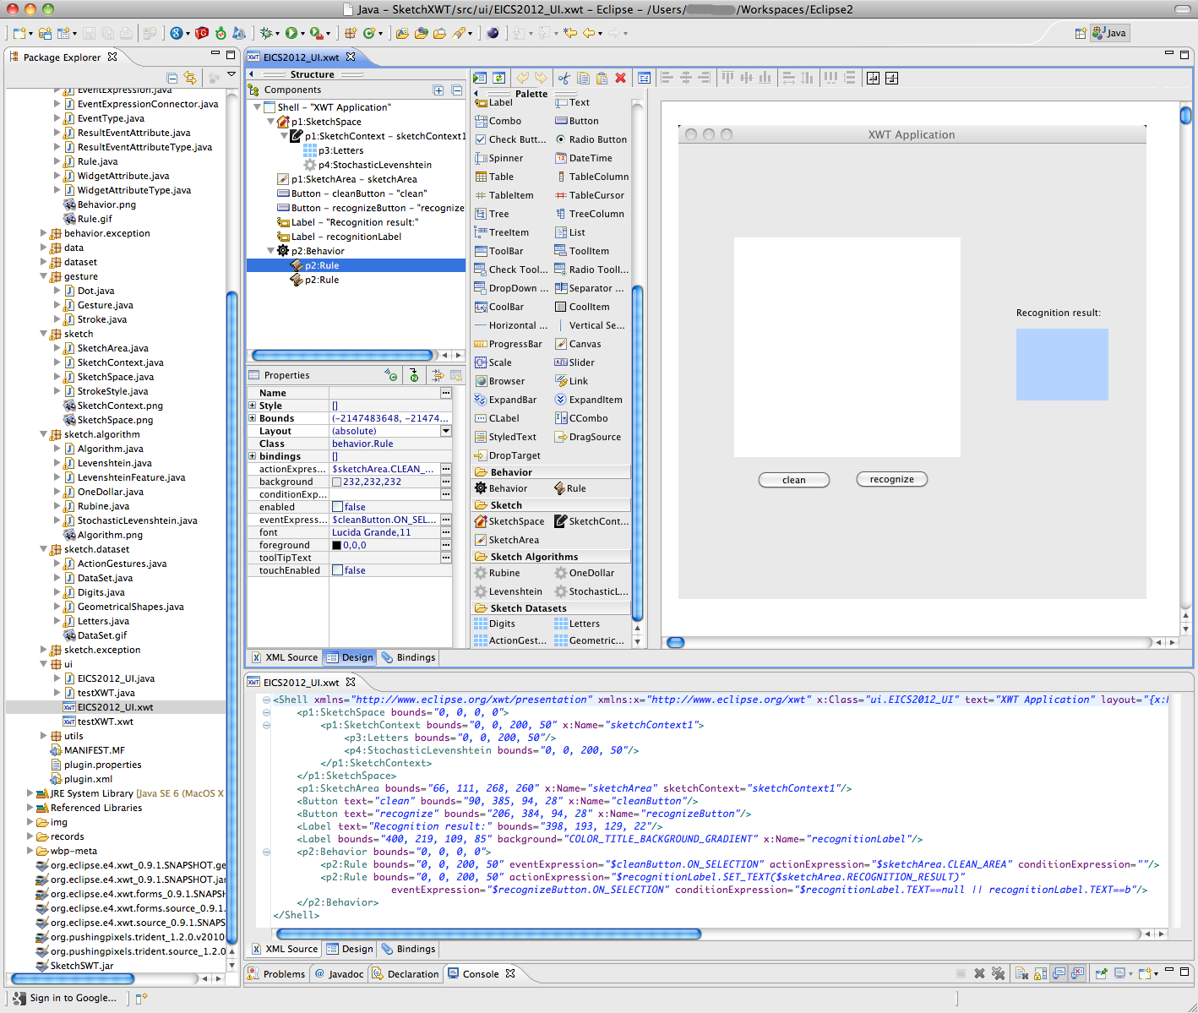
WindowBuilder integration (demo)

Slide 28
Roadmap
Context
An open platform for benchmarking gesture recognition algorithms
Including the results in user interfaces
Ongoing and future works

Slide 29
Ongoing and future works
Theoretical
Conceptual modeling of gesture-based UIs
Methodological
Integration into UsiXML
Definition of development lifecycle (e.g. SPEM)
Empirical
User study on user satisfaction with gesture integration
Development benefits estimation

Slide 30
Thank you for your attention!

