Slide 1
Formal Definition of Collaborative Spaces
Sergio Arzola-Herrera
Josefina Guerrero-García
Juan Manuel González-Calleros
Claudia Zepeda-Cortés
Facultad de Ciencias de la Computación
Benemérita Universidad Autónoma de Puebla
Email: jguerrero@cs.buap.mx
juan.gonzalez@cs.buap.mx

Slide 2
Contents
1
Introduction
2
FlowiXML Methodology
3
Divulgation Platform for Scientific Research
4
Evaluation
5
Conclusions and Future Work

Slide 3
Introduction
Systems are developed in order to facilitate the user tasks; however a lot of systems do not do it very well, because they are complex and not accord to the user needs.
Programmers and designers :
take too much importance about the system developing and take the user in second place.
even do not consider the user, for whom is destined the system.
We can see this by reviewing the actual system interfaces which does not accord with the user needs.

Slide 4
Introduction
We present a methodology which is focused in the processes and user’s tasks into a workflow. This methodology pretends to save time and bring a system with quality to the user according to his needs.
Also we present a case study of this methodology.

Slide 5
FlowiXML Methodology
FlowiXML is a method that provides means to formally design a Workflow Information System (WfIS).
Workflows are activities involving the coordinated execution of multiple tasks performed by different resources to achieve a common business goal.
A task defines some work to be done by a person, by a software system or by both of them.

Slide 6
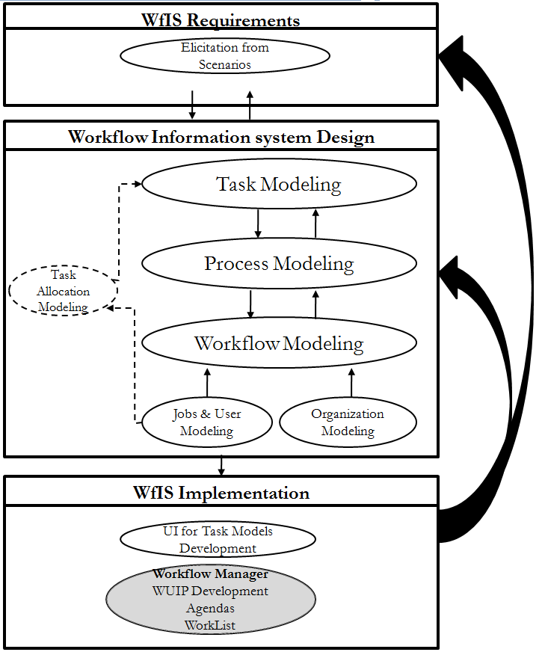
FlowiXML Methodology
It is composed on the following 3 major steps:

Slide 7
Divulgation Platform for Scientific Research
We present a platform which pretends to solve some problems in scientific research
Often published articles are not correctly divulged (only know by people of the area)
Commonly scientific groups publish their works in a HTML page and it is not updated.
Some conferences and workshops are just known by the host university, and they are only spread by an e-mail list.
Students may find hard to find information about research done.

Slide 8
Divulgation Platform for Scientific Research
1.- Task Identification
We focus on the task identification using the following identification criteria:
Change of space (or change of location)
Change of resource
Change of time
Change of nature

Slide 9
Divulgation Platform for Scientific Research
In our case study, we identify the most important tasks according to the preceding, which are the following:
Create Account
Login
Modify Account
Upload Content
Read Bulletins
Manage Events
Manage Work Groups
Manage Contacts

Slide 10
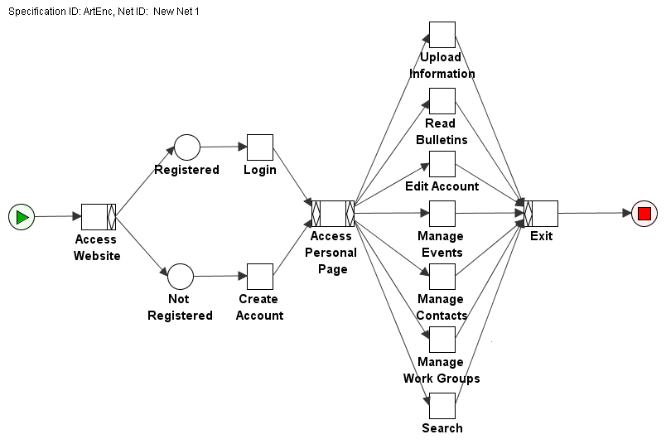
Divulgation Platform for Scientific Research
2.- Process Modeling
After having identified tasks that are part of a process then they have to be related to each other by means of process operators.

Slide 11
Divulgation Platform for Scientific Research
3.- Task Modeling
For each task in a process a task model can be specified, not necessarily, to describe in detail how the task is performed. By exploiting task model descriptions different scenarios could be conducted. Each scenario represents a particular sequence of actions that can successfully be performed to reach a goal.
Task models do not impose any particular implementation so that user tasks can be better analyzed without implementation constraints.

Slide 12
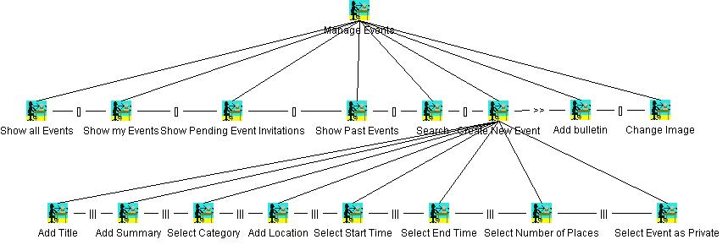
Divulgation Platform for Scientific Research
Manage Events Task Tree

Slide 13
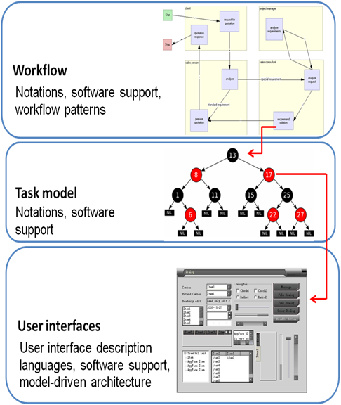
Divulgation Platform for Scientific Research
4.- User Interface Modeling

Slide 14
Divulgation Platform for Scientific Research
The method proposed is applied to the automation of learning process integrating human and machine base activities.
The Cameleon Reference Framework in a simplified description, structures four development steps:
Task & Concepts
Abstract UI
Concrete UI
Final UI

Slide 15
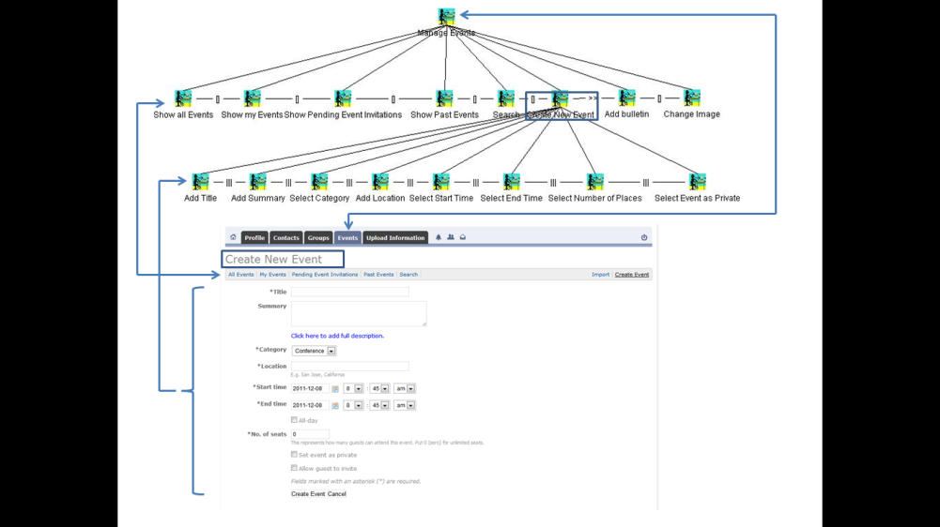
Divulgation Platform for Scientific Research

Slide 16
Demo

Slide 17
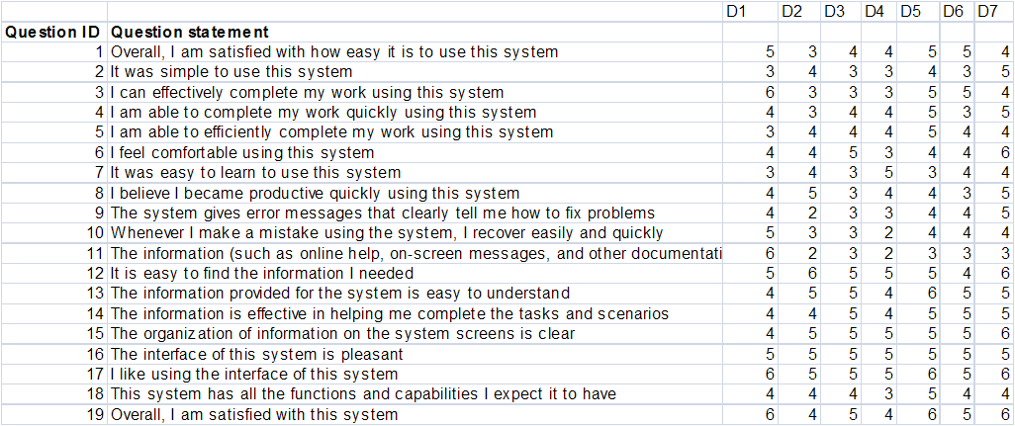
Evaluation
We use the IBM Computer Satisfaction Usability Questionnaire (CSUQ). This questionnaire was selected because of its high reliability, its simplicity, and its high correlation with the results (empirically proved with r=0.94)

Slide 18
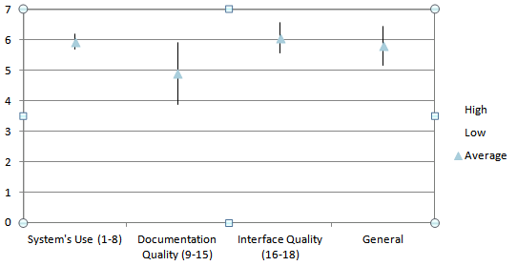
Evaluation
Results:
From this results we conclude that, despite we have a good score in general, we must improve the documentation quality, which qualifications were diverse, however the system interface was perceived good, and so was the pleasure to use the system

Slide 19
Conclusions and Future Work
The design and engineering knowledge to successfully create those systems is documented using FlowiXML Methodology.
FlowiXML designing process is focused on the user needs thus is user-centered. The development steps and notations foster discussion within the stakeholders of the problem before developing the system.
The results of IBM CSUQ questionnaire are promising as the acceptation of the produced system was perceived high.
Still there is work ahead to produce more robust system including the design of collaboration and how to motivate it through the user interface.

Slide 20
Join us
@usixml
http://www.facebook.com/UsiXML

Slide 21
Thank you very much for your attention!
User Interface eXtensible Markup Language
http://www.usixml.org
http://www.usixml.eu
Register as a member of the UsiXML End-User Club at
http://www.usixml.eu/end_user_club
For more information and downloading, http://www.lilab.eu

Slide 22
Contact Information
Juan Manuel Gonzalez Calleros
juan.gonzalez@cs.buap.mx
Josefina Guerrero García
jguerrero@cs.buap.mx
Sergio Arturo Arzola Herrera
satyendraser@gmail.com

Slide 23
Thank You !

